Slide 1
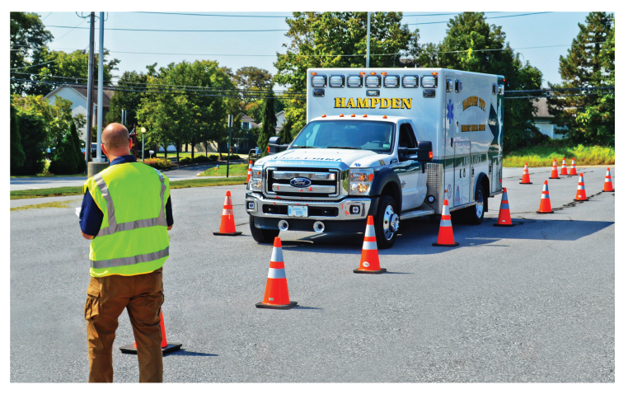
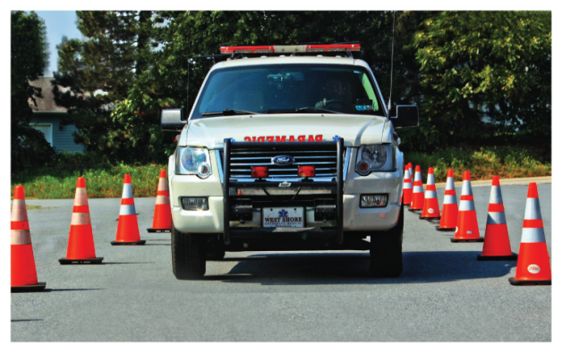

Slide 2
Program Overview
Introduction 20 min.
The Problem 30 min.
The Driver 45 min.
SOPs/SOGs 45min.
A. Review Organization’s SOPs/SOGs
V. Legal Aspects 30 min.
VI. The Vehicle 20 min.
VII. Vehicle Dynamics 60 min.

Slide 3
Program Overview
Operations/Safety 120 min.
Inspections/Maintenance 80 min.
A. Review Organization’s Inspection Process
X. Competency Course Review 30 min.
Appendices
Over the Road Evaluations
A. Non-Emergency
B. Emergency
TOTAL CLASSROOM TIME 8 hrs.

Slide 4
Preface
Tampa 2
National Safety Culture Initiative
Vulnerability Assessment Program (VAP)
Ambulance Operations and Best Practice Considerations for EMS Personnel
VFIS ETC and Risk Control
VFIS Mutual Aid Self-Assessment On-line Tool

Slide 5
Public Safety is our Duty Firefighter Safety is our Responsibility
EVERYONE GOES HOME!
Drive with care – everyone wears
a seatbelt….EVERYONE!
Safe Speed --- Always Under Control
Stop at Red Lights…STOP!
Remain Seated and Belted While in Motion
Protect the Roadway/Scene

Slide 6
TAMPA 2
16 Life Safety Initiative are Still Viable
Continue Advocacy For Culture Change
Focus on Company Officer
Qualification and Training

Slide 7
TAMPA 2
Personal Responsibility / Accountability
Safety
Training
Learning From Mistakes

Slide 8
National Safety Culture Initiative
Organizational Leadership and personal responsibility are critical in creating the culture change needed in the fire service to promote firefighter safety.
Annual Medical Exams
Vehicle Operations
Incident Risk Management
Source: www.ffsafetyculture.org

Slide 9
Vulnerability Assessment Program (V.A.P.)
Systematic process to evaluate risks and ultimately reduce the threat of firefighter injury and death.
Customized report containing suggestions for risk reduction alternatives specific to the identified vulnerabilities.
Source: www.firevap.org

Slide 10
Best Practice Considerations for EMS Personnel
49 best practice considerations
Three General Categories:
Training development
SOPs and communications
Defensive driving
Driver Fatigue & Qualification
Design Guidance for Ambulances
Patient Safety and Comfort
Source: http://www.firstresponder.gov/TechnologyDocuments/
Source: AmbulanceDriver(Operator)BestPracticesReport.pdf

Slide 11
VFIS ETC and Risk Control
Trained nearly 200,000 emergency responders since 2006
Education & Training Material
Workshops & Seminars
Consulting Services
On-line Training (VFIS University)
Risk Control Services

