Slide 1
Module I - Introduction
Goal
A large number of emergency service personnel and civilians are being injured and killed each year as a direct result of inappropriate driving of emergency vehicles.
Participants in this course will have the opportunity to gain and/or verify a broad range of competencies associated with emergency vehicle driving. These competencies include basic understanding of emergency vehicle operations as well as the skills necessary for practical application.

Slide 2
Module I - Introduction
Objectives
Summarize the goal of this emergency vehicle driver training program.
Describe the importance of an emergency vehicle driver training program.
Identify the critical elements of a comprehensive emergency vehicle driver training program.

Slide 3
Course Goal
Present the necessary classroom, competency course training, and testing for new and existing emergency vehicle drivers. The program will verify proficiency in both the knowledge and understanding of, as well as, the practical application to emergency vehicle driving.

Slide 4
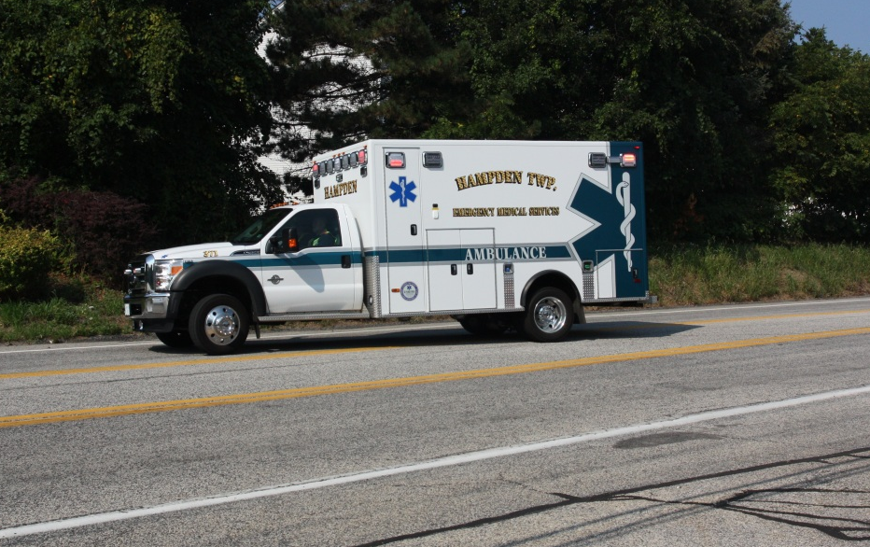
Why Is It …
The tool used the most is the one trained with the least?

Slide 5
Importance of Driver Training
All emergencies involve vehicle response.
Approximately 25% of firefighters killed are responding to or returning from incidents.
Drivers being criminally charged.
Driver training program demonstrates the organization’s commitment to safety.

Slide 6
Comprehensive Emergency Vehicle Driver Training
Classroom Instruction
Simulator Training (optional)
Competency Course Completion (after the candidate becomes familiar with the apparatus)
Street and Highway Driving
Testing (written, competency course and over the road)
Refresher Training

Slide 7
“Best Practices in Emergency Vehicle Safe Operation”
Best Practices are defined as certain themes that have emerged in recent years which help characterize a situation

Slide 8
Refresher Training
Classroom Education
Online Education
Competency Course
Over-the-Road Evaluation

Slide 9
Team Approach
Team approach to Emergency Vehicle Response
Optional Competency Course Proficiencies
Height Clearance
Temporary Traffic Control Zone

