Slide 1
Module II - The Problem
Goal
Identify the increasing seriousness of emergency vehicle collisions and the resulting impact upon all concerned. Emphasis is placed on the fact that emergency vehicle drivers are being criminally charged when a collision occurs which results from negligent driving on the part of the emergency vehicle driver and serious injury or death occurs to others involved in the collision.

Slide 2
Module II - The Problem
Objectives
Explain the common-sense approach of driving under all conditions within the context of laws governing emergency vehicle operations.
Describe the high incidence of collisions involving emergency vehicles and the associated deaths and injuries to emergency service personnel and members of the public.

Slide 3
Module II - The Problem
Objectives (Cont’d)
Describe the types, conditions, and causes of collisions involving emergency vehicles and their impact upon all concerned.
Identify and explain the factors that contribute to the incidence of collisions involving emergency vehicles.

Slide 4
Perspective
Serious Misconception
…to rely solely on laws governing emergency vehicle response will guarantee safe passage during emergency responses.

Slide 5
FF Fatalities While Responding/Returning
Year | Fatalities | Total Fatalities for year
2010 | 16 | 73
2011 | 11 | 61
2012 | 13 | 64
2013 | 15 | 97
2014 | 7 | 64
Total | 62 | 359
Source: USFA
PM Fill-In

Slide 6
Ambulances - A Dangerous Environment
NHTSA Fatality Reporting System
  3,200 crashes per 100 million miles driven
  8X the rate of cars and light trucks
60% of crashes occurred during emergency response
58% of the fatalities occurred during emergency response
Source: FEMA:FA272

Slide 7
Emergency Vehicles Crash Summary
Auto Collisions:
  Ambulances: Intersection Incidents
  Fire Trucks: Rollovers
Auto Liability:
  Ambulances: Intersection Incidents
  Fire Trucks: Intersection Incidents
Source: VFIS

Slide 8
Impacts of Vehicle Accidents
Personal Injury or Death to Emergency Responders
Peripheral Injury or Death to Others
Vehicle and Equipment Loss
Long Term Impact
PM Fill-In

Slide 9
Adverse Effect
Psychological Effects
Loss of Experienced Personnel
Stress of Criminal or Civil Litigation
Financial Impacts
Failure to Deliver Emergency Services
Poor Public Image
PM Fill-In

Slide 10
Case Study 1
Volunteer Fire Fighter Dies in Tanker Crash En Route to Grass Fire – Indiana
Death in the Line of Duty...A summary of a NIOSH fire fighter fatality investigation
F2012-30 Date Released: March 17, 2014

Slide 11
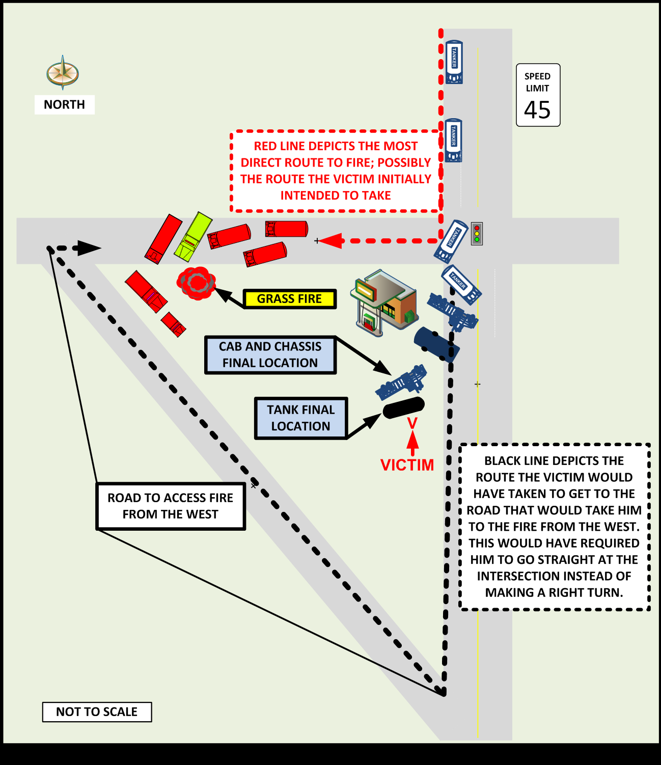

Slide 12
Contributing Factors
Seat belt
Speed
Roadway intersection protocol
Tanker weight and characteristics
Unnecessary emergency response

Slide 13
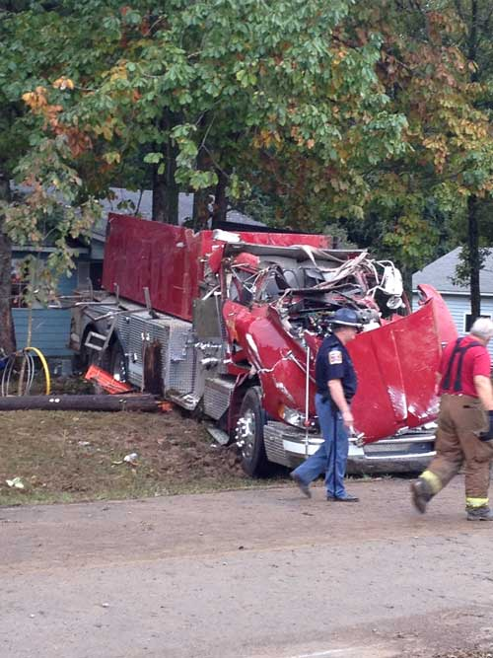
Case Study 2
Tanker Rollover –
Volunteer FD Probationary Member Is Killed After the Pumper/Tanker he was Operating Leaves the Roadway and Overturns—Alabama
Death in the Line of Duty...A summary of a NIOSH fire fighter fatality investigation
F2013-26 Date Released: June 4, 2014

Slide 15
Contributing Factors
No department- or state-required driver training program
Inexperienced driver
Not wearing a seat belt
Driving or entering a curve at a speed not negotiable for a large vehicle such as a pumper/tanker
Exiting a curve on a narrow roadway with a minimal shoulder
Vehicle overturned
Incident management system not implemented at the fire scene

Slide 16
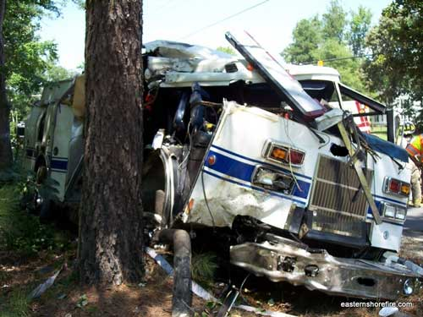
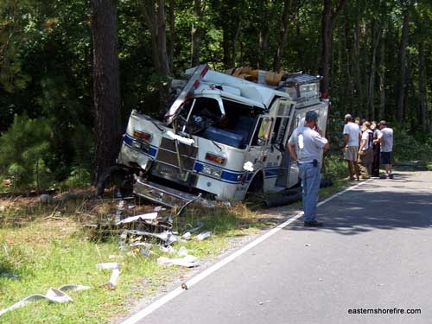
Case Study 3
Volunteer Fire Fighter Dies After Being
Ejected From Front Seat of Engine—Virginia
Death in the Line of Duty...A summary of a NIOSH fire fighter fatality investigation
F2012-23 Date Released: February 28, 2013

Slide 17
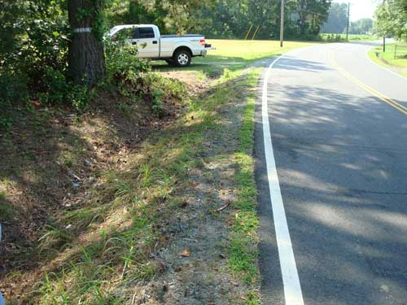
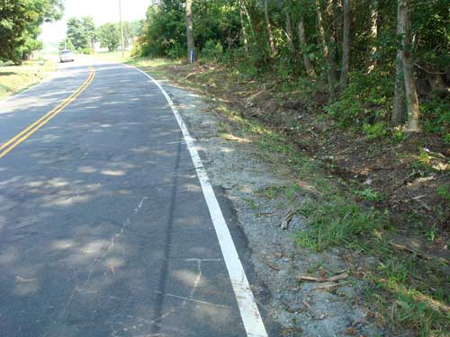
Road Conditions

Slide 18
Contributing Factors
Narrow roadway with minimal shoulder in a curve
Loss of control of the vehicle (right wheels
left the paved surface)
Non-use of seat belt
Inadequate SOPs for seat belt usage
Inadequate driver training

Slide 19
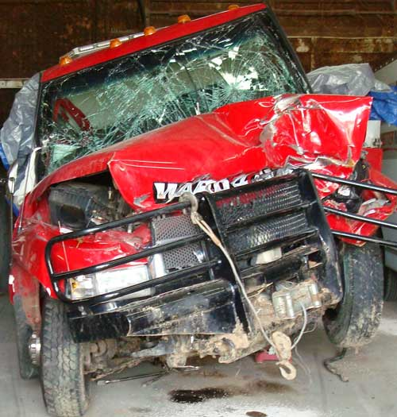
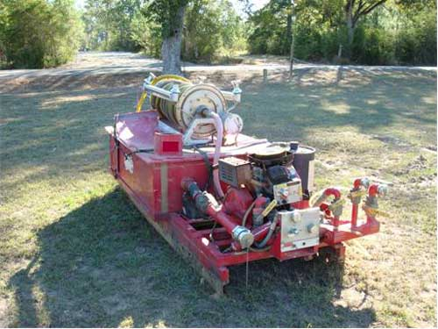
Case Study 4
Volunteer Fire Fighter Dies in a Single-Motor-Vehicle Crash
While Responding to a Medical Assistance Call – Louisiana
Death in the Line of Duty...A summary of a NIOSH fire fighter fatality investigation
F2011-21 Date Released: October 5, 2012

Slide 20
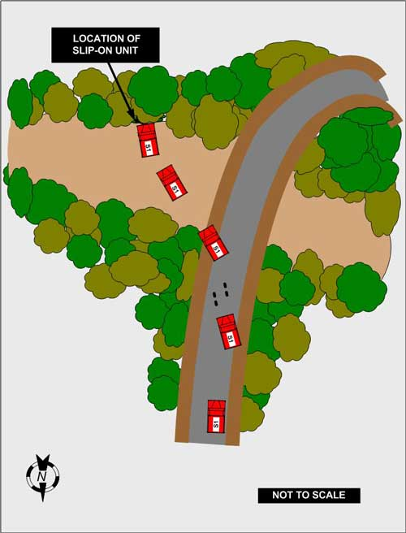

Slide 21
Contributing Factors
Speed
Narrow, unmarked, rural roadway
Rain and poor visibility

Slide 22
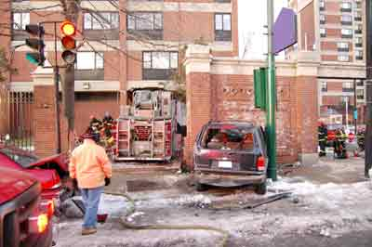
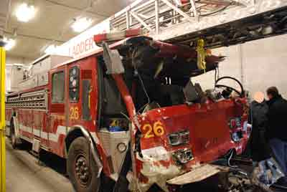
Case Study 5
Career Lieutenant Dies and Three Fire Fighters are Injured
in Ladder Truck Crash - Massachusetts
Death in the Line of Duty...A summary of a NIOSH fire fighter fatality investigation
F2009-05 Date Released: February 26, 2010

Slide 23
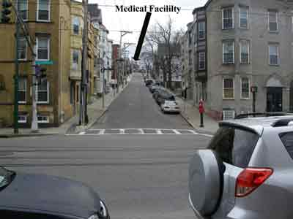
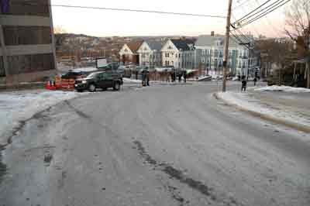
Road Conditions

Slide 24
Contributing Factors
Apparatus braking system deficiencies
Deficiencies in the apparatus maintenance program
Insufficient training for fire apparatus operators and fleet maintenance personnel
Failure to wear seat belts

Slide 25
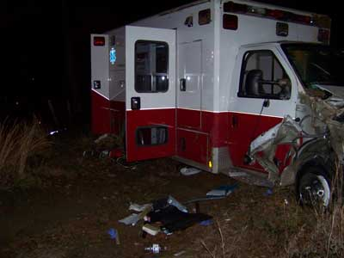
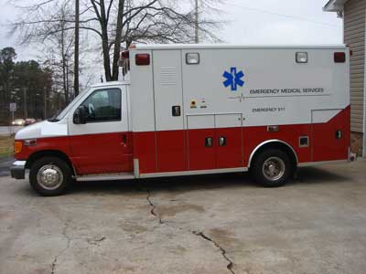
Case Study 6
Career Fire Fighter/Paramedic Dies 2 Days After Being Ejected
During an Ambulance Rollover Incident – Georgia
Death in the Line of Duty...A summary of a NIOSH fire fighter fatality investigation
F2009-30 Date Released: July 2, 2010

Slide 26
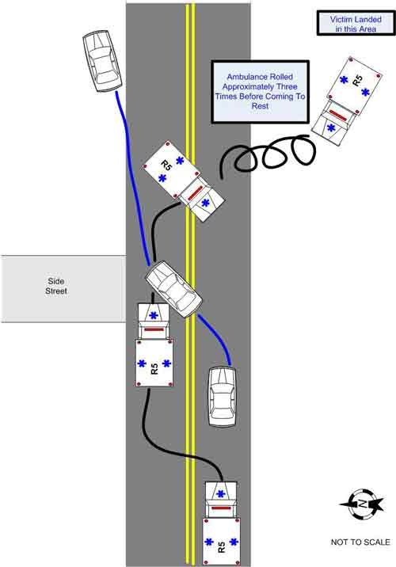

Slide 27
Contributing Factors
Failure of the motorist to yield the right-of-way to an approaching emergency vehicle with audible and visual signals in use
Ejection of the victim
Blunt force trauma resulting in multiple rib fractures
The victim’s underlying medical conditions

Slide 28
Summary of Recommendations
Standard operating procedures
  Response Classifications
  Seatbelts
  Qualifications for drivers
Emergency vehicle operator training and ongoing competency training
Regular vehicle inspections and maintenance
Promote institutional safety culture

Slide 29
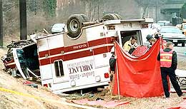
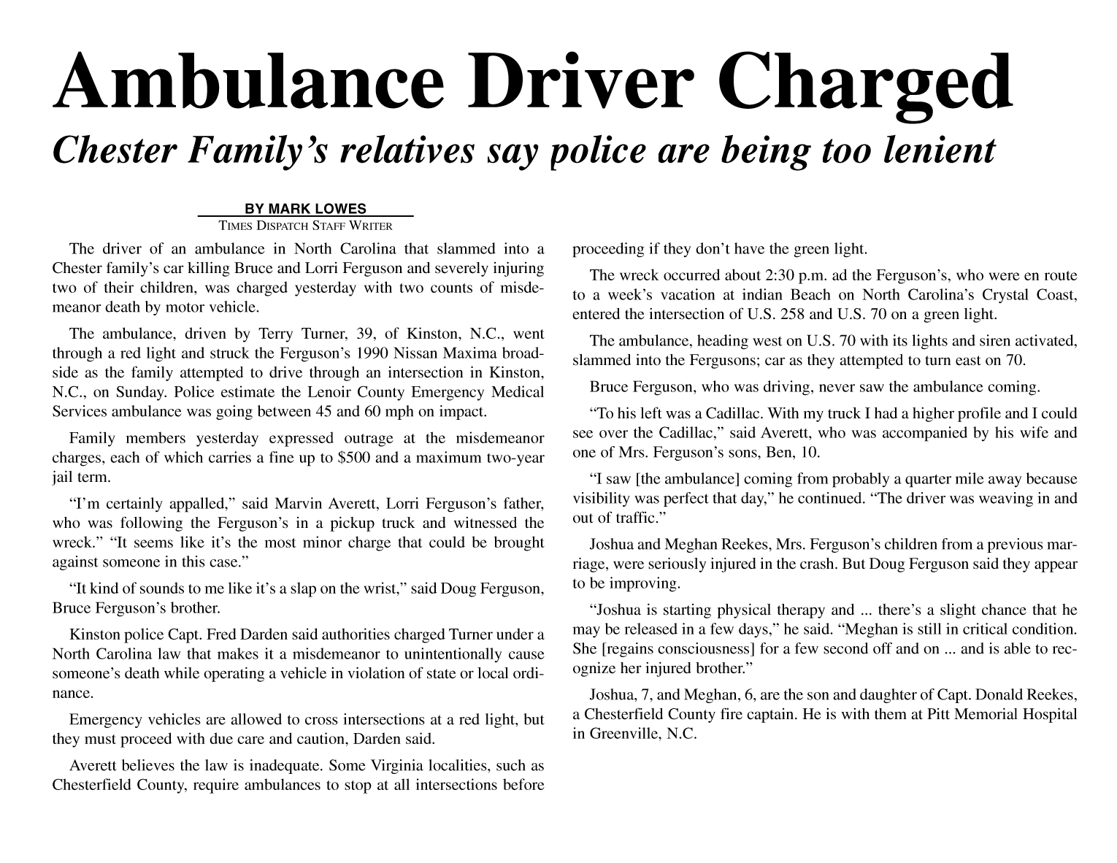
Criminalization of Emergency Service Personnel
California
Ohio
Texas
Georgia

