Slide 1
Module VI - The Vehicle
Goal
To have the participant understand physical forces which act upon vehicles and impact their handling. Study the various vehicle characteristics and how they impact both the physical forces acting on the vehicle and the manner in which the vehicle handles.
Notes:
The Goal

Slide 2
Module VI - The Vehicle
Objectives
Understand the differences between various vehicle types.
Recognize how technology may assist drivers of emergency vehicles.
Identify vehicle components and features.

Slide 3
Glossary of Terms
Ballast- Anything that is not secured and may become a projectile.
Sterile Cab – eliminating non-essential duties or activities such as; casual conversation, listening to music, eating, and cell phone use, and unnecessary conversation while the apparatus is responding in an emergency mode.

Slide 4
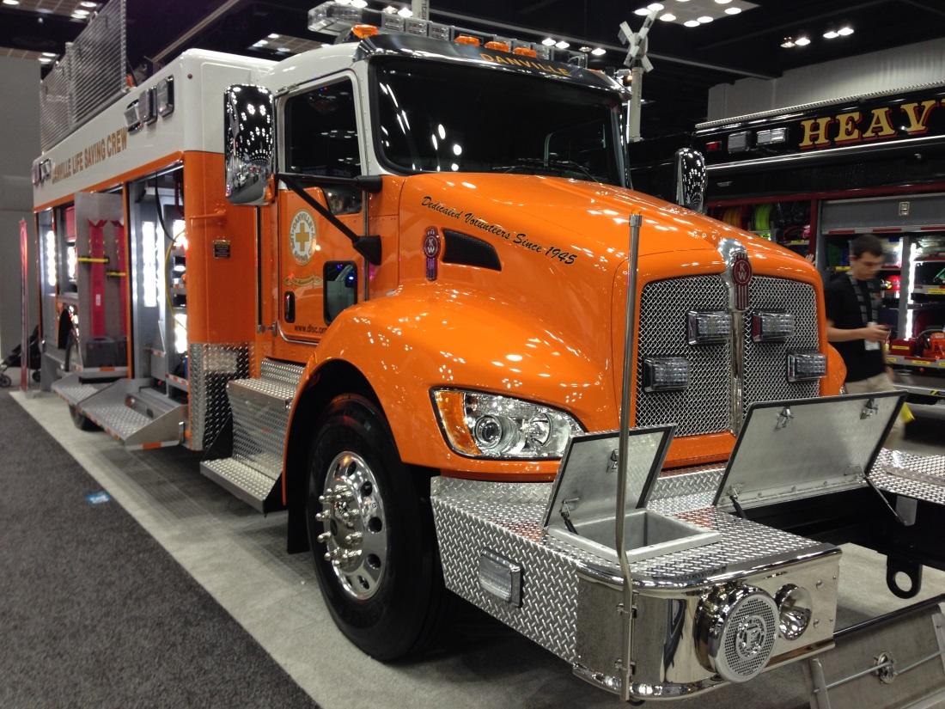
Types of Emergency Vehicles

Slide 5
Sterile Cab
A Research Study of Ambulance Operations and Best Practice Considerations for Emergency Medical Services Personnel recommends the securing of all items in the vehicle.
NFPA 1901 requires all equipment not required to be used during an emergency response to be contained in a bracket capable of containing its contents through a 9 g force in the longitudinal axis or a 3 g force in any other direction.

Slide 6
Sterile Cab
Personal items such as keys and cellular phones as well as helmets and portable radios are often left unsecure in the cab of emergency vehicles and are a real hazard to responders. These items are known as ballasts.

Slide 7
Sterile Cab
The goals of a Sterile Cab include but are not limited to:
Minimize the use of communication devices (hands on and hands free)
No texting
No eating
Turn off music
Minimize casual conversations
Secure all equipment in the cab to 3 g compliance
PM Fill-In

Slide 8
Technology
Advances in technology have led to the development of a number of systems that may assist drivers and have improved safety on the roads.
Autonomous Vehicle Technology
GPS Monitoring Systems
Forward Collision Warning Systems (CWS)
Lane Departure Warning Systems (LDWS)
Roll Stability Control Systems (RSC)
Electronic Driver Monitoring/Feedback Systems
Onboard Video Monitoring
PM Fill-In

Slide 9
Five Levels of Automation
Level 0 – No Automation
Level 1 – Function Specific
Level 2 – Combined Function
Level 3 – Limited Automation
Level 4 – Full Automation
PM Fill-In
Notes:
Fill in PM

Slide 10
Technology
Roll Stability control Systems (RCS)
Level 1 Automation – Function Specific
Automatically intervene if a high rollover risk is detected while driving

Slide 11
Technology
Electronic Driver Monitoring/Feedback Systems Monitor:
Speed
G-forces
Fuel Consumption
Etc.

Slide 12
Technology
Onboard Video Monitoring Systems
Continuous video monitoring
May only record when activated
May have driving metrics similar to Driver Monitoring/Feedback Systems
May have driver audible warning signals
Provide learning and/or coaching opportunities

Slide 13
Vehicle Features
Transmission
Automatic
Manual
**Note that there is no “P” on either type of shift mechanism,
emphasizing that these vehicles are parked in the neutral
position with the parking brake applied.**
Notes:
The majority of newer apparatus are equipped with automatic transmissions. Shifting can be accomplished by various means such as using a shift lever or a push button.
Operating a vehicle with a manual transmission requires more training and practice than a vehicle equipped with an automatic transmission.

Slide 14
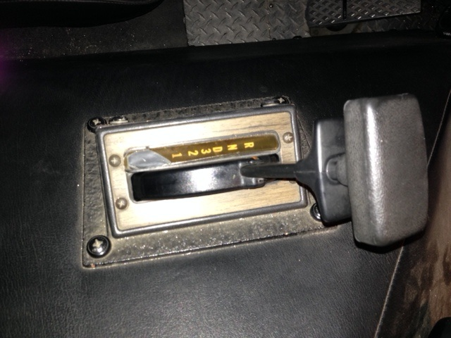
Automatic Transmissions
Lever Shift
R – reverse
N – neutral
D – drive
Use shift lever to change gears

Slide 15
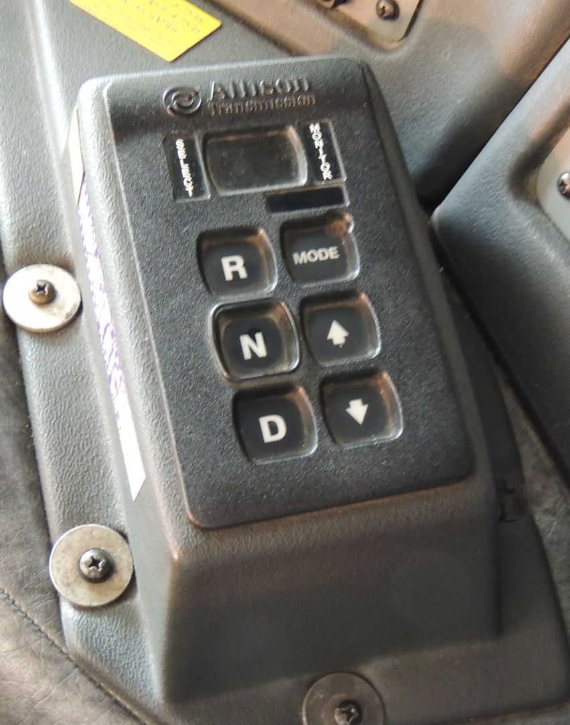
Automatic Transmissions
Push Button
R – reverse
N – neutral
D – drive

Slide 16
Transmission Shift Selector
Use arrow buttons to change gears

Slide 17
General Information - Automatic
The display window should display the gear the transmission is in
Use arrow button or shift lever to change gears
Do not shift from neutral to drive or reverse at engine speeds above idle
Stop the vehicle completely before shifting from a forward to reverse or reverse to forward

Slide 18
General Information - Automatic
Select drive for all normal driving conditions
The transmission will upshift and downshift automatically
Accelerator pedal position influences the automatic shifting
The lower the gear range, the greater the engine braking power

Slide 19
General Information - Automatic
Use up or down arrow button on push button selector to reach the desired gear. On the lever shift selector, depress the override button and move the shift selector to the desired gear
Use neutral for parking and apply parking brake
Do not allow the vehicle to coast in neutral

Slide 20
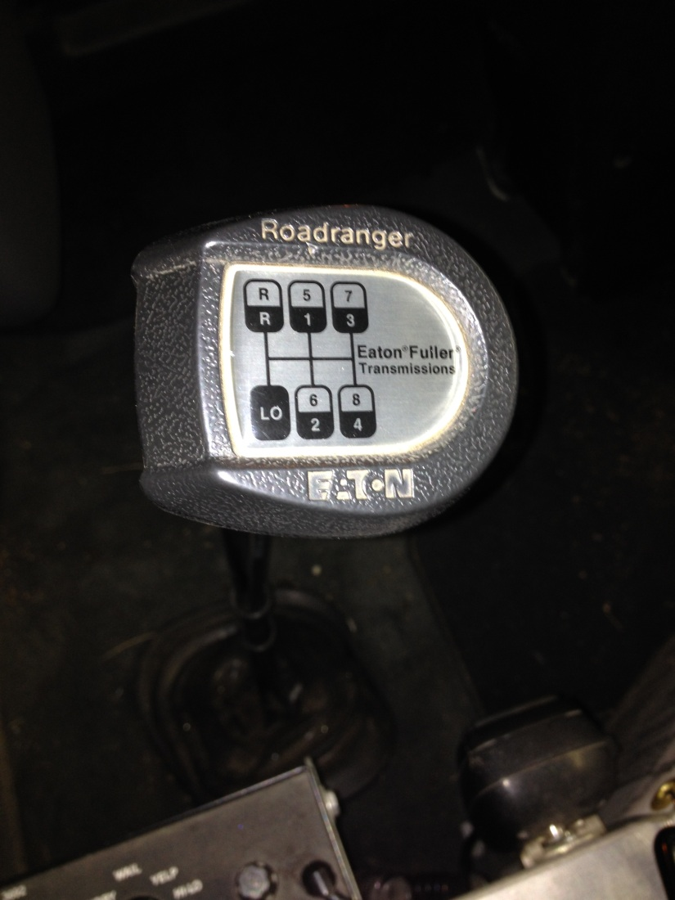
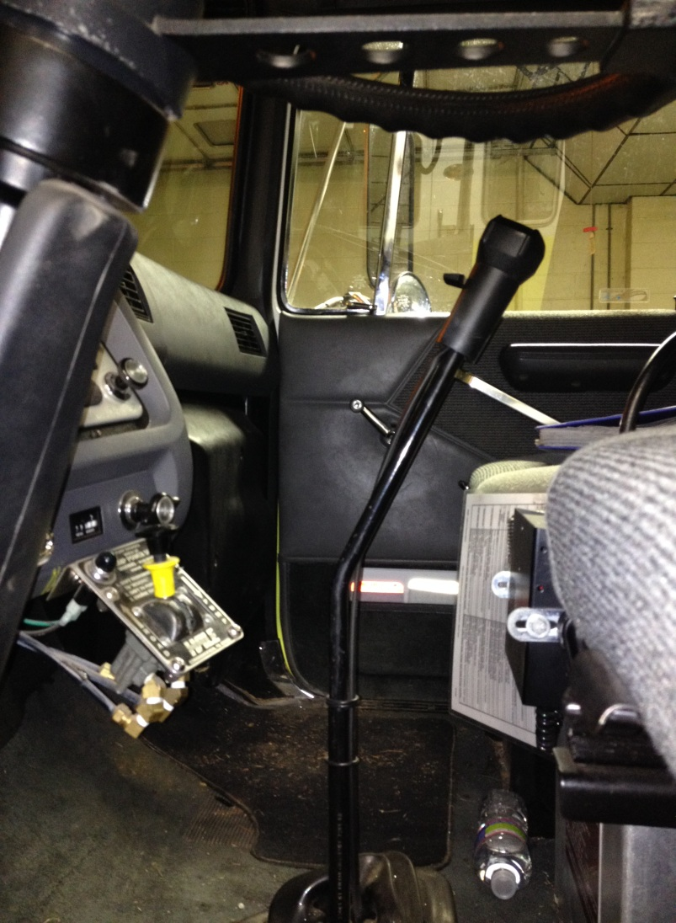
Manual Transmission

Slide 21
Shifting Gears -UP
Release accelerator, push in clutch and shift into neutral at the same time
Release clutch
Let engine and gears slow down to the rpm required for the next gear
Push in clutch and shift to higher gear
Release clutch and press accelerator at the same time
Notes:
Basic method for shifting up. Most heavy vehicles with manual transmissions require double clutching to change gears. Shifting gears using the double clutching requires practice. If you remain in neutral too long, you may have difficulty putting the vehicle into the next gear. If this happens don’t try to force it, return to neutral, increase engine speed to match road speed and try again. Study the owners manual to learn operating rpm range and learn what speeds each gear is for. Practice is important.

Slide 22
Shifting Gears -DOWN
Release accelerator, push in clutch and shift into neutral at the same time
Release clutch
Press accelerator, increase engine and speed to the rpm required in the lower gear
Push in clutch and shift to lower gear at the same time
Release clutch and press accelerator at the same time
Notes:
Basic method for shifting down. Most heavy vehicles with manual transmissions require double clutching to change gears. Down shifting, like upshifting, requires knowing when to shift. Use either the tachometer or the speedometer at the right rpm or road speed for proper shifting

Slide 23
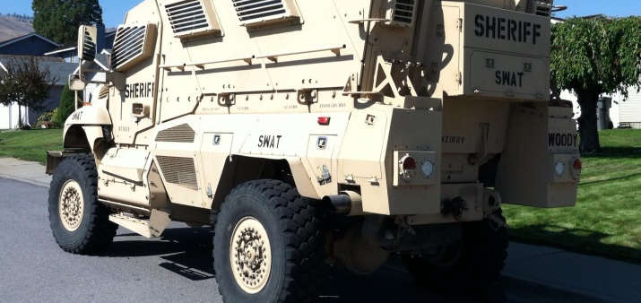
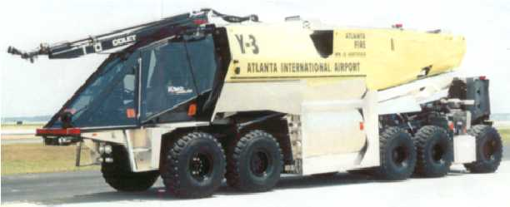
Special Vehicles

