Slide 1
Module VII – Vehicle Dynamics
Goal
To have the participant understand the forces that act upon vehicles and how both vehicle design and physical forces affect handling.

Slide 2
Module VII – Vehicle Dynamics
Objectives
Understand the physical forces that affect vehicle handling.
Recognize that vehicle characteristics influence the effect of physical forces on emergency vehicles.

Slide 3
Vehicle Dynamics Overview
Driving Too Fast
Accelerating Too Quickly
Traction Control
Braking Too Hard
Brake Fade
Changing Direction
Traveling Through a Curve

Slide 4
Physical Forces
Friction
Velocity
Momentum and Inertia
Centrifugal Force

Slide 5
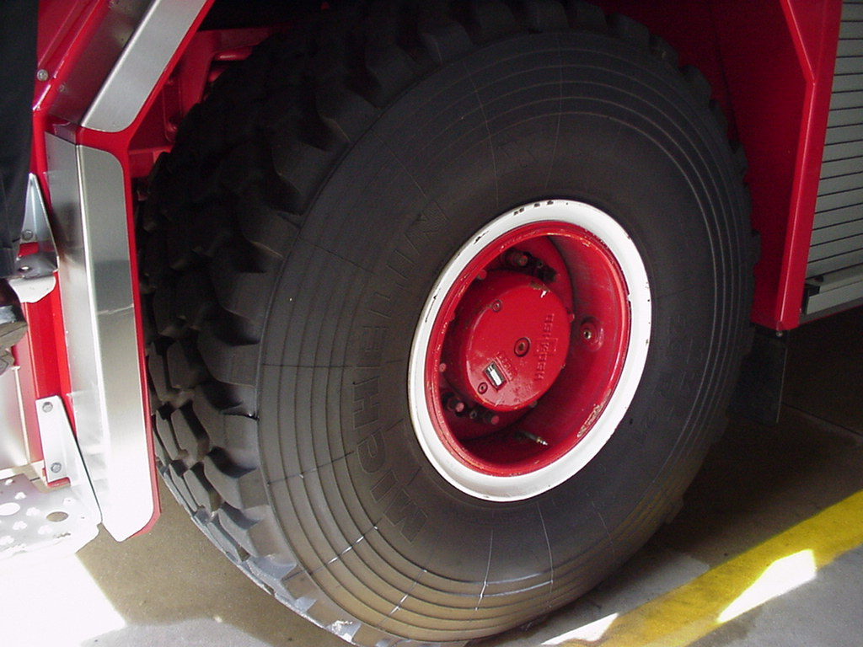
Physical Forces
Friction – resistance to motion between two moving objects that touch.
  Tire/Road Friction
  Brake Friction
  Steering Friction

Slide 6
Physical Forces
Velocity – speed
  Acceleration (velocity increase)
  Deceleration (velocity decrease)
  Braking (velocity decrease)
PM Fill-In

Slide 7
Physical Forces
Momentum – is measured as the product of the object’s mass or weight times its velocity.
Inertia – the force it takes for a moving object to stay in motion in the same direction.

Slide 8
Physical Forces
Centrifugal Force – the force caused by inertia,
which tends to make a rotating body move away from the center of rotation.

Slide 9

Physical Forces
Centrifugal Force

Slide 10
Vehicles in Motion
Sway (Roll)
Dive – Squat (Pitch)
Over steer (Yaw)

Slide 11
Vehicles in Motion
Chassis in Motion
Controlling Motion
Weight Transfer

Slide 12
Pitch
Pitch is rotation around an axis running from the driver's left to right in a vehicle; thus the front pitches up and the rear down, or vice-versa.

Slide 13
Yaw
Yaw is rotation about an axis drawn from top to bottom, and perpendicular to the other two axes.

Slide 14
Roll
Roll is rotation around an axis drawn through the body of the vehicle from rear to front in the normal direction of travel, or the direction the driver faces.

Slide 15
Vehicle Characteristics
Total Weight and Weight Distribution
Suspension System
Braking System(s)
Baffling System
Rollover Awareness

Slide 16
Vehicle Characteristics
Total Weight and Weight Distribution
  Gross Axle Weight Rating (GAWR)
  Gross Vehicle Weight Rating (GVWR) or (GCWR)
  Weight Distribution – Horizontal and Vertical Centers of Gravity

Slide 17
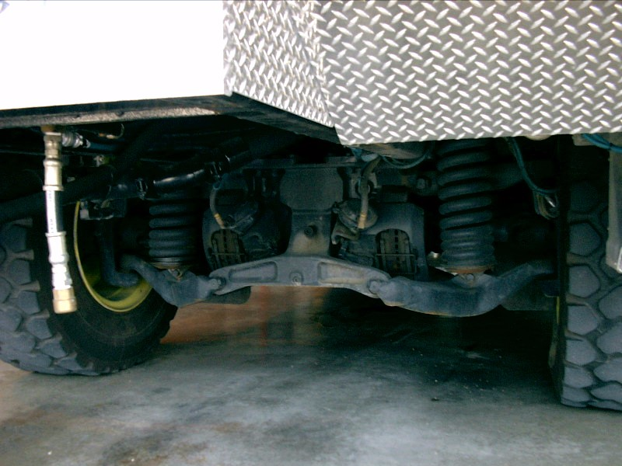
Vehicle Characteristics
Suspension System
Axles
Springs
Wheels and Tires

Slide 18
Braking Systems
Standard
Parking or Service
Auxiliary Braking Systems

Slide 19
Standard

Slide 20
Air Brake System
Foot Brake Valve
Front & Rear Axle Tanks
Main Air Supply Tank
Air Dryer
Compressor
Governor

Slide 21
Braking Systems
Braking Systems
  Electronic Braking Control Systems (ECBS) brake by wire
  Anti-lock Braking Systems (ABS)
  Secondary or Auxiliary Braking Systems
    Driveline Retarder
    Compression or Engine Brake
    Exhaust Brake
    Automatic Transmission Retarder

Slide 22
Braking Systems
Auxiliary brakes increase the life of brake linings
Some auxiliary braking devices should be shut off when the apparatus is being operated on slippery/wet surfaces
  Check your vehicle’s operation manual

Slide 23
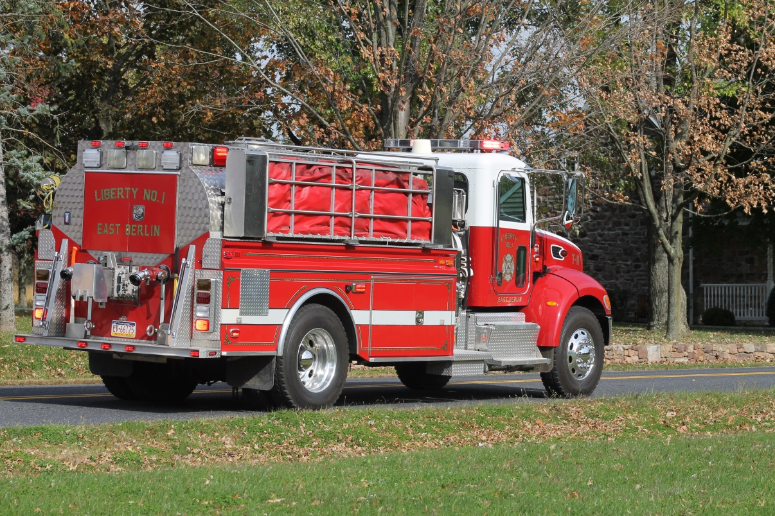
Vehicle Characteristics
Baffling Systems

Slide 24
Vehicle Characteristics
Rollover Awareness
  Center of Gravity
  Road Conditions
  Seatbelts

Slide 25
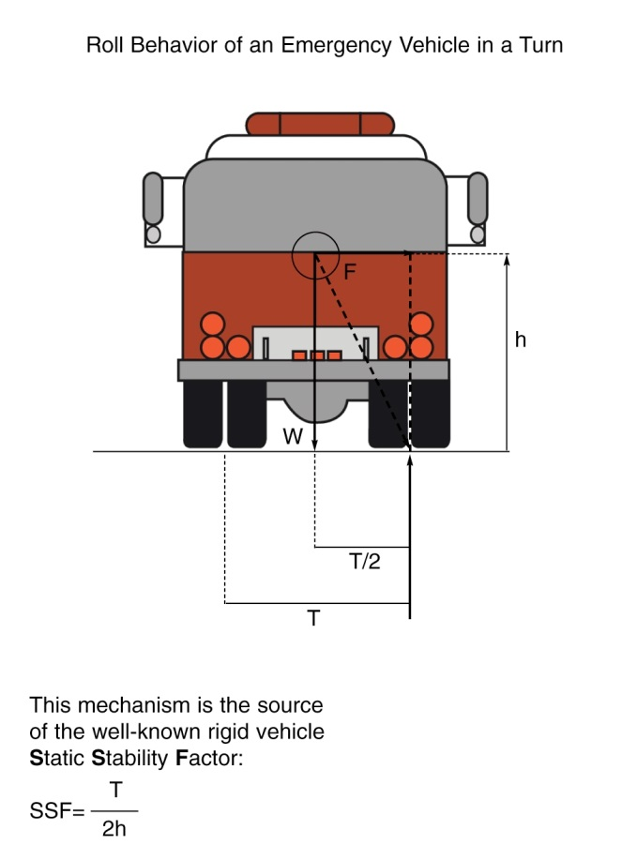
Stability Factor Calculation
Estimate where the middle of the water tank is and measure the distance from that point to the floor. (H)
Measure the distance the rear wheels are from the center of the drivers side rear tire to the passenger side rear tire. (T)

Slide 26

Stability Factor Calculation
Height | SSF
2’ | 1.5
3’ | 1.0
4’ | .75
5’ | .6
6’ | .5
7’ | .42
8’ | .375
9’ | .333
10’ | .3
T = 6’

Slide 27
Weight Transfer
The amount of weight on your tire is what ultimately determines its traction limit. Too little weight and the rubber doesn’t stick to the road; too much weight causes it to stick too hard and creates excess heat
Notes:
There are three ways that weight transfers can occur: acceleration, deceleration, steering.

Slide 28
Vehicle Balance and Traction Concepts
When the vehicle is in motion:
  Sudden steering, braking and/or acceleration change vehicle balance and traction dramatically
  Sudden loss of vehicle balance causes traction loss and traction loss compounds crash results

Slide 29
Vehicle Balance and Traction Concepts
When brakes are applied:
  Weight or center of mass transfers to the front of the vehicle
  Causes a noticeable drop of the front of the vehicle and a rise in the rear
  Occupants feel a forward movement

Slide 30
Vehicle Balance and Traction Concepts
When acceleration is applied:
  Weight or center of mass transfers to the rear of the vehicle
  Causes a noticeable rise to the front of the vehicle and a drop in the rear of the vehicle
  Occupants feel a rearward movement

Slide 31
Vehicle Balance and Traction Concepts
When steering is applied:
  Weight or center of mass transfers to the front right or left of the vehicle
  Causes a noticeable drop and tilt of the front of the vehicle and a rise and tilt of the rear of the vehicle
  Occupants feel a movement forward to the corner of the vehicle

Slide 32
Vehicle Balance and Traction Concepts
Key to vehicle operation:
  Smooth and efficient steering, braking, and accelerator movements
  Any abrupt movements or changes of the vehicle are transferred to the vehicle suspension and have a significant affect on the balance of the vehicle

Slide 33
Vehicle Balance and Traction Concepts
Traction concerns:
  Stationary (Static) – A stationary vehicle parked on a flat surface with brakes set is an example of static traction. It has greatest resistance to movement. There is greater traction between a stationary wheel and a road than a sliding wheel and a road
Notes:
Traction or adhesion is the grip between the tires and the road surface that allows a vehicle to start, stop and/or change direction. Three types of traction influence the control/or movement of a motor vehicle. Stationary(static), rolling(dynamic), or sliding.

Slide 34
Vehicle Balance and Traction Concepts
Traction concerns:
  Rolling (dynamic) –There is more traction between a rolling and wheel and the road. This is why a driver needs to keep the wheels rolling and not lock the brakes when trying to steer or stop a vehicle

Slide 35
Vehicle Balance and Traction Concepts
Traction concerns:
  Sliding – Traction between tires and the road does not remain constant. Sand, gravel or water on the road decrease the level of traction. As speed increases, traction between the tires and the road surface decrease. With the decrease traction, the possibility of skidding or sliding increases

Slide 36
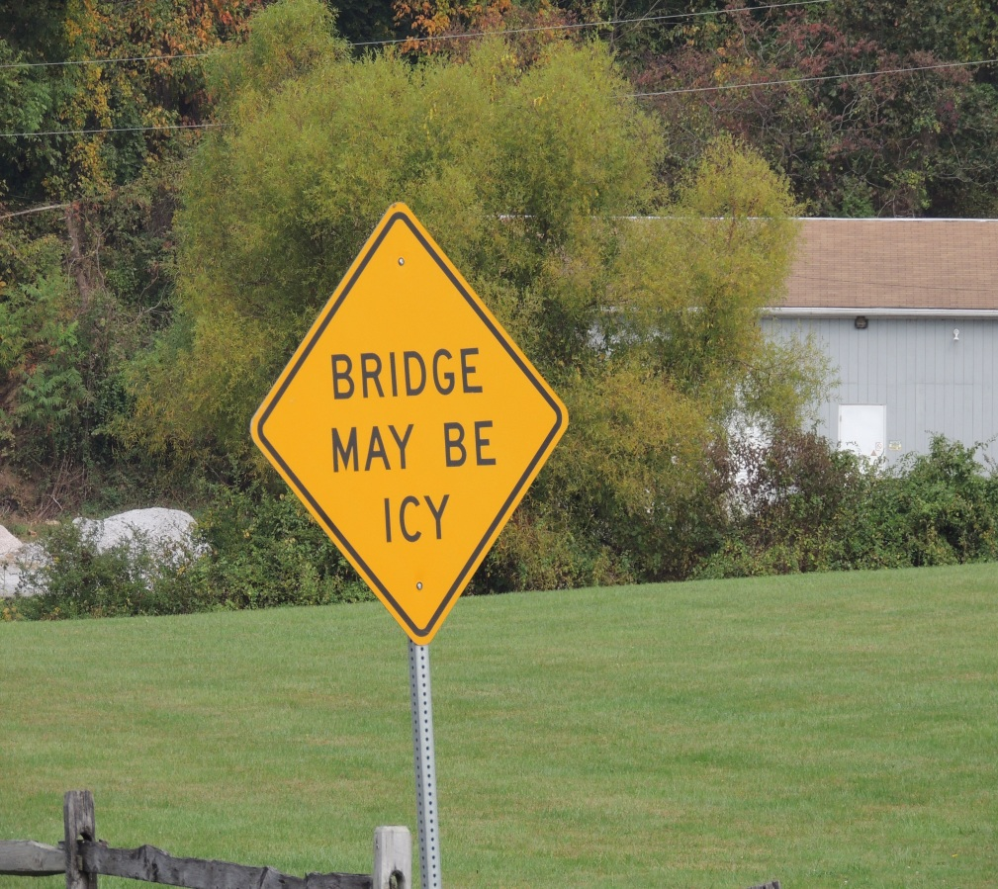
Matching Speed to Road Conditions
Slippery surfaces

Slide 37
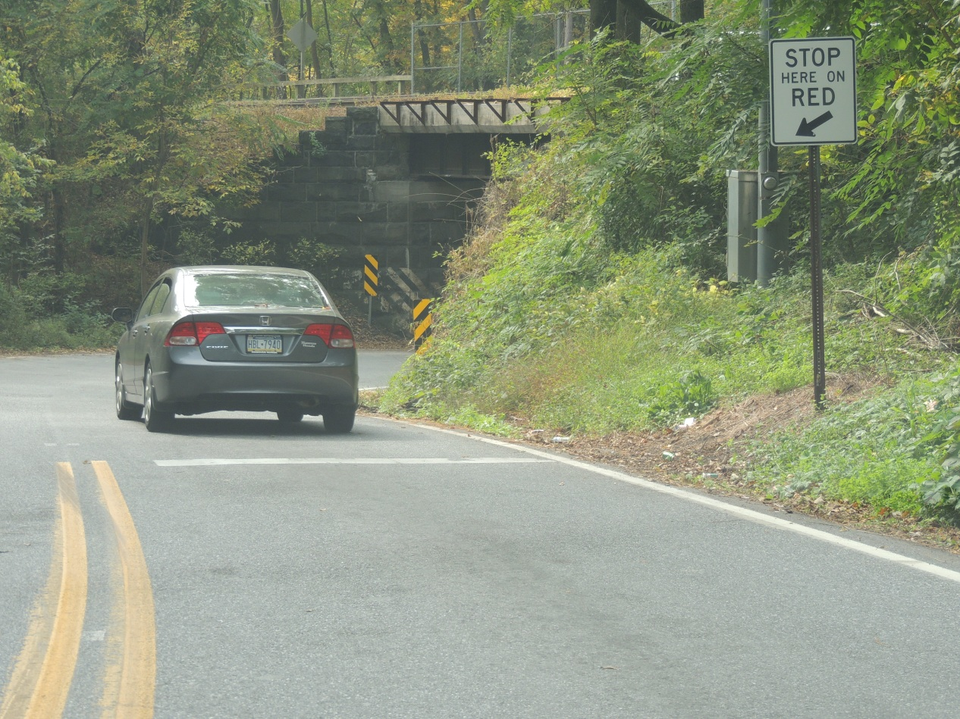
Matching Speed to Road Conditions
Curves

Slide 38
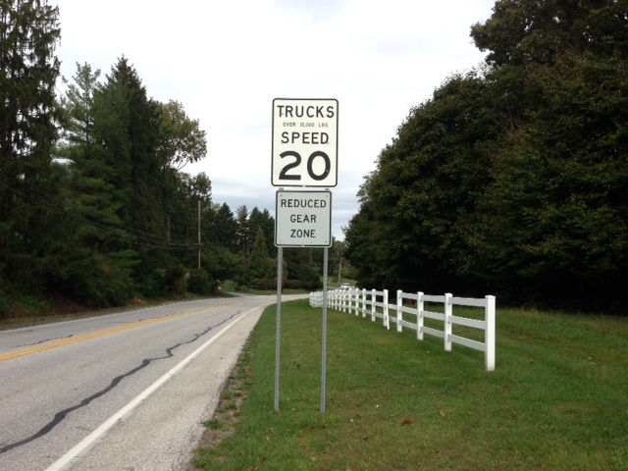
Matching Speed to Road Conditions
Downhill grade

Slide 39
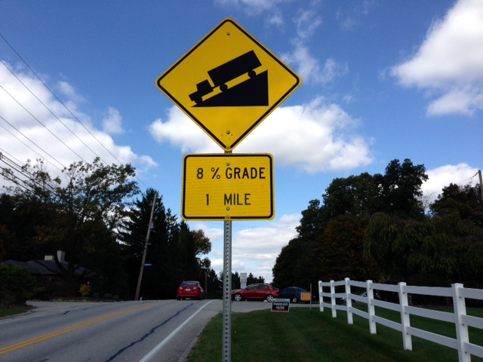
Matching Speed to Road Conditions
Steep grade
Notes:
Be aware of road conditions and pay attention to cautionary signs Using brakes appropriately.

Slide 40
Warning
Matching Speed to Road Conditions
When descending grade, remember that frequent use of service brakes causes them to become hot, which results in a reduction of their stopping ability.
Notes:
Grade descent speed should be such that the service brakes are used infrequently and that they remain cool, thus retaining their effectiveness.

Slide 41
Rollover Prevention
FEMA/USFA White Paper Findings
  Driver error is a major factor in nearly all incidents
  Majority are single vehicle crashes
  Inexperience or lack of specific training is major factor
  Failure to wear seat belts contributes to many fatalities

Slide 42
Common Rollover Circumstances
Too much relative speed into curve or corner
Soft shoulder drop-off
Uneven surface drop-off and improper recovery

Slide 43
Excessive Relative Speed
Vehicle speed measured at any MPH which is considered unsafe in relationship to your environment, road conditions, and your vehicle
Notes:
Definition of excessive relative speed.

Slide 44
Rollover Prevention
Soft Shoulder Drop off
  Unpaved road or paved road w/unpaved shoulder
  Tires drop-off onto shoulder & may begin to sink
  Driver brakes abruptly
    Transferring considerable vehicle weight causing wheels to plow
    Slowing vehicle abruptly and sinking into soft shoulder

Slide 45
Rollover Prevention
Uneven Surface Drop off and Improper Recovery
  Travel likely on road with an unpaved shoulder
  Driver drifts off of paved surface with right tires
  In an attempt to get vehicle back onto road surface, the driver over steers hard left
Notes:
The greater the difference in surface heights, the more severe an angle of steering must be applied to overcome the resistance of the road surface against the tires of the vehicle.

Slide 46
Rollover Prevention
Body Roll
  The movement of the body & chassis onto the suspension & tires
  Dynamic weight transfer causes changes in the vehicle’s weight distribution on:
    Each axle
    Each tire
    Center of gravity

Slide 47
Rollover Prevention
Causes of Body Roll
  Acceleration
  Water Slosh
  Steering motion
  Road configurations
  Driving thru a curve
  Tire sidewall flexibility
  Personnel moving inside vehicle
Notes:
The emergency vehicle design that affects vehicle handling and influences the physical forces is the design and use of baffling systems on vehicles that carry water. The physical forces of momentum and inertia cause all vehicle weight to shift whenever the driver accelerates, brakes, or turns the vehicle. If the vehicle is carrying water the shift of weight becomes a dynamic movement. The water shifting can easily result in the loss of vehicle control.

Slide 48
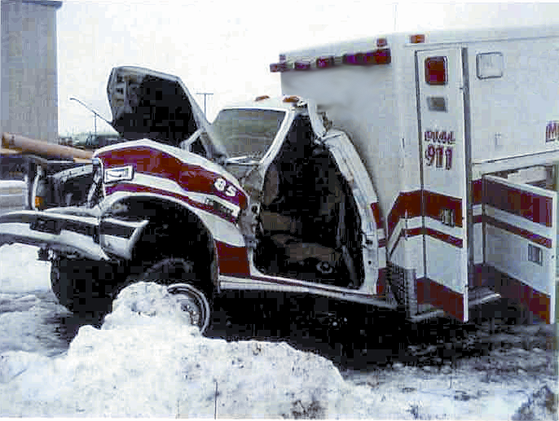
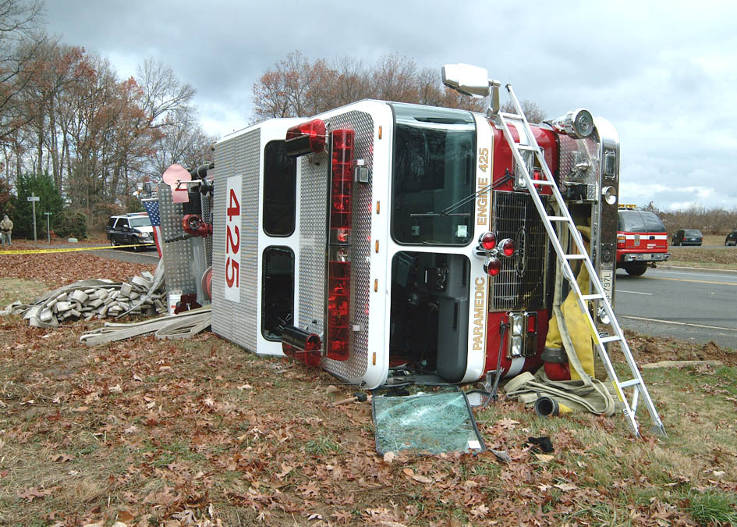
Wear Seatbelts & Slow Down

