Slide 1
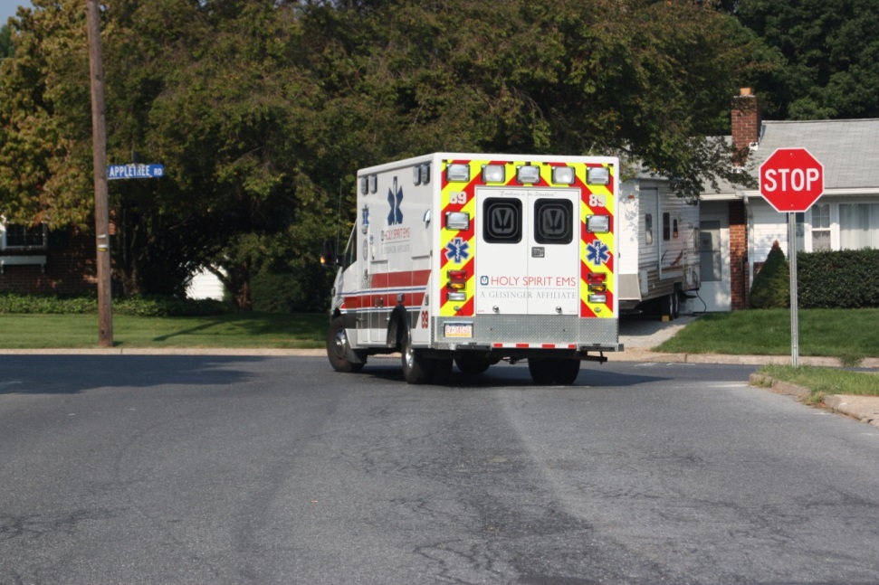
Intersections
Controlled
Uncontrolled
Pre-Emption

Slide 2
Basic Maneuvers
Account for traffic one lane of traffic at a time, treating each lane of traffic as a separate intersection.

Slide 3
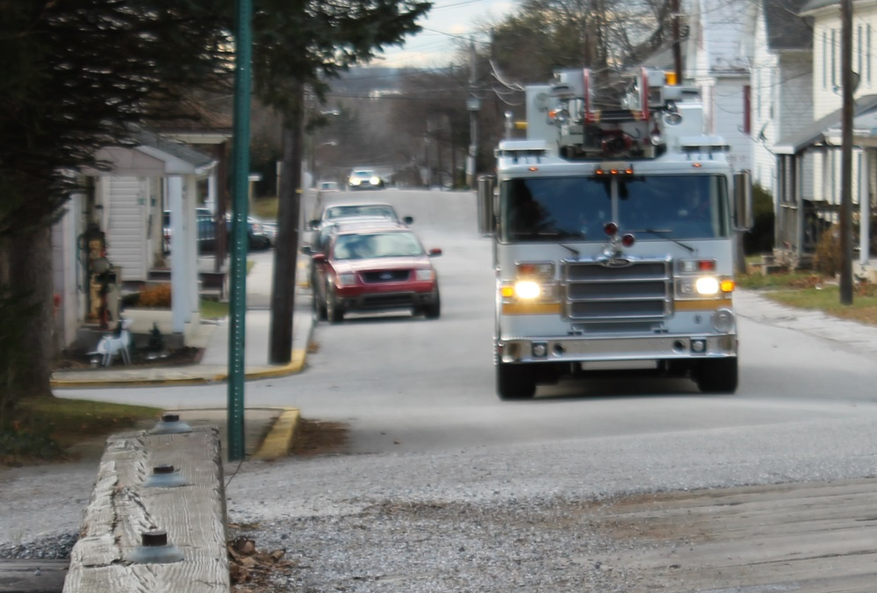
Uncontrolled Intersection
Scan for possible hazards
Begin to slow well before reaching intersection and cover the brake pedal
Change siren cadence not less than 200’ before intersection
Avoid using opposing lane of traffic if at all possible

Slide 4
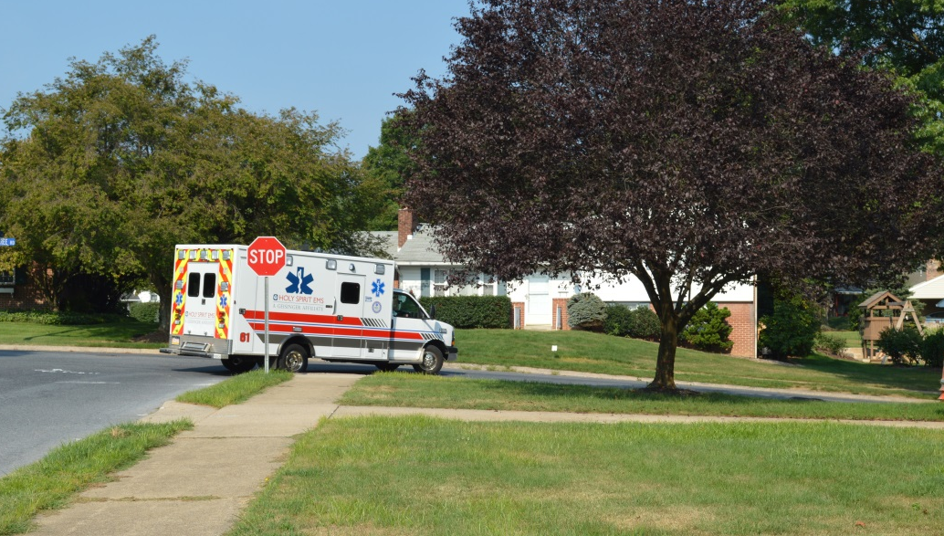
Controlled Intersection
Do not rely on warning devices to clear traffic
Scan for possible hazards
Begin to slow well before reaching intersection and cover the brake pedal

Slide 5
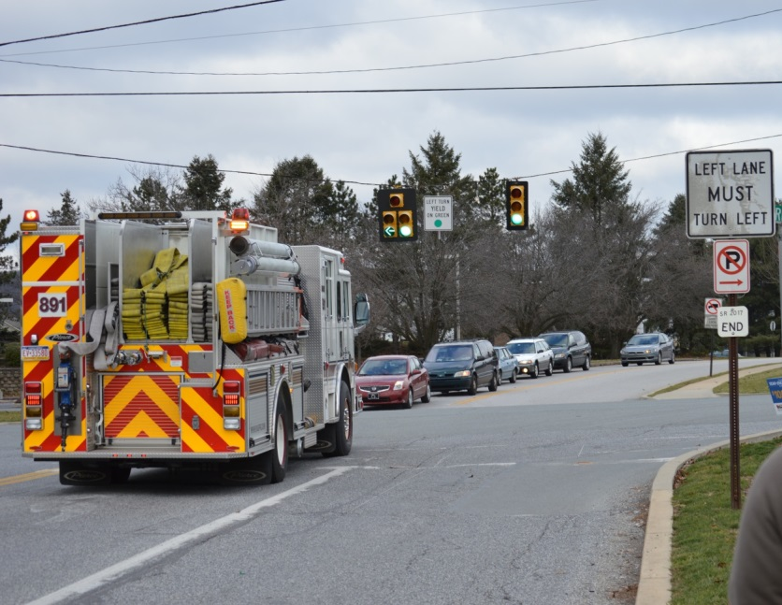
Controlled Intersection
Be aware of “stale” green and prepare to stop
Change siren cadence not less than 200’ before intersection
Scan intersection for possible passing options

Slide 6
Controlled Intersection
NFPA 1500 complete stop guidelines
  When directed by law enforcement
  Red traffic lights
  Stop signs
  Negative right of way intersections
  When driver can not account for all lanes
  When other intersection hazards are present
  Stopped school bus with flashing warning lights
Establish eye contact with other vehicle drivers
PM Fill-In

Slide 7
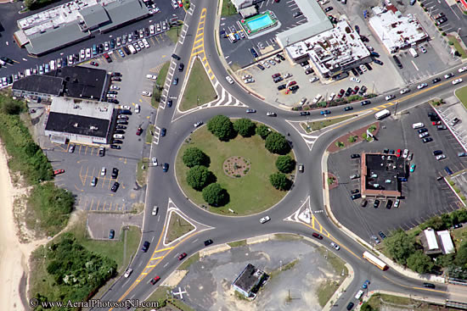
Special Intersections

Slide 8
Road Surface Conditions That Impact Traction
Rain/Standing water
Snow and ice (frost)
Wet leaves
Excessive heat
Loose gravel, sand and stone
Damaged or uneven surface

Slide 9
Identifying Slippery Surfaces
1. Shaded areas – Shady parts of the road will remain icy long after open areas have melted
2. Bridges – When the temperature drops, bridges will freeze before the road will. Be especially careful when the temperature is close to 32 degrees Fahrenheit

Slide 10
Identifying Slippery Surfaces (Cont’d)
3. Melting Ice – Slight melting will make ice wet. Wet ice is much more slippery than ice that is not wet.
4. Black Ice – Black ice is a thin layer that is clear
enough that you can see the road underneath it. It makes the road look wet.

Slide 11
Identifying Slippery Surfaces (Cont’d)
5. Just After Rain Begins – Right after it starts to rain, the water mixes with oil left on the road by vehicles. This makes the road slippery. If the rain continues, it will wash the oil away.
6. Hydroplaning – In some weather, water or slush collects on the road. The tires lose their contact with the road and have little or not traction and your vehicle may hydroplane.

Slide 12
Operating Under Adverse Conditions
Vision Implications
  Night Driving
  Precipitation

Slide 13
Night Driving
Dim Dash and Cab Lights
Reduce Speed
Keep Headlights and Windshield Clean
Watch the Area Beyond the Headlights
Keep your Eyes Moving, Scan Continuously

Slide 14
Operating Under Adverse Conditions
Adverse Handling Implications
  High Winds
  The Driver

Slide 15
Best Practices for High Winds
Reduce speed
Check for oncoming traffic
Adjust lane position
Do not over steer when responding to a gust
Prepare to counter steer
Stay off the brake

Slide 16
The Driver
Prepare Adequately Through Driver Training
Use Low Beams and Wipers
Watch for Slowed and/or Stopped Vehicles
Check Rearview Mirrors Regularly
Practice Both Space and Speed Management While Increasing the Safety Cushion

Slide 17
Railroad Crossing Safety
Passive vs. Active Crossings

Slide 18
Railroad Crossing Safety
Passive Crossing
  No traffic control device
  Decision to top or proceed rests entirely in the hands of the operator
  Requires driver to
    recognize the crossing
    search for a train using the tracks
    decide if there is sufficient clear space to cross safely

Slide 19
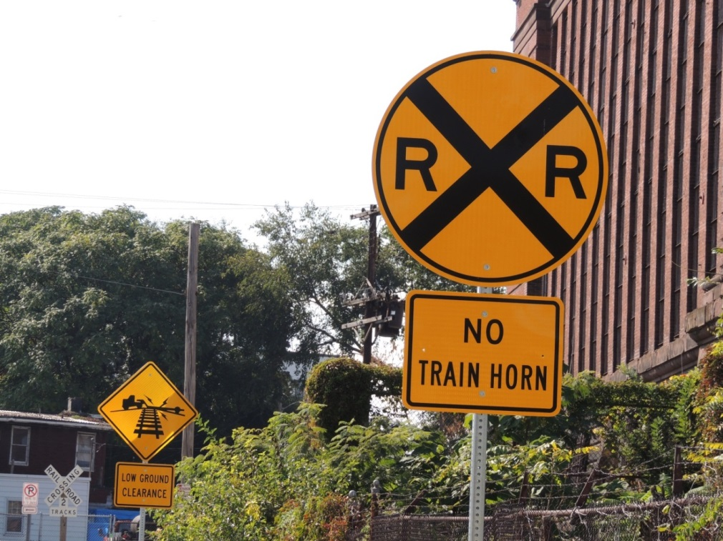
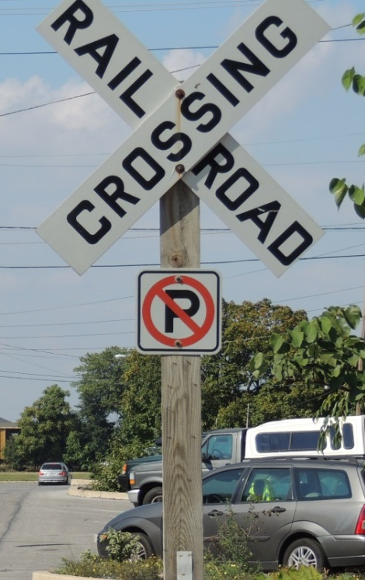
Railroad Crossing Safety
  Passive devices include signs, and pavement markings in advance of the crossing

Slide 20
Railroad Crossing Safety
Active Crossing
  This type of crossing has a traffic control device installed at the crossing to regulate traffic at the crossing.
  These active devices include flashing red lights, with or without a bells and flashing red lights with bells and gates.

Slide 21
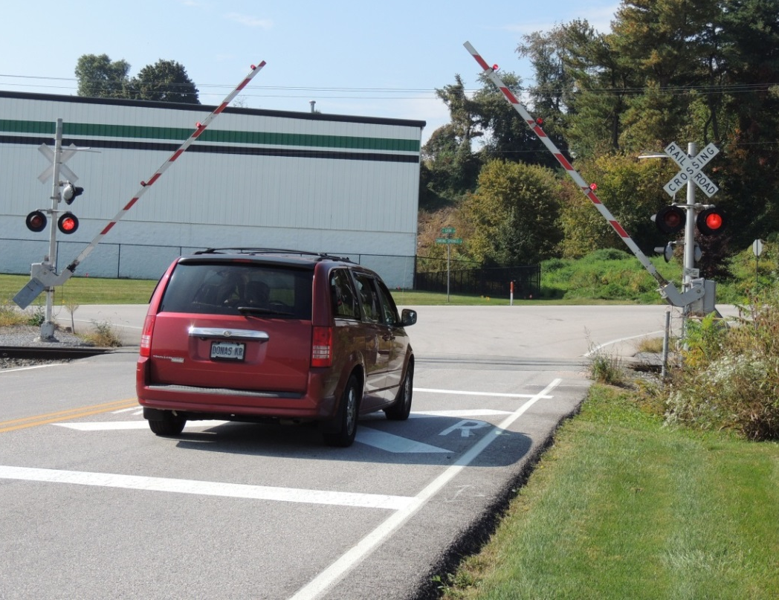
Active Crossing Example

Slide 22
Best Practices for Railroad Crossings
Come to a complete stop at all railroad crossings.
Turn off sound producing devices, open the window and look both ways. At crossings with obstructions or severe curves utilize crew members to check crossing.

Slide 23
Railroad Crossing Life Saving Practices (Cont’d)
3. Never race a train to cross the tracks
4. Never pass another vehicle with 100 feet
of the crossing
5. Watch out for other vehicles that must stop
at railroad crossings
6. Never shift gears on the crossing
7. Don’t place the vehicle on tracks

Slide 24
Railroad Crossing Life Saving Practices (Cont’d)
8. When fighting fires on or near a track
contact the railroad
9. Only use the crossing if you can be sure
your vehicle is high enough to completely
clear the crossing without stopping
10. Don’t be fooled by the optical illusion
presented by the train, it is moving faster
and is closer than you think

Slide 25
Collision Avoidance
Collision Avoidance
  Identify Escape Route
  Brake Smoothly and Firmly
  Accelerate Smoothly
  Steer to Avoid Head-On Impact

Slide 26
POV Response
Emergency Responders must be educated in their responsibilities and risks associated with response in privately owned vehicles and understand the importance of safe operation when responding
The responder must understand that first and foremost, he or she must arrive safely at the emergency scene or the station in order to be of any help to the public
Notes:
Play VFIS POV Risk Series Video

Slide 27
Placement of Vehicles at Highway Incidents
Placement at Incidents
Positioning So As to Minimize the Blinding Effect of Warning Lights
Identify Potential Hazards at Scenes
Advanced Warning
Traffic Control

Slide 28
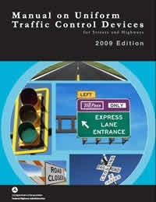
MUTCD
www.mutcd.fhwa.dot.gov
Notes:
The Manual on Uniform Traffic Control Devices provides recommendations for traffic control.

Slide 29
MUTCD 2009
Chapter 1A – General
Section 1A.07 – Responsibility
MUTCD
Each state shall be in substantial compliance
  Highway Safety Act of 1966
State Highway Agencies shall adopt a manual
Meet the requirements of the most recent edition adopted by the Federal Highway Administration
2009 Edition

Slide 30
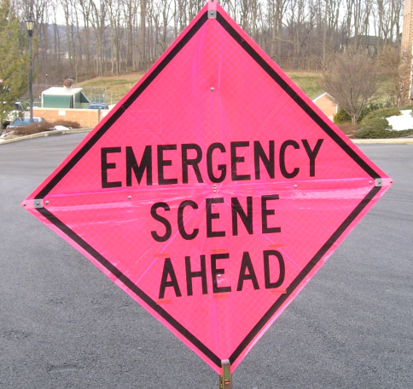
Section 1A.12
10 of the 13 colors are being used
Fluorescent Pink – Incident Management

Slide 31
Section 6D.03 Worker Safety
  Key Elements of Worker Safety and TTC Management
  Training
  Temporary Traffic Barrier
  Speed Reduction
  Activity Area
  Safety Planning

Slide 32
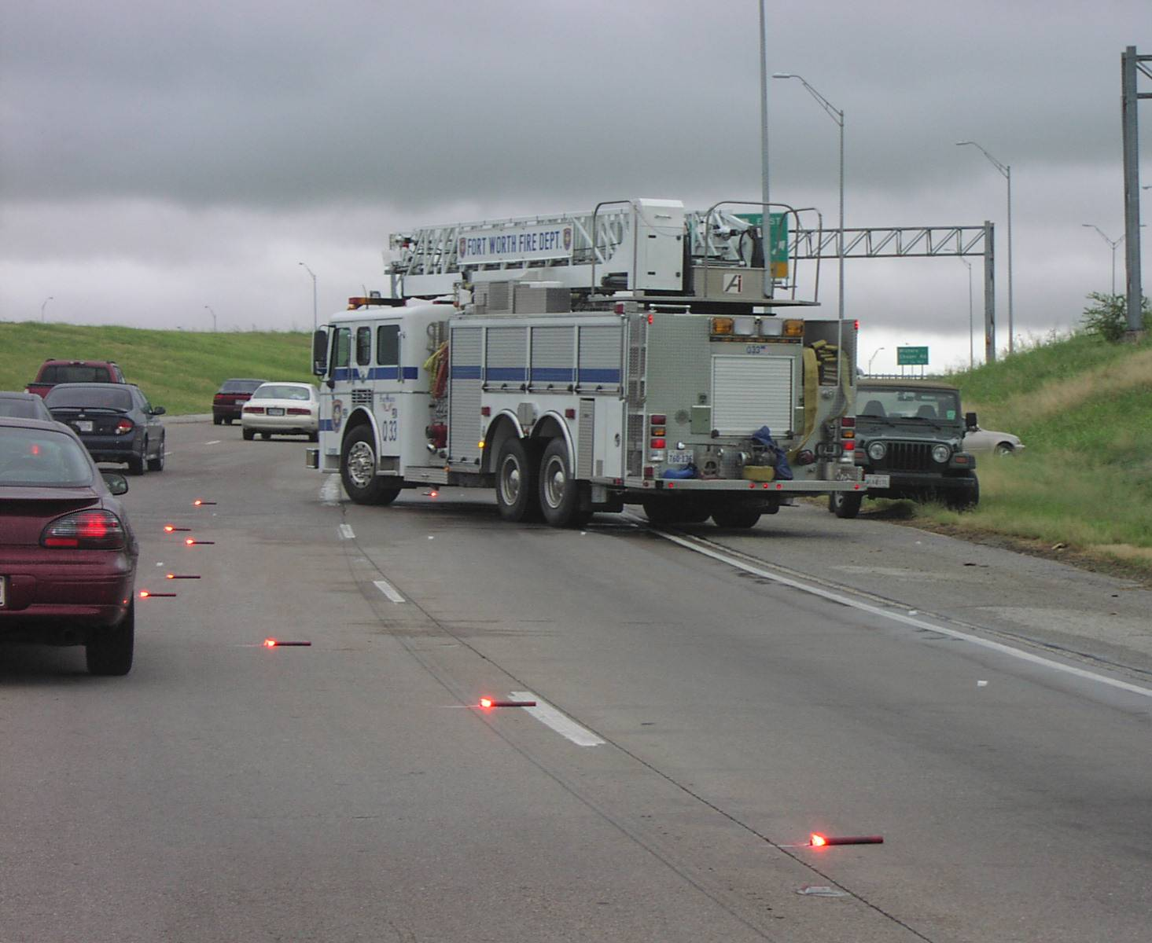
Lateral Buffer Space
If lateral buffer space requires part of a lane, close that lane – avoid partial closures
Notes:
Lateral buffer space is the area between the incident space and the adjacent travel lane
Lateral buffer space can be beneficial because it allows for more room for responders to work
Lateral buffer space can be accommodated through the use of lane(s) +1 blocking
Partial lane closures are not recommended because they can confuse drivers and decrease scene safety

Slide 33
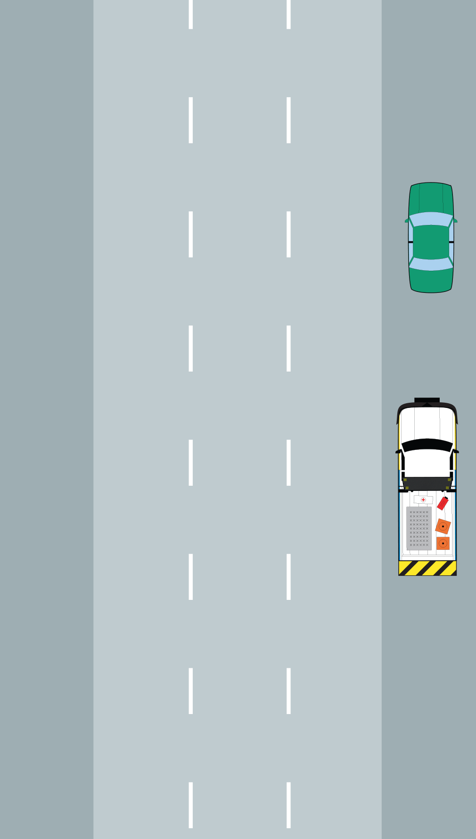
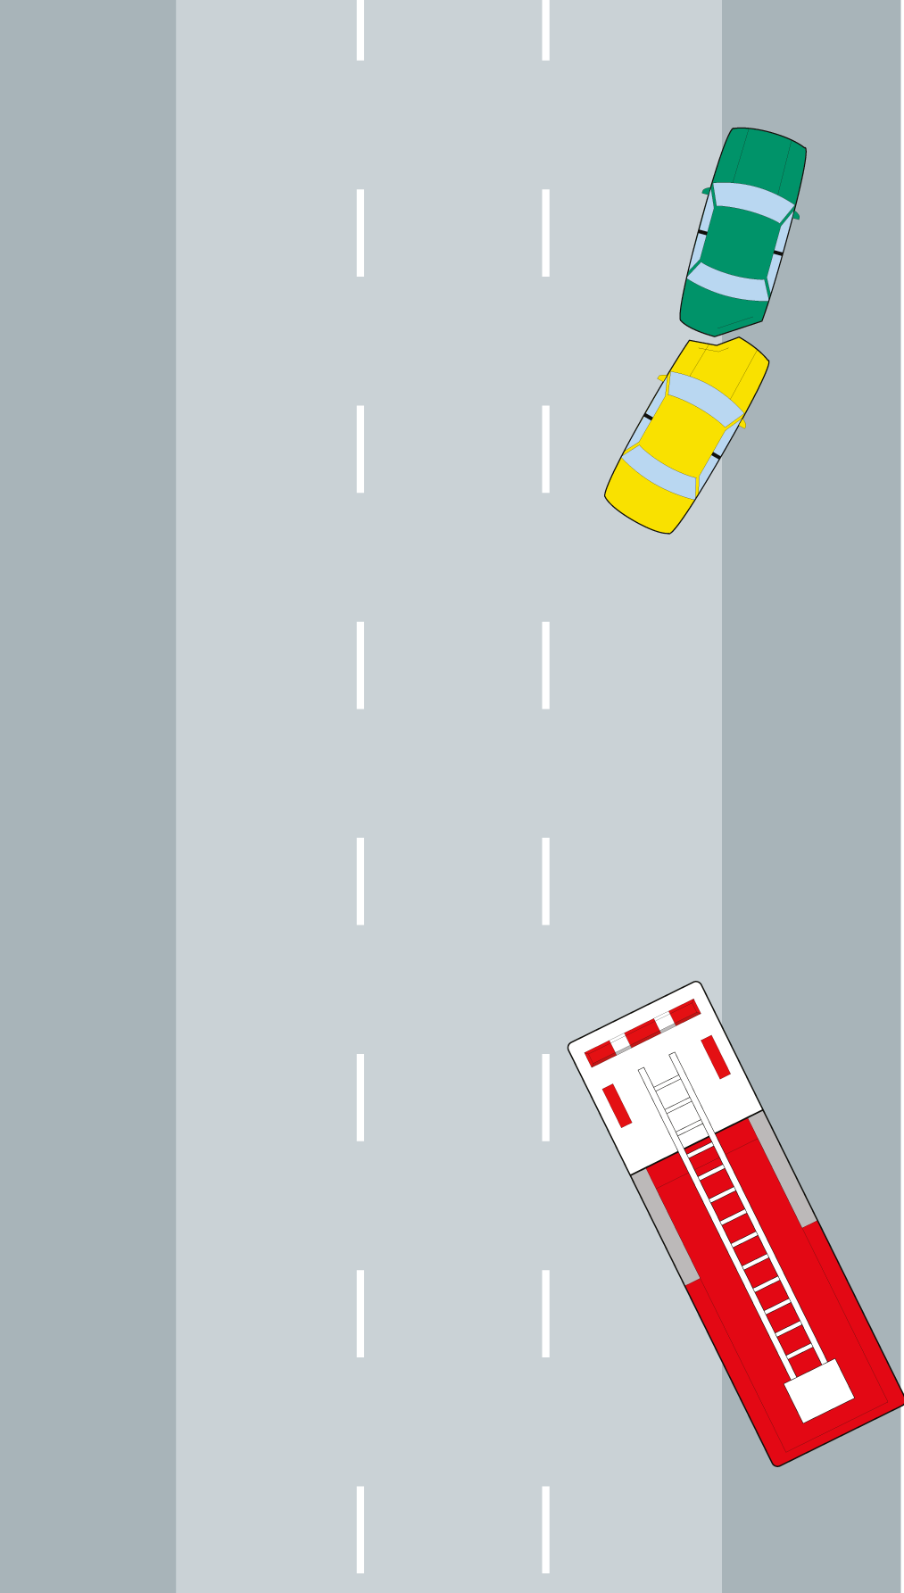
Linear vs. Multi-Lane Blocking
Linear Blocking
Multi-Lane Blocking
Source: FHA SHRP2
Notes:
This slide provides a visual representation of linear and multi-lane blocking

Slide 34
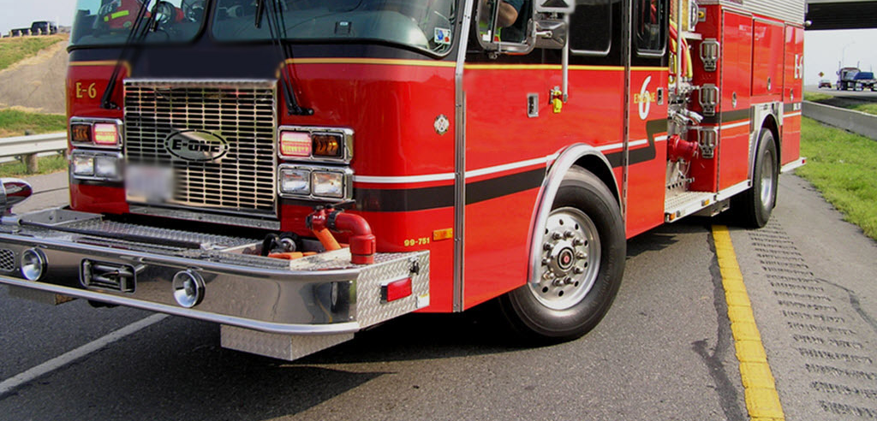
Critical Wheel Angle
Turn front wheels of vehicles away from the incident
Source: FHA SHRP2
Notes:
When positioning the responder vehicle, you should always work on the assumption that the unit will be hit by oncoming traffic
Therefore, it is considered optimal to turn wheels so that they are not facing the incident space
In the event that the responder vehicle is struck, the wheel angle being positioned away from the work area will lessen the likelihood that it is pushed into the area where responders are working
This type of wheel positioning is referred to as the critical wheel angle

Slide 35
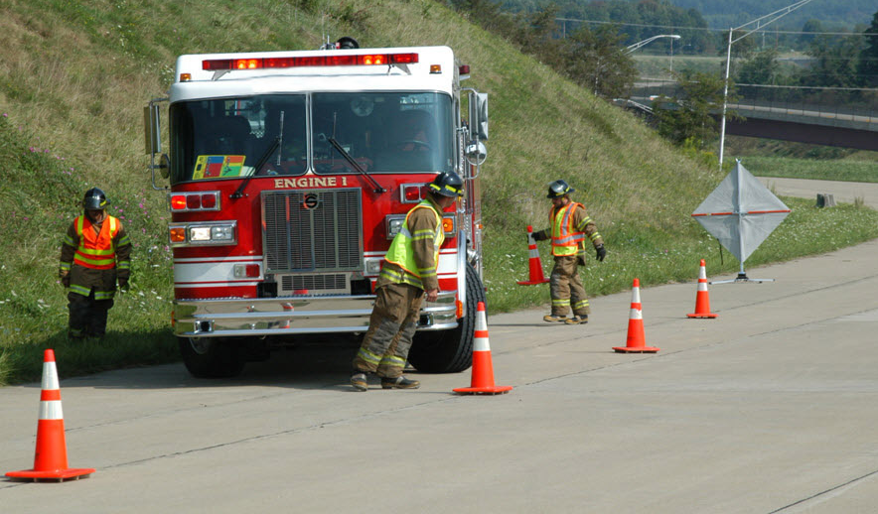

Zero Buffer
Source: FHA SHRP2
Notes:
Animation: Click forward to make STOP sign appear
Every block creates an area of danger at the space between the furthermost point of the angle (usually at the front left or right side of the vehicle) and the area where traffic passes
This area is referred to as the zero buffer
If you have to pass through the ‘zero’ buffer zone, stop, check for traffic and then proceed along the unit remaining as close to the emergency vehicle as possible

Slide 36
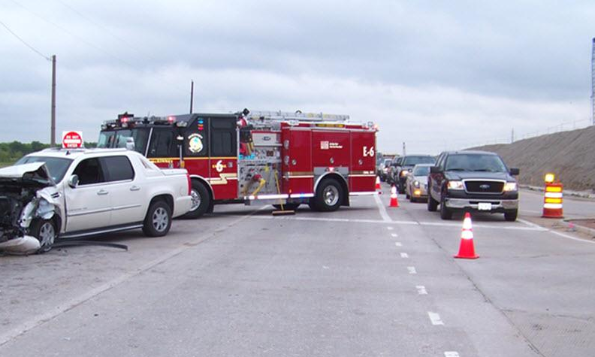
Zero Buffer
Source: FHA SHRP2
Notes:
Animation: Click forward to make red oval appear
Ask students to identify the zero buffer

Slide 37
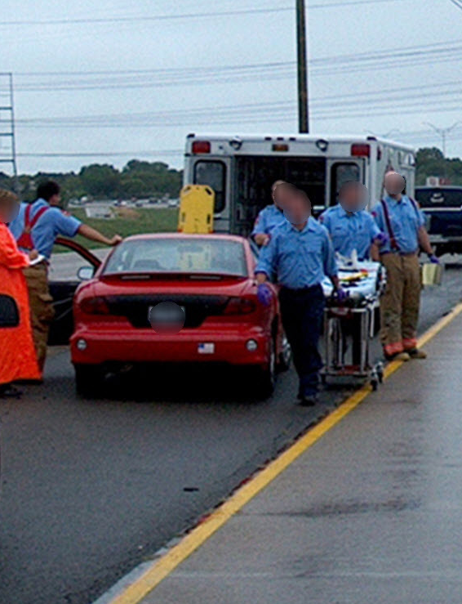
Lane(s) +1 Blocking
By the very natural of fire/rescue and EMS work, additional space to work is typically required
Lane(s) +1 Blocking occurs when responders block the involved lane(s) plus one additional lane to provide a lateral buffer space for safety
Source: FHA SHRP2
Notes:
Oftentimes, to ensure responder and motorist safety, it is necessary to close additional lanes for portions of the incident
A good rule of thumb is to take only as many lanes as you need for only as long as you need them
A typical incident will have at least one lane or the shoulder obstructed upon arrival and under some circumstances, it may be necessary to close another lane initially even if the incident is not directly obstructing it
This protocol, where one additional lane is blocked in order to increase safety, is referred to as lane(s) +1 blocking.
Use of the lane(s) +1 blocking protocol creates an adequate buffer against moving traffic for responders

Slide 38
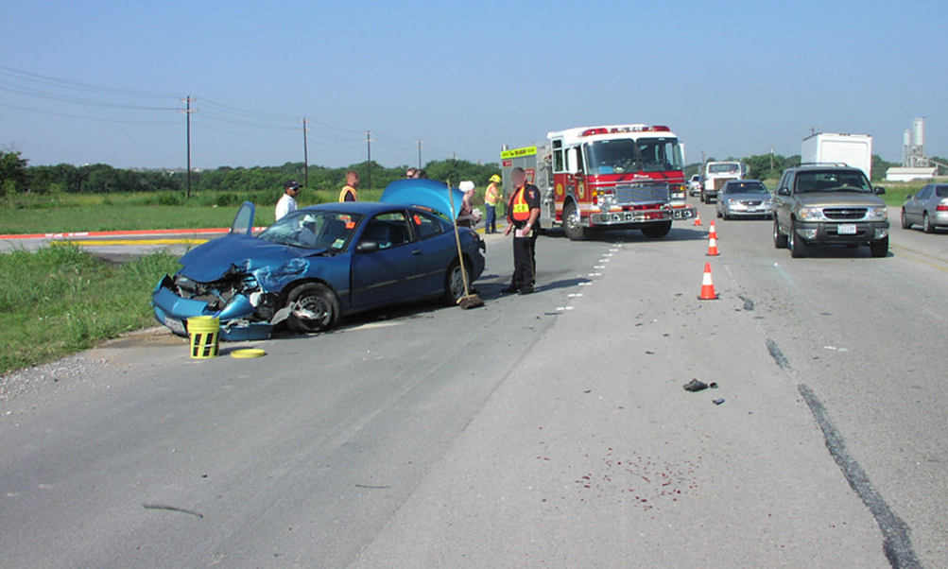
Lane(s) +1 Blocking Protected Work Space
Source: FHA SHRP2
Notes:
Animation: Click forward for red shape to appear
The purpose of lane(s) +1 blocking is to provide responders working at an incident scene a protected work space where they can do their jobs safely

Slide 39
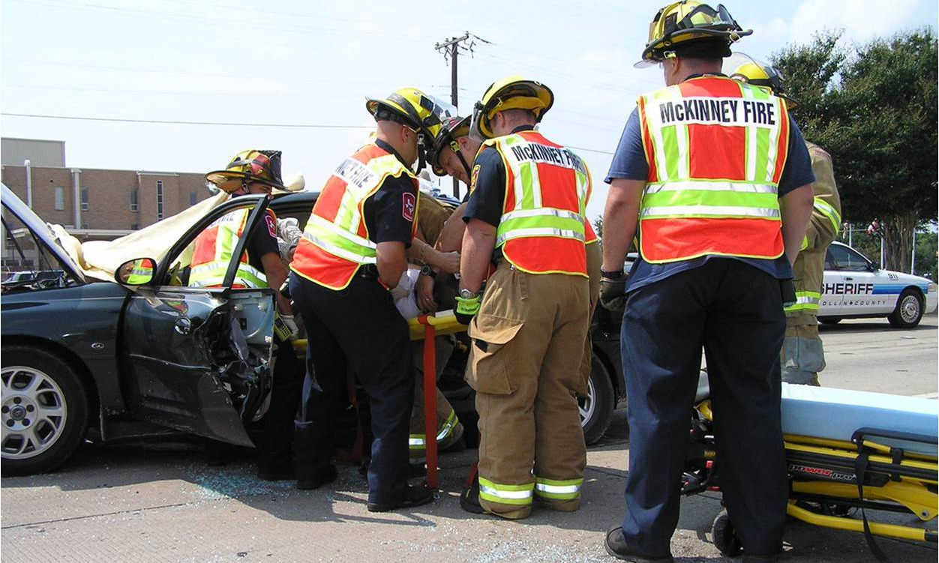
Lane(s) +1 Blocking Patient Loading
Source: FHA SHRP2
Notes:
Fire and EMS personnel need room to work during patient treatment and patient movement, so they can focus on the patient and not be focused on avoiding moving traffic
Once the patient is loaded, vehicle positioning should be assessed to determine if the extra lane can be opened

Slide 40
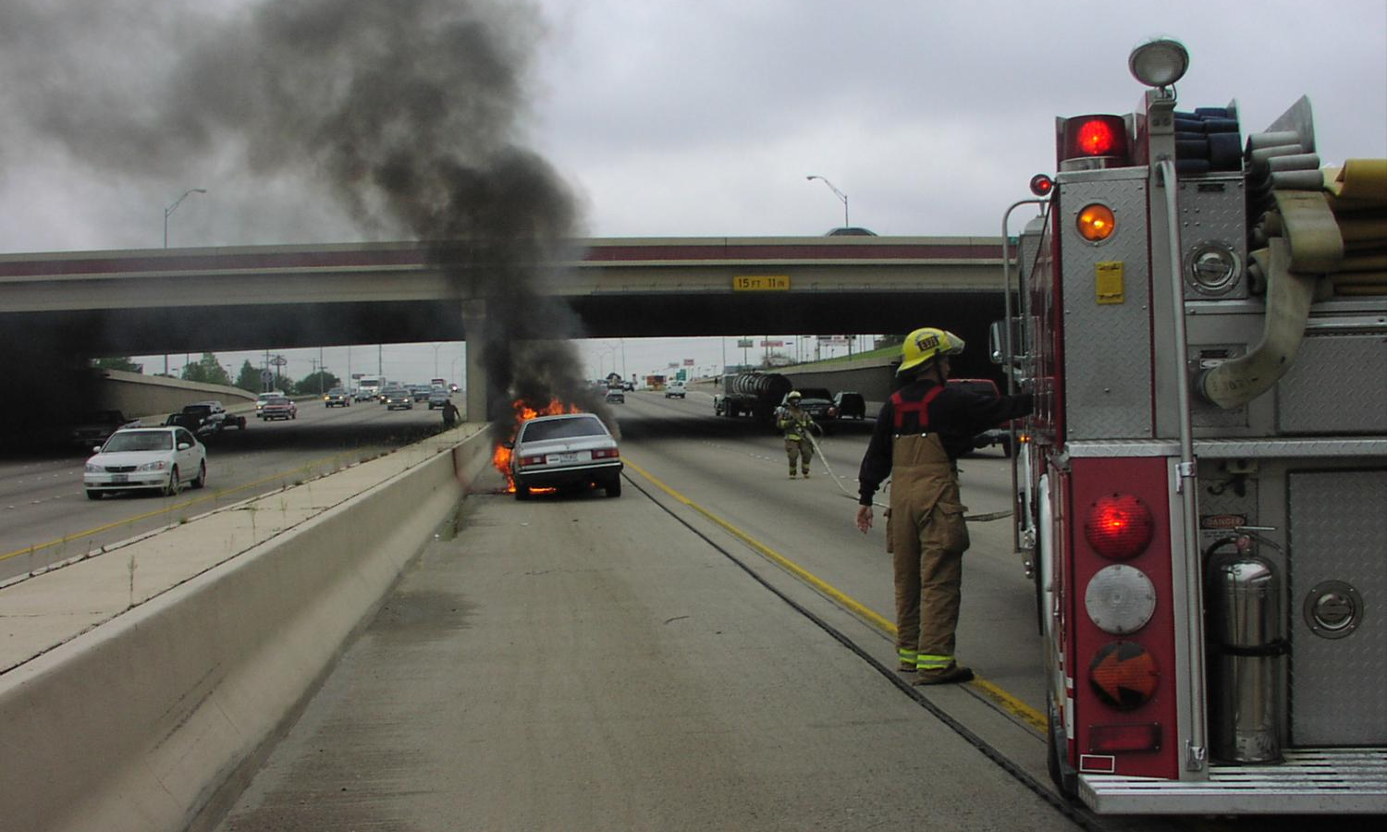
Lane(s) +1 Blocking Vehicle Fires
Source: FHA SHRP2
Notes:
Due to the potential of exploding projectiles and visibility concerns related to smoke, vehicle fires typically require lane(s) +1 blocking

Slide 41
Federal Regulation
23 CFR 634
Worker Visibility Final Rule
Source: Responder Safety

Slide 42

Shortcoming of Wearing No Vest!
Source: FHA SHRP2
Notes:
Animation: Click forward to make the white outline appear
Describe the obvious difference the vest makes and why this is dangerous for responders in traffic incidents
Also point out that not wearing a vest could also have consequences related to worker compensation
For example, a responder who sustains injuries while working at a traffic incident may not receive full benefits from their insurance if they were not wearing their vest
If you need a simple and straightforward vest policy consider this – If your feet are on the street, your vest is on your chest

Slide 43
Exception
Firefighters, when actively engaged in emergency operation that directly expose workers to flame, fire, heat or hazardous materials may wear retro reflective turnout gear
Police Officers, in potential adversarial rolls to include traffic stops and searches
“At all other times vests shall be worn”
Source: FHA SHRP2
Notes:
Exceptions to the use of vests during emergency operations.

Slide 44

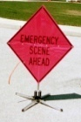


Temporary Traffic Control Zone
Advance
Warning Area
Transition Area
Activity Area
Buffer – Work Space
Termination Area
150’ between Apparatus
Source: FHA SHRP2

Slide 45
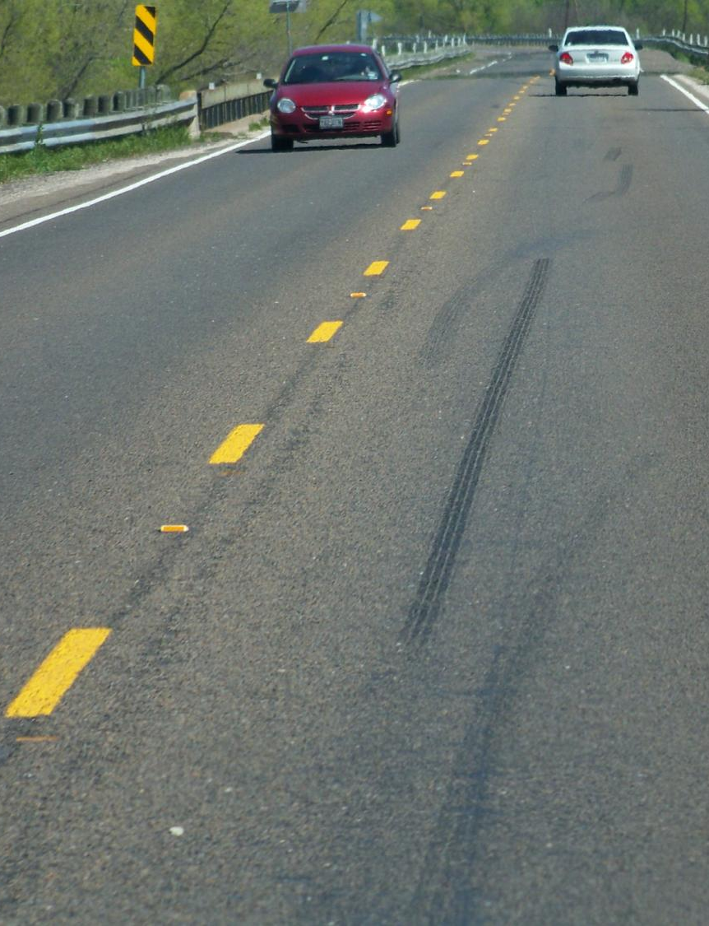
Easy Reference
Skip lines are typically spaced 40 feet apart (start to start)
Speed Limit (MPH) | Taper Length (ft.) | Number of Cones Required
25 | 125 | 4
35 | 245 | 7
45 | 540 | 14
55 | 660 | 17
65 | 780 | 20
40 feet
Source: FHA SHRP2
Notes:
As previously discussed, the taper lengths provided here are required for planned work zones and are a goal for responders to work towards when establishing traffic incident management areas
In many situations, especially early on, responders will simply not have the cones available to set up tapers of this length and will have to do the best they can with the resources they have
Explain that the ultimate goal of a taper is to have the taper appear as a straight line indicating the direction in which you want the motorist to merge

Slide 46
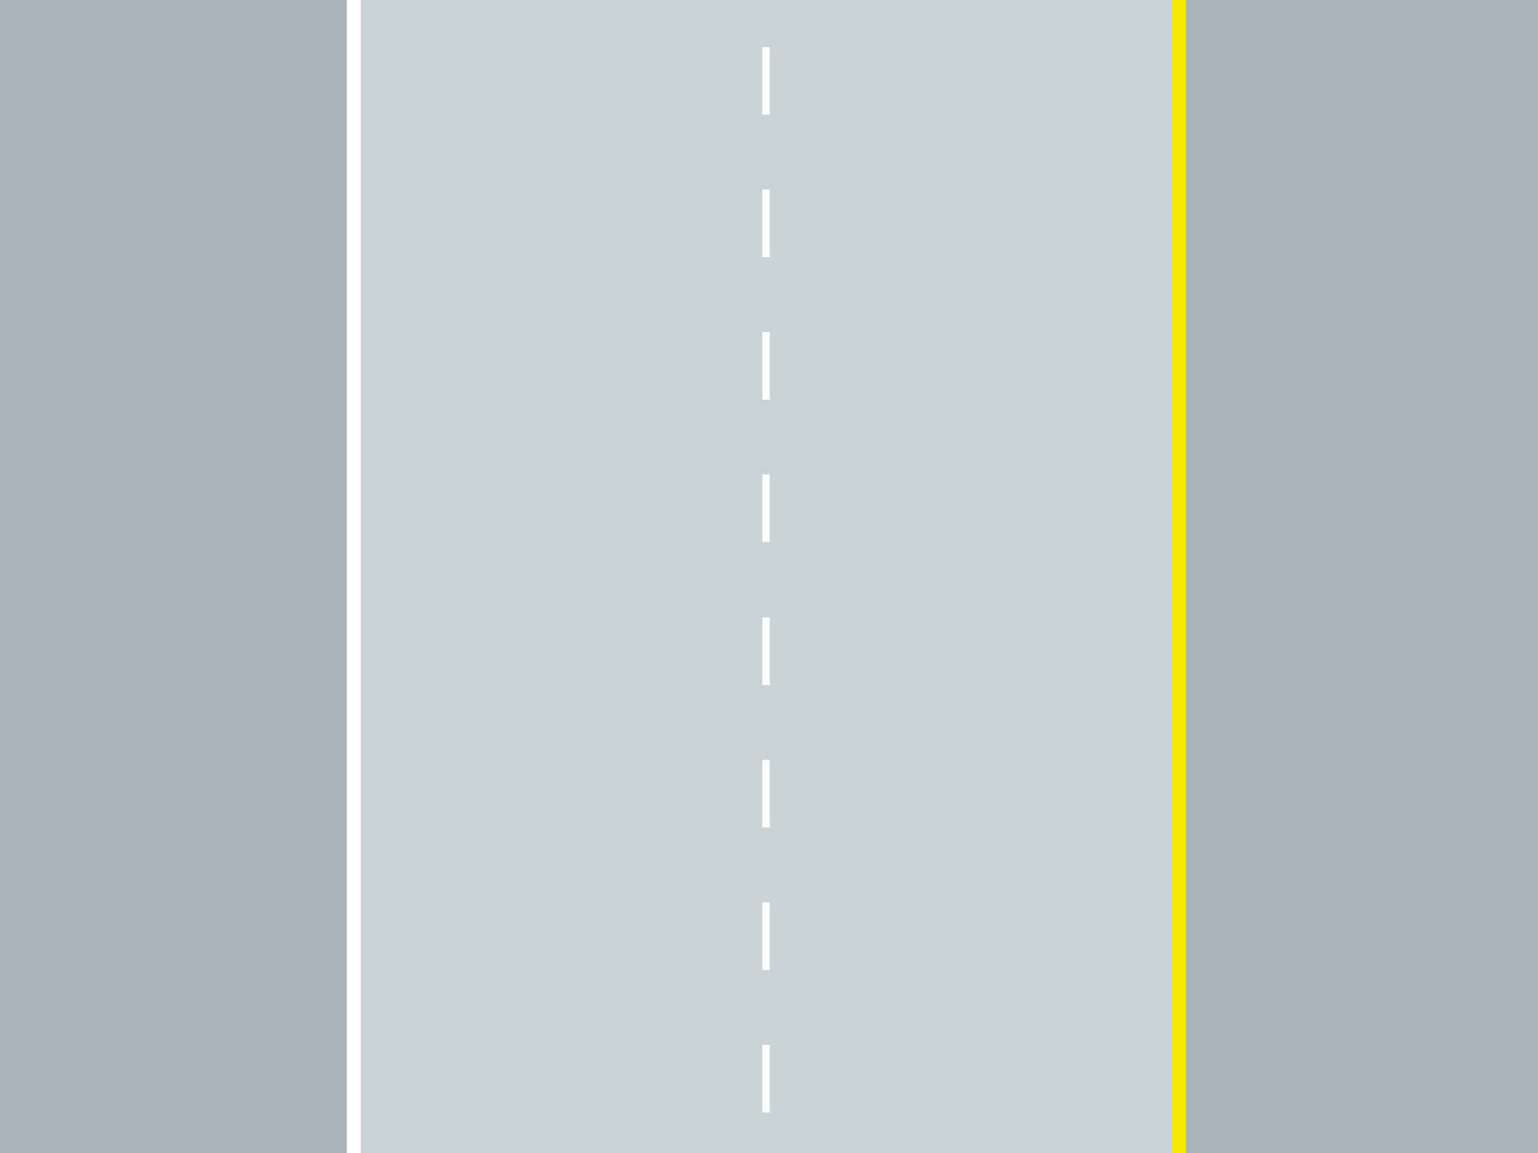


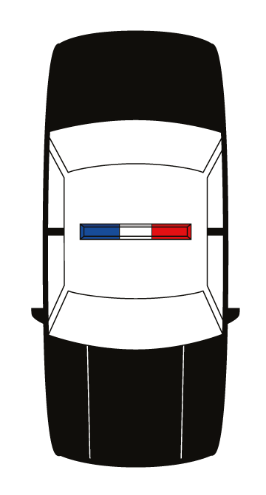
Notes:
Animation: Click forward to start the cone set up, which is a timed animation (only requires one click)
In this example, the skip lines are used to guide taper set up
Explain that for safety reasons, each time a cone is placed, the responder must return to the shoulder before walking to the next skip line
This methodology means that responders spend most of their time in the safety of the shoulder
If there are no skip lines, responders should lay out cones at a 10:1 radio - for every 10 paces, a cone is placed one additional pace over, starting with the first cone on the white line of the shoulder
A typical “pace” is equal to approximately 3 feet
For example, with 5 cones, using this method creates a taper that is approximately 120 feet long

Slide 47
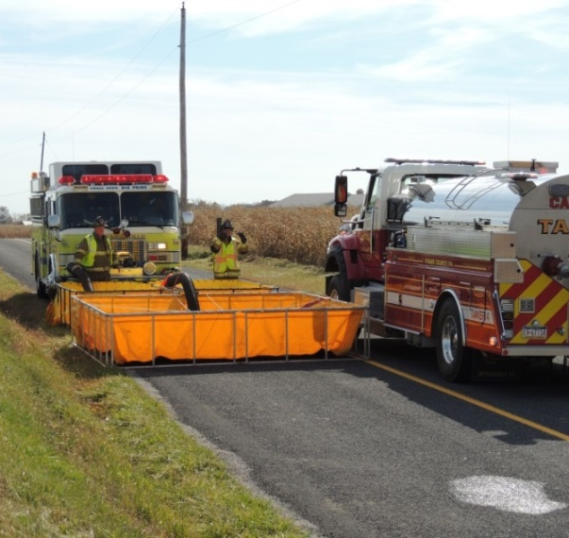
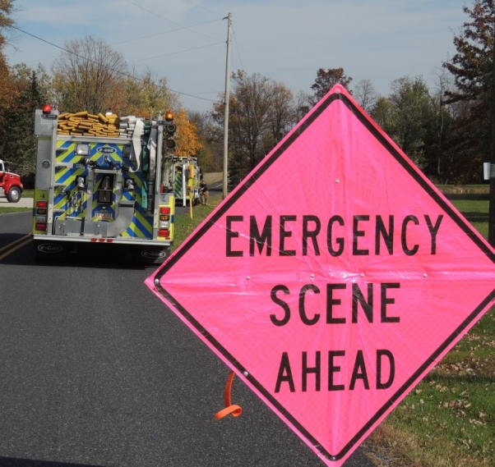
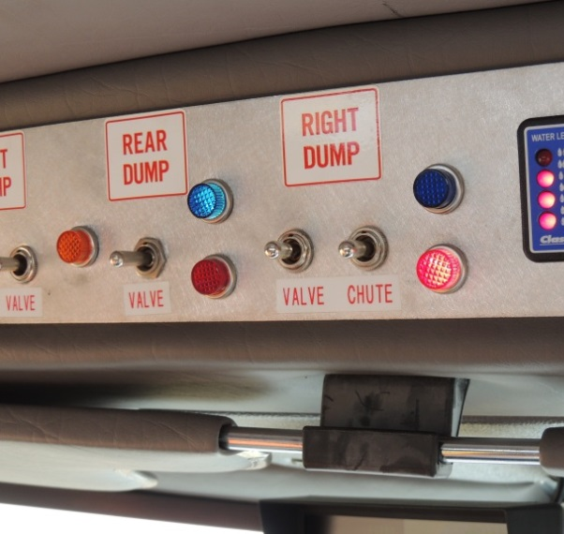
Tanker/Tender Operations
Policy on use of warning devices
Specialized water shuttle training

Slide 48
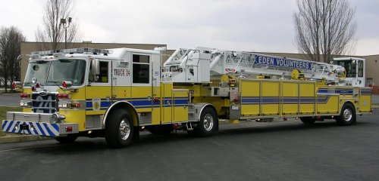
Tiller Operations
Increase in numbers
Specialized training
  Speed and relative speed
  Physical forces exaggerated
  Tiller steering should only occur when absolutely necessary to aid in vehicle operation and maneuvering
  Hand positioning for tiller operator is 8 and 4

