Slide 1
Module IX Vehicle Inspections and Maintenance
Goal
To have the participant understand and perform routine maintenance of their emergency vehicles and their role and responsibility in the process.
Notes:
Module Goal

Slide 2
Module IX Vehicle Inspections and Maintenance
Objectives
Explain the value and importance of regular vehicles inspections.
Identify the major component systems of an emergency vehicle.
Describe how to perform pre- and post-trip inspections.

Slide 3
Module IX Vehicle Inspections and Maintenance
Objectives (Cont’d)
List the three types of preventive maintenance.
Explain the role of the emergency vehicle driver in performing certain vehicle inspections and maintenance functions.
Describe the importance of keeping accurate and complete records.

Slide 4
Emergency Vehicle Components
Chassis
Body
Primary Function Components (task or mission)
Auxiliary Systems

Slide 5
Emergency Vehicle Components
Chassis
Frame
Suspension System
Steering and Braking Systems
Power Train Components

Slide 6
Emergency Vehicle Components
Body
Primary Function
Auxiliary Systems

Slide 7
Inspections
Post-Trip
Cleaning of Vehicle
Replacing Supplies
Inventory Equipment
Re-fueling and Checking Fluid Levels, If Justified
Report Any Unusual Occurrences or Malfunctions
PM Fill-In

Slide 8
Inspection Checklist
Pre-trip
Vehicle Overview
Check the Engine Compartment
Start Engine and Check Inside Cab
Check Headlights, Signal Lights, Warning Lights, and Audio Devices
Conduct Walk Around Inspection
Check Controls and Indicators
Check Brake System (air brakes)

Slide 9
PRE-TRIP INSPECTION
CHECKLIST
Notes:
New

Slide 10
Pre-Trip Inspection Checklist
Vehicle Overview
Look at general condition
Check windshield for damage and it is clean
Look for damage and whether the vehicle is leaning
Check under the vehicle for fresh oil, coolant, grease or fuel leaks
Review vehicle log
Notes:
New

Slide 11
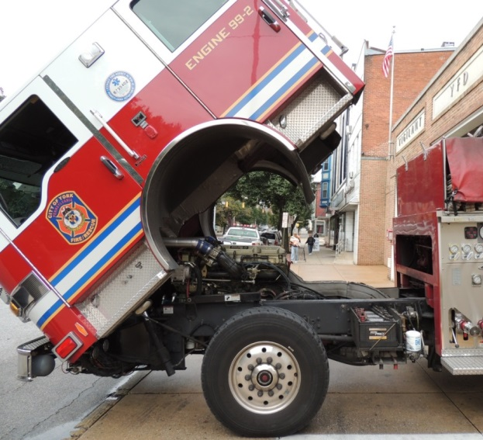
Pre-Trip Inspection Checklist
Check engine compartment
Verify parking brake is engaged
Check engine oil level
Coolant level and condition of hoses
Power steering fluid
Notes:
New

Slide 12
Pre-Trip Inspection Checklist
Check engine compartment (cont’d)
Windshield washer fluid
Belts for tightness and wear
Leaks in engine compartment
Battery fluid level and connections
Automatic transmission fluid level
Notes:
New

Slide 13
Pre-Trip Inspection Checklist
Start engine
Listen for noises
Verify gauges are within normal ranges
Check any warning lights and/or buzzers
Notes:
New

Slide 14
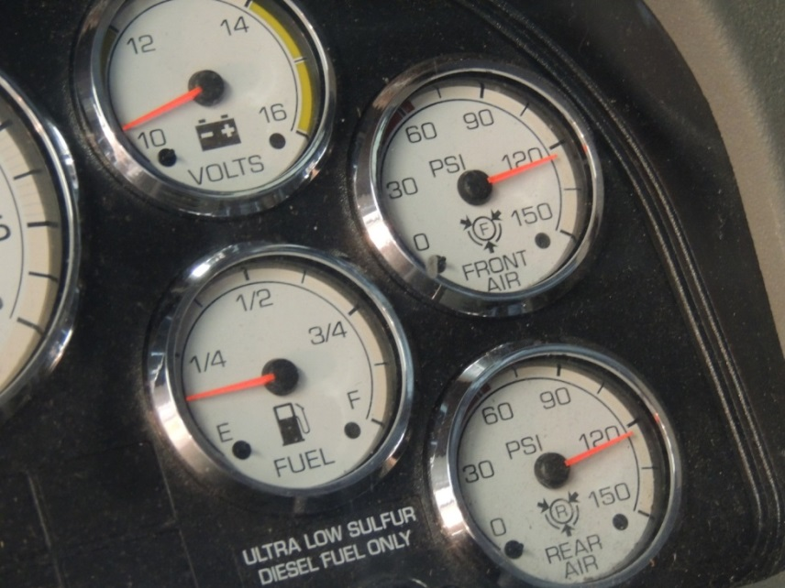
Pre-Trip Inspection Checklist
Check gauges & warning lights
Coolant temp. gauge
Voltmeter
Tachometer
Speedometer
Fuel level gauge
Transmission oil temp
Compound air pressure
Notes:
New

Slide 15
Pre-Trip Inspection Checklist
Check inside cab
Check operations of vehicle controls
Steering wheel
Accelerator
Brakes (parking, service, secondary braking system)
Transmission
Notes:
New

Slide 16
Pre-Trip Inspection Checklist
Check inside cab (Cont’d)
Check operations of vehicle controls (Cont’d)
Horn(s)
Windshield wiper/washer
Light switches and indicators
Mirrors
Seat adjustments/seatbelts
Notes:
New

Slide 17
Pre-Trip Inspection Checklist
Check headlights, signal lights, warning lights and audio devices
Running, parking and brake lights
Turn signals and four-way flashers
Headlights (low and high beams)
Warning lights
Work lights (front, rear, intersection, side and others)
Notes:
New

Slide 18
Pre-Trip Inspection Checklist
Conduct walk-around inspection
Left front wheel and tire for condition, tread and inflation and the left front suspension
Windshield, wipers, washer, front bumper and cleanliness of audio devices, lamps and reflectors
Right front wheel and tire for condition, tread and inflation and the right front suspension
Notes:
New

Slide 19
Pre-Trip Inspection Checklist
Conduct walk-around inspection (Cont’d)
Cab doors and closure, vehicle body, special body provisions such as pump panel, patient compartment door, equipment and storage compartments and doors
Right rear wheels and tires for condition, tread and inflation and the right rear suspension
Notes:
New

Slide 20
Pre-Trip Inspection Checklist
Conduct walk-around inspection (Cont’d)
Hose bed, rear patient compartment doors and other body features (specific to the vehicle being inspected), lamps and reflectors
Left rear wheel and tire for condition, tread and inflation and the left rear suspension and fuel fill
Notes:
New

Slide 21
Pre-Trip Inspection Checklist
Conduct walk-around inspection (Cont’d)
All compartments and cab doors, all closures, vehicle body
Operator’s position specific to the vehicle being inspected such as pump pane. capes, valves, drains and equipment
Notes:
New

Slide 22
Pre-Trip Inspection Checklist
Check controls and indicators at operator’s position or any other or any other special function, components, wherever located
Check engine controls and indicators, pump controls and indicators, pump panels lights and other controls specific to the vehicle being checked.
Notes:
New

Slide 23
Pre-Trip Inspection Checklist
Check brake system (air brakes)
Test low pressure warning signal
Check to ensure that spring brakes come on automatically
Check the rate of air pressure buildup
Test the air leakage rate
Test the parking brake
Test the service brake
Notes:
New

Slide 24
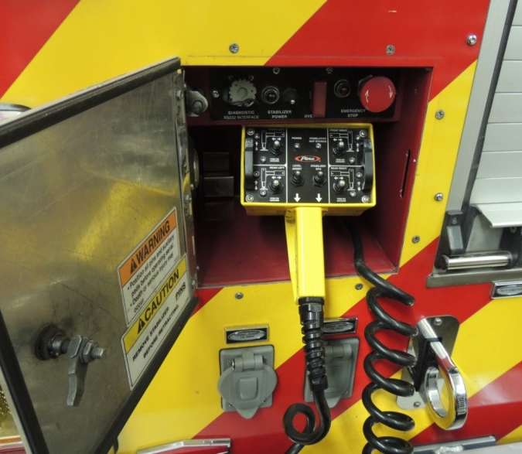
Pre-Trip Inspection Checklist
Fixed equipment
Cab lift controls
Ladder controls
Cable reels
Radio equipment
Other permanently affixed items
Notes:
New

Slide 25
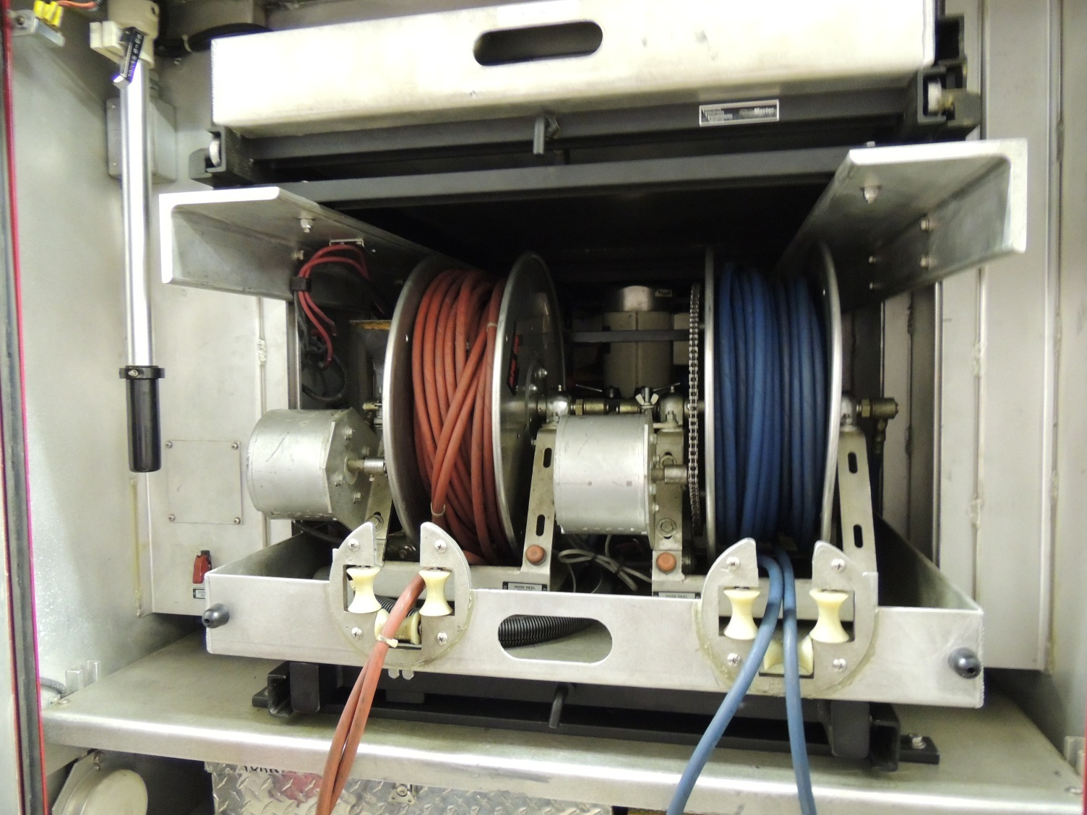
Fixed Equipment
Notes:
New

Slide 26
Practical Application
Time to get up and moving…
Provided a copy of vehicle checklist
Demonstrate vehicle check…
Notes:
New- Exercise

Slide 27
Preventive Maintenance Benefits
Safety
Costs
Operational Effectiveness
Liability
Basis for Purchasing Decisions

Slide 28
Types of Preventive Maintenance
Routine Maintenance
Scheduled Maintenance
Crisis Maintenance
PM Fill-In

Slide 29
Types of Preventive Maintenance
Routine
Fluid Level Checks
Wheels and Tires
Electrical Systems and Devices

Slide 30
Types of Preventive Maintenance
Scheduled
Manufacturer’s Recommended Schedule
Amount of Use (example: Regeneration Process)
Organizational Policy
Professional Standards

Slide 31
Types of Preventive Maintenance
Crisis
Classification A (immediate)
Classification B (as soon as possible)
Classification C (next P.M.)
PM Fill-In

Slide 32
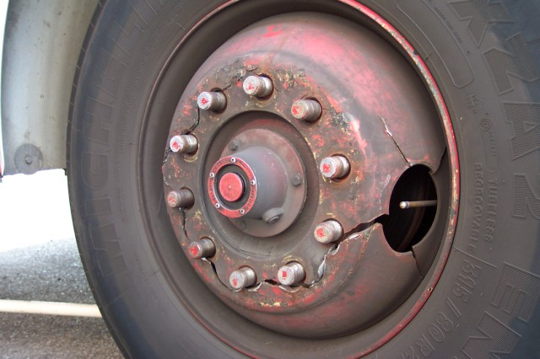

Slide 34
Role of the Emergency Vehicle Driver
Battery or Batteries
Braking System
Coolant System
Electrical System
Fuel
Hydraulic Fluids

Slide 35
Role of the Emergency Vehicle Driver
Lubrication
Oil (engine)
Tires
Steering System
Belts
Tools, Appliances, and Equipment

Slide 36
Role of the Emergency Vehicle Driver
Document the need for maintenance on the assigned vehicle
Verify that the requested and needed maintenance was performed
Follow established departmental guidelines for taking the vehicle out of service

Slide 37
NFPA 1911 Out of Service Criteria
A. Identify apparatus out of service
Sign on outside of door
Special bag that covers steering wheel
Large sign on driver’s window

Slide 38
NFPA 1911 Out of Service Criteria (Cont’d)
B. Identify components out of service
Distinctive color sign located on the inside of the driver’s door identifying which component
Highly visible device provided at the components control(s)

Slide 39
NFPA 1911 Out of Service Criteria (Cont’d)
C. Driving and Crew Area
Cracked or broken windshield
Missing or broken door latches
Seats without seatbelts, damaged seatbelts, or missing or broken buckles
Broken wipers or foot throttle

Slide 40
NFPA 1911 Out of Service Criteria (Cont’d)
D. Chassis, suspension driveline, wheels and axles
GAWR that exceeds manufacturer’s load rating for any tire
Weight that exceeds the GAWR for that axle
Actual overall weight that exceeds GVWR or GCWR

Slide 41
NFPA 1911 Out of Service Criteria (Cont’d)
D. Chassis, suspension driveline, wheels and axles
Tires with cuts to the cords
Front tires with less than 4/32 – inch tread or rear tires with less than 2/32 – inch tread at two adjacent major tread grooves anywhere on the tire
Wheels or rims damaged
Weld cracks

Slide 42
NFPA 1911 Out of Service Criteria (Cont’d)
E. Engine systems
Engines that won’t crank or start
Engines that are overheating
Leaking of fuel
Excessive leaking of oil
Oil that contains coolant
Oil that is diluted with fuel
Stop-engine light that fails to turn off

Slide 43
NFPA 1911 Out of Service Criteria (Cont’d)
F. Engine cooling system
Coolant system leak
Coolant that contains oil
Cooling system that exceeds max. operating temperature

Slide 44
NFPA 1911 Out of Service Criteria (Cont’d)
G. Transmission and clutch
Automatic transmission that overheats in any range
Automatic transmission that has a “do not shift” light on
Transmission components that are leaking transmission oil

Slide 45
NFPA 1911 Out of Service Criteria (Cont’d)
H. Low voltage and line voltage
electrical systems
Legally required lighting or horn not operational
Ignition system not operational
Charging system not operational
Failure of warning lights that creates any position around the apparatus from which no warning light is visible
Inoperative siren (OOS for emergency response)
Damaged receptacles or other observed shock hazards

Slide 46
NFPA 1911 Out of Service Criteria (Cont’d)
I. Braking Systems (Air)
Service brakes that have a air pressure drop of more than 2 psi in 1 min. or a straight chassis or more than 3 psi in 1 min. for a combination chassis, with the engine stopped and the service brake released.
Brakes that are out of adjustment
ABS warning indicator (light) activated

Slide 47
NFPA 1911 Out of Service Criteria (Cont’d)
I. Braking Systems (Air) (Cont’d)
Braking systems that are not operational
Air compressor that fails to build up pressure in accordance with manufacturer’s min. specifications
Air compressor failure to maintain 80 to 90 psi pressure in accordance with manufacturer’s min. specifications
Brake shoes or disk brake pads that have grease or oil on them

Slide 48
NFPA 1911 Out of Service Criteria (Cont’d)
I. Braking Systems (Air) (Cont’d)
Rotors and/or drums that are worn beyond manufacturer’s min. specifications
Brake linings or pads worn beyond manufacturer’s min. specifications
Air gauge or audio low-air warning device failure

Slide 49
NFPA 1911 Out of Service Criteria (Cont’d)
J. Braking Systems (Hydraulic)
Leaking brake fluid
Brake shoes or disc brake pads that have grease or oil on them
Braking systems not operational
Braking systems that do not meet tests or standards
ABS warning indicator (light) activated

Slide 50
NFPA 1911 Out of Service Criteria (Cont’d)
J. Braking Systems (Hydraulic) (Cont’d)
Parking (service brake) that does not meet tests or standards
Brake warning light that is activated or brake pedal that falls away or drifts toward floor when brake pressure is applied
Brake linings, pads, rotors, drums that do not meet manufacturer’s min. specifications
Rotors and/or drums that are worn beyond manufacturer’s min. specifications

Slide 51
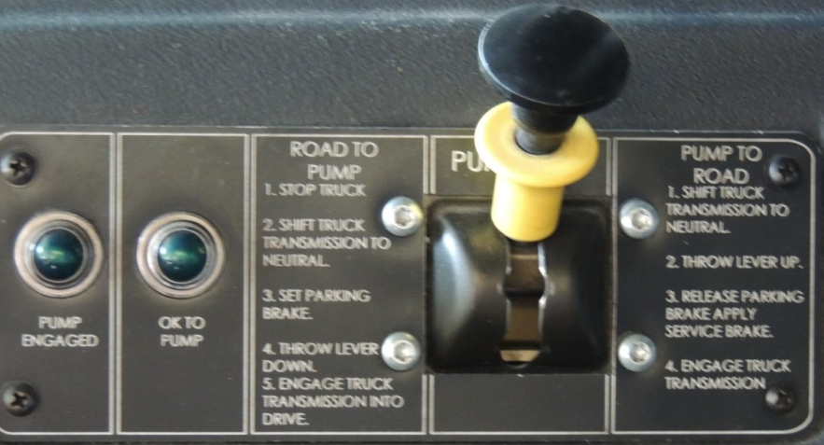
NFPA 1911 Out of Service Criteria (Cont’d)
K. Fire pump system
Pump will not engage
Pump shift indicator does not function properly
Pressure control system not operational
Pump transmission components have a leak

Slide 52
NFPA 1911 Out of Service Criteria (Cont’d)
K. Fire pump system (Cont’d)
Pump operator’s panel throttle is not operational
Pump operator’s engine speed advancement interlock is not operational

Slide 53
NFPA 1911 Out of Service Criteria (Cont’d)
L. Aerial device systems
Power takeoff (PTO) will not engage
Stabilizer system is not operational
Aerial device is not operational
Hydraulic system components are not operational
Cable sheaves that are not operational

Slide 54
NFPA 1911 Out of Service Criteria (Cont’d)
L. Aerial device systems
Cables are frayed
Base and section rails show ironing beyond recommendations
Aerial device is deformed
Torque box fasteners and turntable fasteners broken or missing

Slide 55
Recordkeeping
Maintenance Records
Operational Records

Slide 56
Practical Application
Review and discuss the departments out of service criteria and the process to document and report the defect.
Notes:
Explain the role of the driver in performing the vehicle check and the importance of keeping accurate and complete records. Review the forms required by the AHJ.

