Slide 1
Module X: Emergency Vehicle Competency Course
Goal
To provide emergency vehicle operators with the skills to safely and efficiently operate emergency vehicles.

Slide 2
Module X: Emergency Vehicle Competency Course
Objectives
Discuss the purpose of successfully completing a competency course as a component of an emergency vehicle driver training program.
List the specific skills associated with the competency course and their relationship to operating an emergency vehicle.

Slide 3
Module X: Emergency Vehicle Competency Course
Objectives (Cont’d)
Describe the importance of safe operations and specific safety precautions when participating on an emergency vehicle driver training competency course.
Explain the method of scoring for evaluating an emergency vehicle driver completing the competency course.

Slide 4
Purpose of Course Program
Assist in the training of a candidate driver
Qualify a candidate for the street and highway portion
Verify the competency of an existing driver
Examine the proficiency of an existing emergency vehicle driver

Slide 5
Performance Criteria
Comfortable seating position
Ease and convenience for reaching all essential vehicle controls
Proper hand position on the steering wheel
Careful vehicle control
Precise steering adjustments
Consistent vehicle speed
Proper adjustment & effective use of mirrors

Slide 6
Supplemental Over-The-Road Driving
Comply with NFPA 1002 and/or NHTSA’s National Standard Curriculum – Ambulance
Successfully complete competency
course first
Minimum of Ten (10) hours of street/highway driving

Slide 7
Emphasis on Safety
Dedicated safety officer
Driver briefing
All personnel identified and visible
Only personnel with assignment on course
Radio communications
Vehicle can be declared as unsafe
Malfunctions reported immediately

Slide 8
Emphasis on Safety
Only one vehicle on course at any time
Second person in cab of vehicle
All personnel seated and belted
No Food, Drink, or Smoking permitted
Maximum course speed – 15 mph
Operate with headlights on
Proceed only after being given signal

Slide 9
Competency Course
Station One Straight Line
Station Two* Confined Space Turn Around
Station Three* Alley Dock
Station Four* Serpentine
Station Five Offset Alley
Station Six Offset Backing/Parallel Parking
Station Seven* Diminishing Clearance
Station Eight Stop Sign
*NFPA 1002- Required

Slide 10
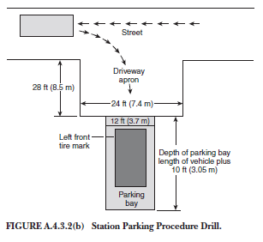
Optional Exercise
Alley Dock Exercise can be converted to a Station Parking (NFPA 1002)
Notes:
Optional Exercise offered in NFPA 1002

Slide 11
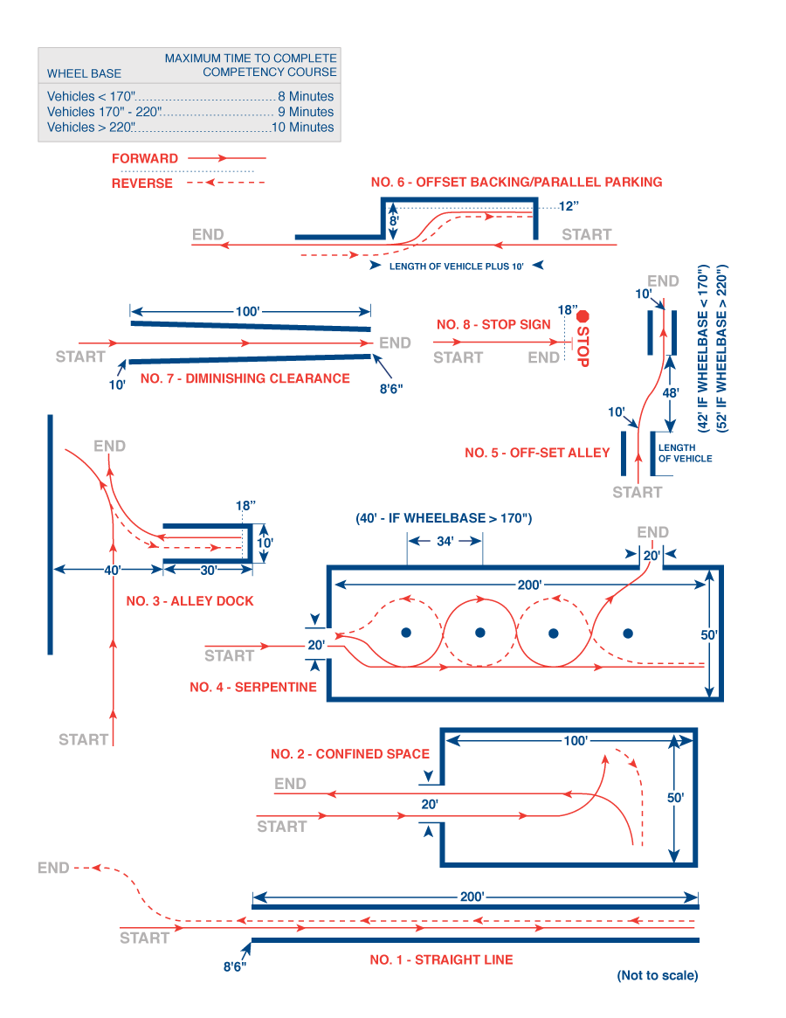

Slide 12
Scoring of Competency Course
Each cone brushed, moved, or
overturned 10 Points
Cross any line, each time crossed. 3 Points
Park 12” or more from the curb
(Offset Backing / Parallel Park) 3 Points
Stop 18” or more from or go past the
measured point 10 Points

Slide 13
Over-The-Road Evaluation
The instructor or AHJ shall conduct an over the road evaluation in the emergency and non-emergency mode.
Street and Highway Driving Evaluation Form- Non-Emergency
Street and Highway Driving Evaluation Form- Emergency

Slide 14
QUESTIONS
800-233-1957
www.vfis.com

