Slide 1
Module
II

Slide 2
Module II - The Problem
Goal
Identify the increasing seriousness of emergency vehicle collisions and the resulting impact upon all concerned. Emphasis is placed on the fact that emergency vehicle drivers are being criminally charged when a collision occurs which results from negligent driving on the part of the emergency vehicle driver and serious injury or death occurs to others involved in the collision.

Slide 3
Module II - The Problem
Objectives
Explain the common-sense approach of driving under all conditions within the context of laws governing emergency vehicle operations.
Describe the high incidence of collisions involving emergency vehicles and the associated deaths and injuries to emergency service personnel and members of the public.

Slide 4
Module II - The Problem
Objectives (Cont’d)
Describe the types, conditions, and causes of collisions involving emergency vehicles and their impact upon all concerned.
Identify and explain the factors that contribute to the incidence of collisions involving emergency vehicles.

Slide 5
Perspective
Serious Misconception
…to rely solely on laws governing emergency vehicle response will guarantee safe passage during emergency responses.

Slide 6
Fatality, Injury, Collision, and Near Miss Data
75% of EMS fatalities are transportation related
Estimated 10,000 ambulance-related collisions annually
Participant Manual
ACTIVITY

Slide 7
Ambulance Crash Fatalities
25% of ambulance-involved fatal crashes were EMS personnel or patients.
75% involve an occupant of another vehicle or non-occupant
Source: USFA

Slide 8
Ambulances - A Dangerous Environment
NHTSA Fatality Reporting System
  3,200 crashes per 100 million miles driven
  8X the rate of cars and light trucks
60% of crashes occurred during emergency response
58% of the fatalities occurred during emergency response
Source: FEMA:FA272

Slide 9
Ambulance Crash Summary
Auto Collisions:
  Ambulances: Intersection Incidents
Auto Liability:
  Ambulances: Intersection Incidents
Source: VFIS

Slide 10
Impacts of Vehicle Collisions
Personal Injury or Death to Emergency Responders
Peripheral Injury or Death to Others
Vehicle and Equipment Loss
Long Term Impact
Participant Manual
ACTIVITY

Slide 11
Adverse Effect
Psychological Effects
Loss of Experienced Personnel
Stress of Criminal or Civil Litigation
Financial Impacts
Failure to Deliver Emergency Services
Poor Public Image
Participant Manual
ACTIVITY

Slide 12
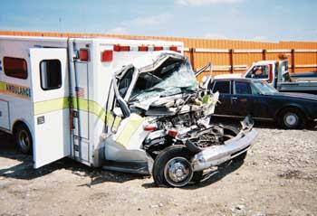
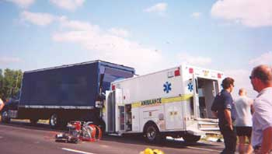
Case Study 1
Type III Ambulance – Inter-facility Transport
Career Fire Fighter/Emergency Medical Technician Dies and Paramedic is Injured in a Three-Vehicle Collision – Nebraska
A summary of NIOSH Investigation:
F2003-33 Date Released: May 31, 2005

Slide 13
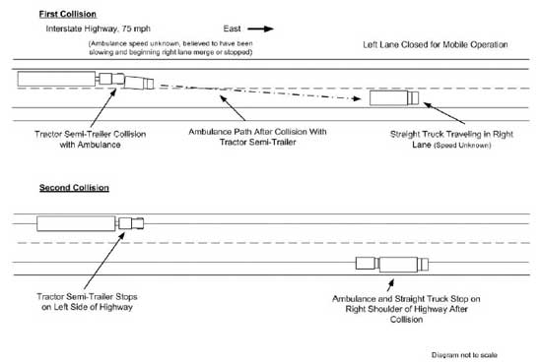
Case Study 1

Slide 14
Contributing Factors
Ensure that EMS workers use the patient compartment vehicle occupant restraints whenever possible
Consider using shoulder straps with occupant restraints on patient cots to limit the movement of the patient from the cot during a vehicle crash.
Develop and evaluate occupant protection systems designed to provide crash protection for EMS workers and the mobility necessary to access patients and equipment within ambulance patient compartments

Slide 15
Recommendations
Departments should provide defensive driver training to all emergency vehicle operators.
Departments should ensure that all drivers are trained and certified in emergency vehicle operations.
Departments should develop standard operating procedures (SOPs) for responding to, or returning from, an alarm and monitor to ensure their use.
Departments should ensure that the load carrying capacity of all apparatus is equal to, or less than, the Gross Vehicle Weight Rating (GVWR).

Slide 16
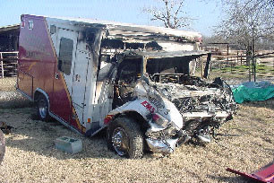
Case Study 2
Type III Ambulance – Emergency Response
Career Fire Fighter/Emergency Medical Technician Dies In
Ambulance Crash – Texas
A summary of NIOSH Investigation:
F2003-05 Date Released: October 29, 2003

Slide 17
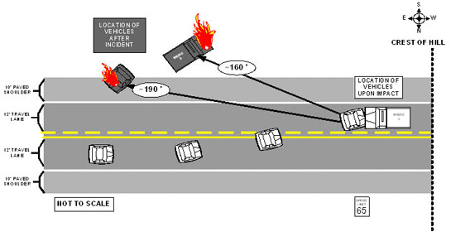
Case Study 2

Slide 18
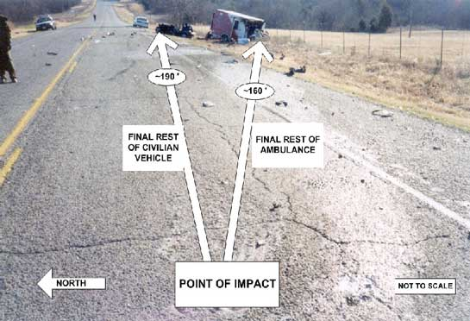
Case Study 2

Slide 19
Recommendations
Departments should provide defensive driver training to all emergency vehicle operators.
Departments should ensure that all drivers are trained and certified in emergency vehicle operations.
Departments should develop standard operating procedures (SOPs) for responding to, or returning from, an alarm and monitor to ensure their use.
Departments should ensure that the load carrying capacity of all apparatus is equal to, or less than, the Gross Vehicle Weight Rating (GVWR).

Slide 20
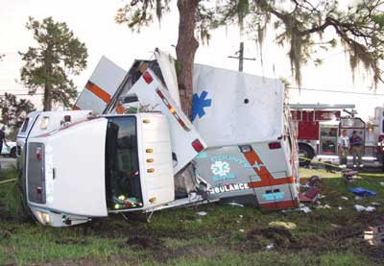
Case Study 3
Type I Ambulance – Non-Emergency Transport
Career Fire Fighter/EMT Dies in Ambulance Crash – Florida
A summary of NIOSH Investigation:
F2005-12 Date Released: May 12, 2006

Slide 21
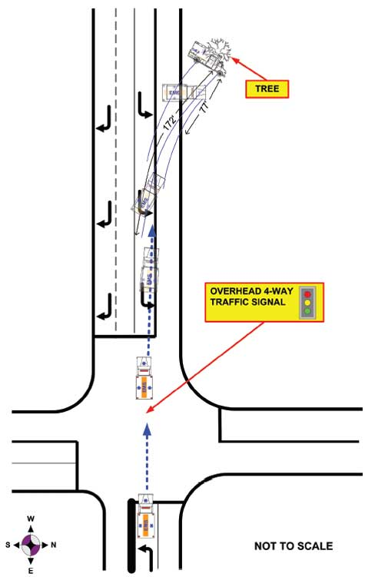

Slide 22
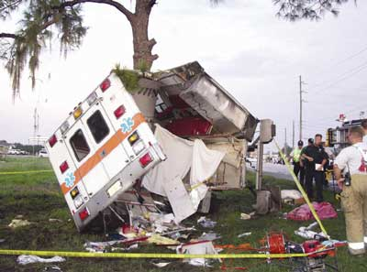
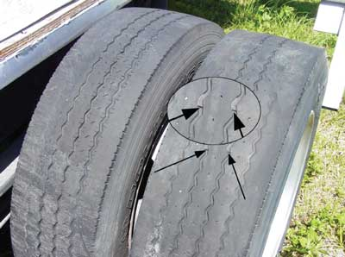
Case Study 3

Slide 23
Recommendations
EMS and fire departments should replace worn tires as part of the apparatus maintenance program
EMS and fire departments should ensure that drivers operate emergency vehicles at speeds appropriate for the conditions to prevent hydroplaning and loss of vehicle control
EMS and fire departments should ensure that drivers receive driver training at least twice a year

Slide 24
Recommendations
Ambulance manufacturers, researchers, and standard setting bodies should continue to improve vehicle safety standards and designs for increased crash worthiness of ambulance patient compartments for occupant survivability

Slide 25
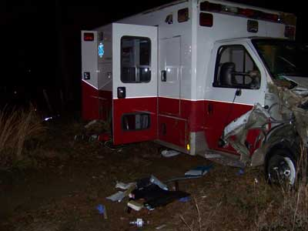
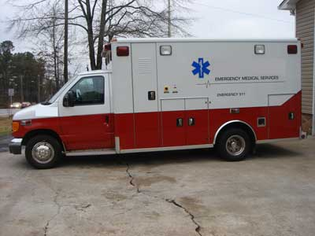
Case Study 4
Career Fire Fighter/Paramedic Dies 2 Days After Being Ejected
During an Ambulance Rollover Incident – Georgia
A summary of NIOSH Investigation:
F2009-30 Date Released: July 2, 2010

Slide 26
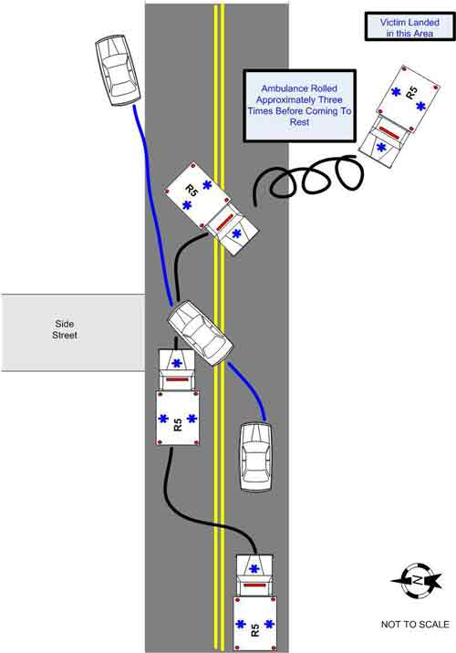

Slide 27
Contributing Factors
Failure of the motorist to yield the right-of-way to an approaching emergency vehicle with audible and visual signals in use
Ejection of the victim
Blunt force trauma resulting in multiple rib fractures
The victim’s underlying medical conditions

Slide 28
Recommendations
States and authorities having jurisdiction should take steps to ensure that motorists are aware of, understand, and follow state traffic codes/laws pertaining to yielding the right-of-way to approaching, authorized emergency vehicles using audible and visual signals
Organizations should take steps to ensure that seat belts are properly worn at all times

Slide 29
Recommendations
Additionally, governing municipalities (federal, state, regional, and local) should:
  Consider enacting legislation to include drivers and occupants of emergency vehicles in existing seat belt legislation and/or repeal existing laws that exempt drivers and occupants of emergency service vehicles from mandatory seat belt use.

Slide 30
Summary of Recommendations
Standard operating procedures
  Response Classifications
  Seatbelts
  Qualifications for drivers
Emergency vehicle operator training and ongoing competency training
Regular vehicle inspections and maintenance
Promote institutional safety culture

Slide 31
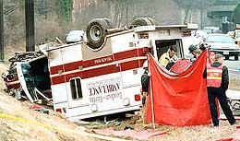
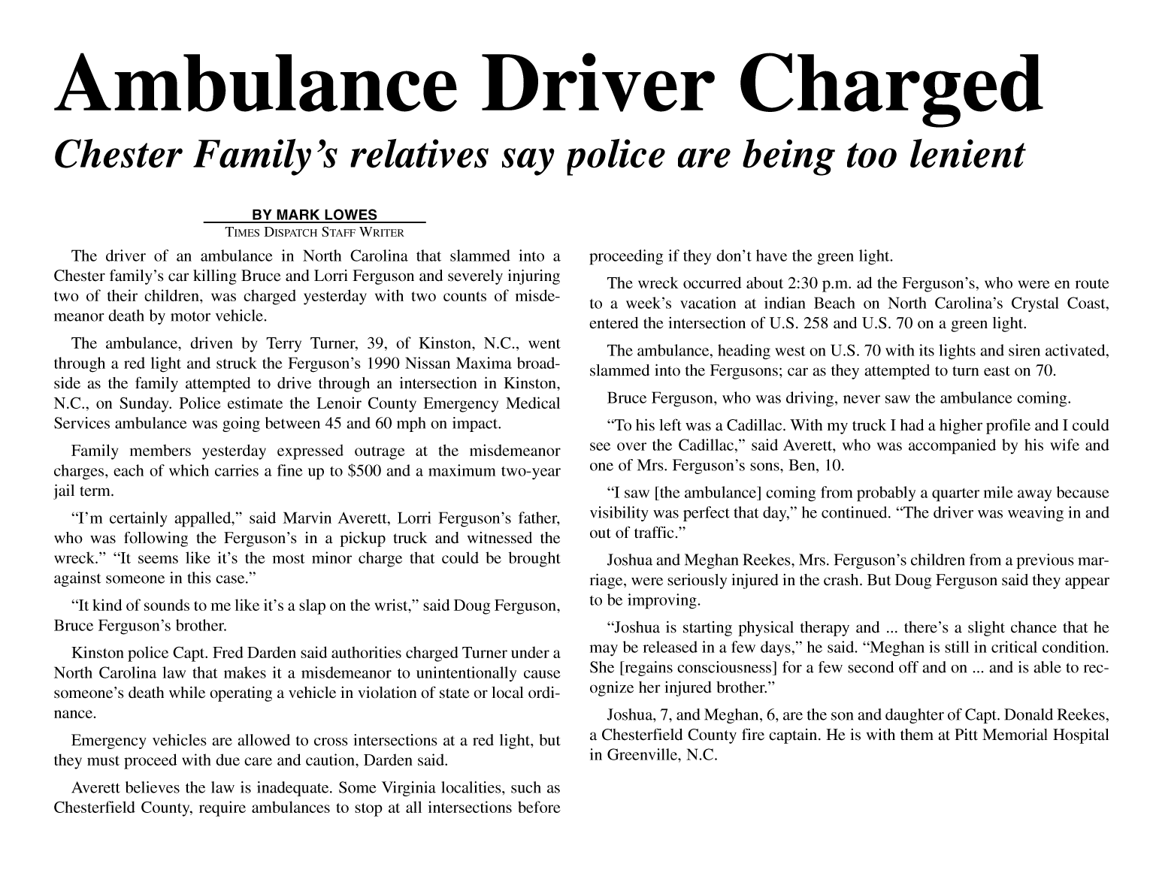
Criminalization of Emergency Service Personnel
California
Ohio
Texas
Georgia

