Slide 1
Module
III

Slide 2
Module III - The Driver
Goal
Understand that the first, and possibly the most important, step in emergency vehicle driver training is the effective selection of drivers. The various components of driver physical and mental well being are recognized. Recognize the necessity of certification, and recertification of driving skills.

Slide 3
Module III - The Driver
Objectives
Explain why personnel selection is critical in developing an effective emergency vehicle driver program.
Identify the numerous human aspects of the emergency vehicle driver selection process and explain their significance.
List the abilities necessary for driving emergency vehicles which must be acquired.

Slide 4
Module III - The Driver
Objectives (continued)
Explain the importance of maintaining accurate and complete personnel records both for the protection of the emergency service organization and the individual emergency vehicle driver.
Identify the importance of maintaining emergency vehicle driving proficiency through an on-going re-certification program.

Slide 5
Importance of Driver Qualification
Human Aspects
Acquired Abilities
Personnel Files
Driver Recertification

Slide 6

Other Aspects
Aggressive Driving
Age, Maturity and Health
Habits

Slide 7
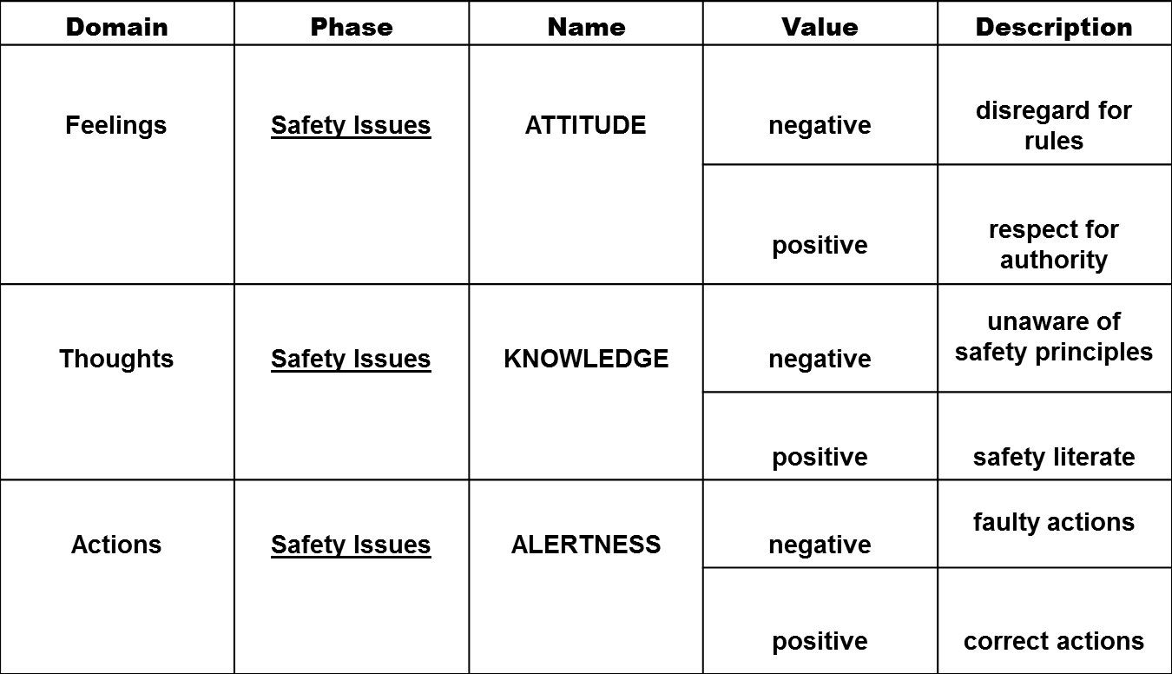
How We Value Safety Issues

Slide 8

Self-Control

Slide 9
Aggressive Driving
Over 9 million crashes annually
  Significant % caused by aggressive driving
Perhaps the biggest reason?
  Denying the need to improve
How do we rate ourselves?
67% rate ourselves as an excellent driver
  A “9 or 10” on a scale of 1-10
Know your drivers
Participant Manual
ACTIVITY

Slide 10
Driver Readiness
Age
Fatigue
  Sleep Deprivation
  Scheduling
Health
  Medication
  Alcohol
Mental Health

Slide 11
Acquired Abilities
Driver’s License
State and Local Laws
Driving Skills / Characteristics
Defensive Driving Techniques

Slide 12
Defensive Driving Techniques
Space Management
Following Distance and Rate of Closure
Hazard Identification
Correct Braking Techniques
Speed Management
Rollover Prevention

Slide 13
Personnel Files
Training Records
Physical Capability
Driving Record
Driver Training
Driving Log
Suspected Substance Abuse

Slide 14
Driver Requalification
Actual Emergency Vehicle Driving Experience
Observed Proficiency
Time Since Last Re-certification
Introduction of New Vehicles
Introduction of New Technology

