Slide 1
Module
VIII

Slide 2
Module VIII - Emergency Vehicle Operations / Safety
Goal
The goal is to have the participant appreciate the necessity of being prepared to drive emergency vehicles. Understanding the need to be mentally and physically prepared to avoid situations that may adversely affect emergency vehicle operations, implement best practices in safety, and develop defensive driving techniques to avoid or reduce the consequences of vehicle collisions.

Slide 3
Module VIII - Emergency Vehicle Operations / Safety
Objectives
Describe both the physical and mental impact of motivation.
Explain the link between motivation and positive changes in individual behavior.

Slide 4
Module VIII - Emergency Vehicle Operations / Safety
Objectives (Cont’d)
Outline the actions that must be completed prior to operating an emergency vehicle.
Recognize that emergency response driving is a complex process involving many factors, tasks, and maneuvers.

Slide 5

Motivation Exercises

Slide 6
Motivation
Routine
Comfort
Confidence

Slide 7
Defensive Driving Goals
To maintain the highest level of safety possible.
To be prepared for unexpected situations and conditions which can adversely affect emergency vehicle operation.
To avoid, through effective training and applied practice, unnecessary legal consequences.

Slide 8
Skid Avoidance
The ability to maintain control of the vehicle utilizing defensive driving skills, vehicle controls and to take in account existing road and traffic conditions. These aspects must be coordinated with good handling skills that demonstrate that the driver is capable of detecting, preventing and making a correction that prevents a skid/crash.

Slide 9
Actions That May Result In Lost Control
Driving too fast for weather, road or tire conditions
Accelerating too hard
Braking inappropriately
Changing direction too abruptly
Tracking a curve at too high a rate of speed

Slide 10
Preparing to Drive
Route Planning
Driver Readiness
Effective Start-Up Procedures

Slide 11
Preparing to Drive
Route Planning
Maximize Response Efficiency
Minimize Collision Exposure
Enabling the Emergency Vehicle Driver to Focus on Actual Driving Tasks
Avoiding Environmental and Construction Hazards

Slide 12
Preparing to Drive
Driver Readiness
Fatigue
Health
Personal Problems

Slide 13
Preparing to Drive
Effective Start-Up Procedures
Circle of Safety Inspection
Adjustment of Cab Features
Wearing of Occupant Restraints
Receive Signal Before Moving

Slide 14
If another driver fails to give you the right of way…
YOU CAN NOT FORCE IT!
YOU CAN NOT ASSUME IT!
YOU DO NOT HAVE IT!

Slide 15
Emergency Response Driving
Predicting the predictable
Expect the unexpected
Be prepared for unexpected problems

Slide 16
Emergency Response Driving
SIPDE System
Scan
Identify
Predict
Decide
Execute

Slide 17
Emergency Response Driving
Five Visual Habits
Aim High in Steering
Get the Big Picture
Keep Eyes Moving, Scan
Make Sure the Other Drivers See the Emergency vehicle
Identify an Escape Route
Participant Manual
ACTIVITY

Slide 18
Identify Distracted Drivers
Vehicles that may drift over the lane divider or within their own lane
Vehicles traveling at inconsistent speeds
Drivers who are preoccupied with maps, food, cell phones or other technology
Drivers who appear to be involved in conversation with their passenger

Slide 19
Use of Emergency Lights and Siren
Signal two basic concepts:
They notify other drivers that an approaching emergency vehicle is operating in an emergency mode.
They request other drivers to yield the right of way to the emergency vehicle in accordance with state and/or local law.

Slide 20
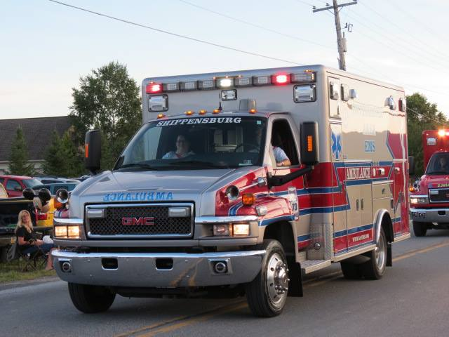
Make Sure You Are Seen And Heard.
Lights
Sirens
Horns

Slide 21
Use of Emergency Lights and Siren
RED - Emergency vehicle
(Fire/EMS) Stop! May also attract
BLUE - Emergency vehicle
(Law enforcement)
AMBER - Danger/Caution
Excellent for rear of vehicle
CLEAR
Good visibility shut off at scene

Slide 22
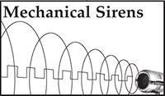
Sirens
A mechanical siren produces a spiraling square wave, thus offering a very strong and focused pattern.
Source: Timberwolf Sirens

Slide 23
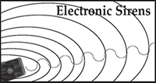
Sirens
Electronic sirens are notorious for having dead spots and creating noise pollution without direct sound penetration making them less effective.
Source: Timberwolf Sirens

Slide 24

“Sirencide”
300 Feet 40 MPH
12 Feet 60 MPH

Slide 25
Use of Emergency Lights and Siren
Procedures for Use of Siren
Use When Responding to an Emergency
Change to Yelp Mode at Least 200’ from Intersection
High-low Mode is Least Effective
Use Another Audible Device to Alert Drivers Who Fail to Hear Siren

Slide 26
Automated Traffic Control Systems
Assist in clearing traffic from an intersection
Annual refresher training in accordance with NFPA 1451
Proceed with caution
Do not assume these systems will give you a green light

Slide 27
Emergency Dispatch Protocols
Agencies usually have defined response guidelines for the emergency vehicle operator to follow. These may include light & siren usage, response speeds, number of vehicles and other locally specific policies.

Slide 28
Emergency Medical Dispatch
Consider relevant standards for emergency medical dispatch
Coordinate with dispatch personnel to understand and implement emergency dispatch protocols

Slide 29
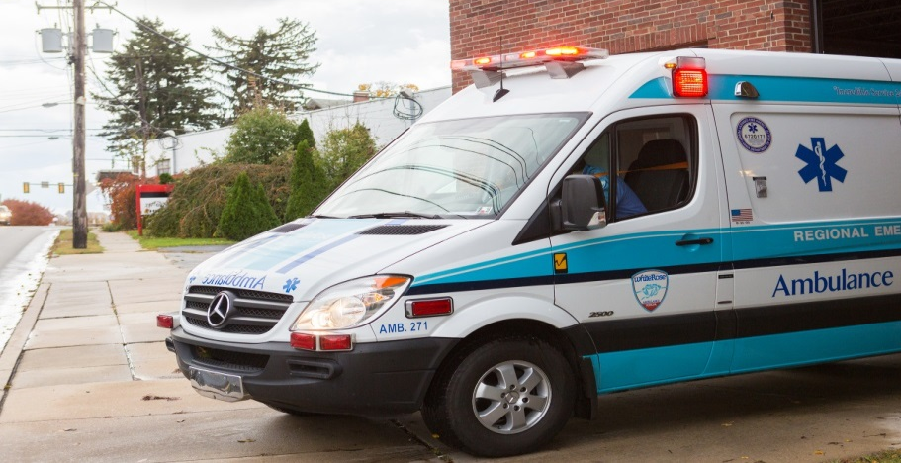
Emergency Dispatch Protocol Example
CAD Entry: Emergency
Smoke or fire in building
Outside fire with exposure
Gas leak inside building
Haz-Mat Release with persons in distress
Critical Medical Incident
Entrapment

Slide 30
Emergency Dispatch Protocol Example
CAD Entry: Non-Emergency
Automatic Fire Alarm- no human report of fire or smoke
Residential Smoke Alarm Sounding- no indication of fire
Odor report- no symptoms or persons in distress
Outside fire with no exposure
Outside gas leak
Electrical wires arcing
Haz-Mat (incl. CO) release- no report of persons in distress
Water leak

Slide 31
Space Management
Establishing a cushion of safety on all sides of an emergency vehicle is essential to safe operation.

Slide 32
Space Management
Blind Spots Alongside
Overhead Clearance
Ground Clearance
Bridges
Traffic Closure from Behind

Slide 33
Defensive Driving
Following Distance
4 Second Rule at 40 mph or less; 5 Second Rule Above 40 mph
Rate of Closure
Blind Spots Alongside
Overhead Clearance
Ground Clearance
Bridges
Traffic Closure from Behind

Slide 34
Rate of Closure-Yielding
Vehicle Speed Outruns Siren’s Effectiveness
Blocked Field of View
Misinterpretation of Direction of Siren Sound
Hearing Impaired Drivers
Inattentive Drivers
Drivers Distracted by Loud Music, Cellular Phone, Kids, Stress, Road Rage
Aggressive Driving

Slide 35
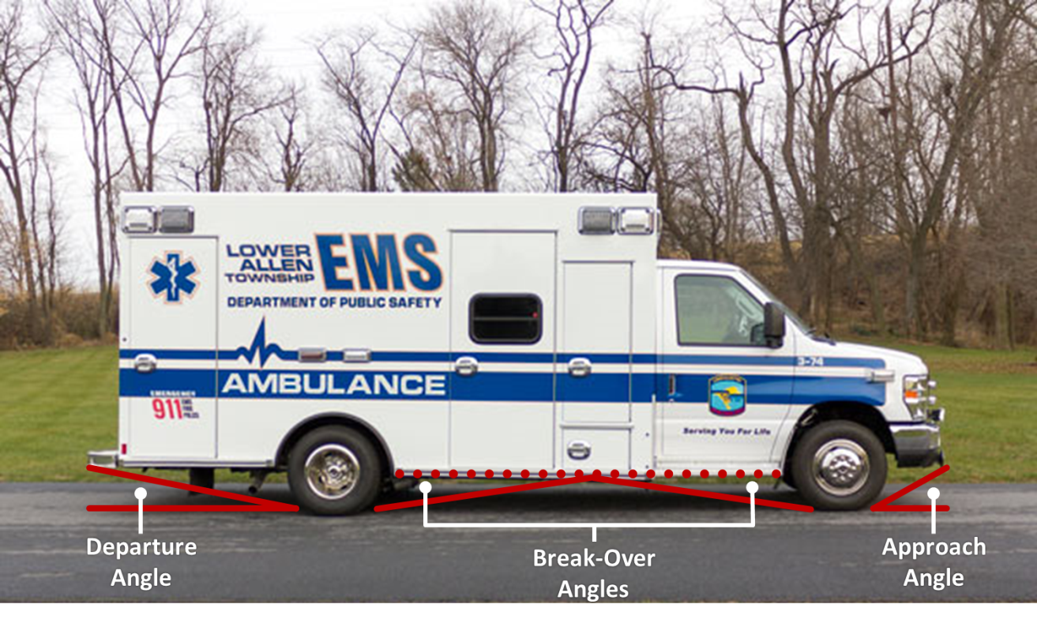
Elevation Angle Limitations

Slide 36
Bridges
Many potential hazards exits on bridges both for drivers and also for workers attempting to make repairs or structural improvements. The exact hazards can vary greatly based on age, locations, limitations, load bearing capacity and weather conditions.

Slide 37
Bridges – Strong Winds
Strong winds create a problem called “buffeting”. These conditions occur on bridges such as Bay Bridges, through mountain passes and ravines, and when being passed by large trucks. These wind gusts and blasts can cause total loss of vehicle control.

Slide 38
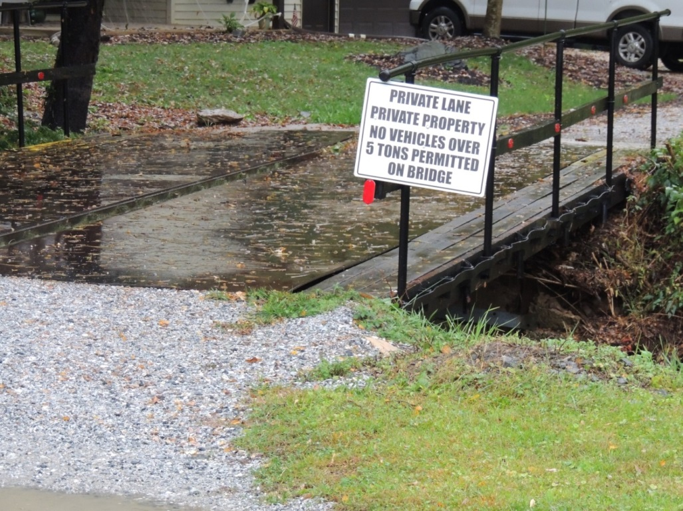
Bridge Limitations - Weight

Slide 39
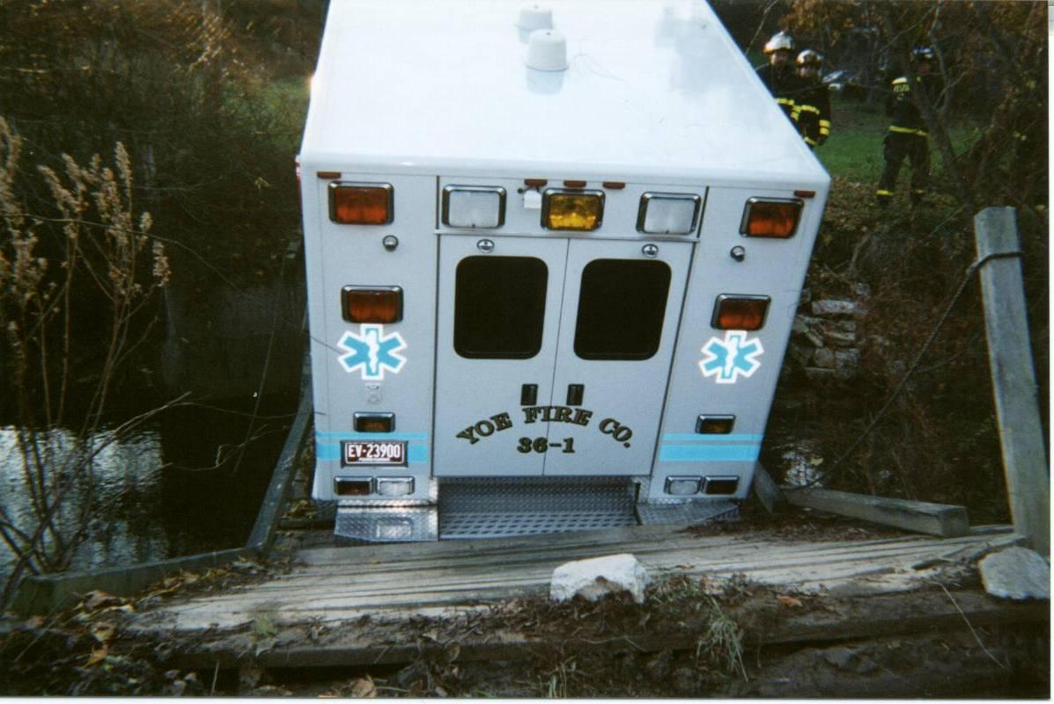
Be Aware of Weight Limits

Slide 40
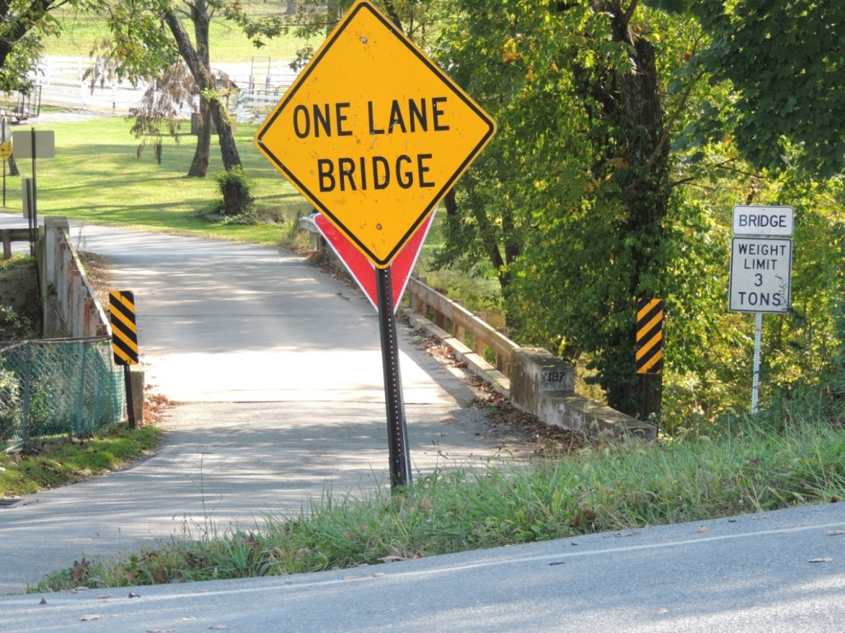
Bridge Limitations – Width

Slide 41
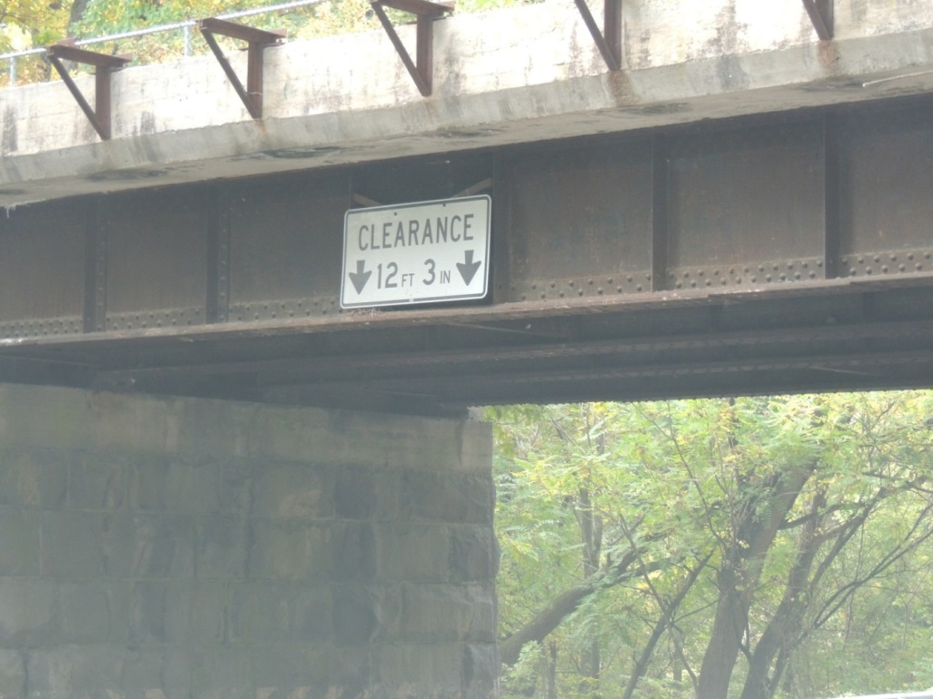
Bridges Limitations – Height

Slide 42
Speed Management
Four important rules:
Emergency vehicles must not be driven in excess of the posted speed limits
Emergency vehicles must not exceed cautionary speeds
Patient Experience
Match speed to road conditions
Participant Manual
ACTIVITY

Slide 43
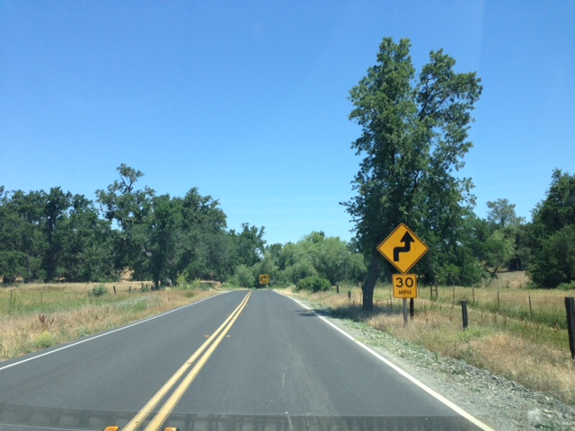
Cautionary Speeds
Example:
Speed limitations around curves
Posted restrictions going downhill
Slower speeds on highway ramps, especially cloverleaf design
Special speed zones such as schools; hospitals; recreation areas; construction; etc.

Slide 44
Basic Maneuvers
Steering
Use Both Hands
Keep Arms Inside of Vehicle
Maintain Hands in “3” and “9” Position

Slide 45
Basic Maneuvers
Braking and Stopping
Hydraulic – Pump brake pedal
Air – Firmly and steadily press brake pedal, release if wheels lock
ABS – Apply firmly and hold down for duration
Disc vs. Drum - Differences

Slide 46
Auxiliary Braking Systems
Warning
Do not use the retarders/engine brakes during inclement weather or when the road surfaces are slippery. Using these systems could result in loss of control of the vehicle

Slide 47
Total Stopping Distance
Perception Time/Distance
Reaction Time/Distance
Vehicle Reaction Time/Distance
Vehicle Braking Distance
Participant Manual
ACTIVITY

Slide 48
Perception Time/Distance
The distance the vehicle travels from the time your eyes see a hazard until your brain recognizes it. Normal time for an alert driver is approximately ¾ of a second.

Slide 49
Reaction Time/Distance
The distance traveled from the time your brain tells your foot to move from the accelerator until the time your foot pushes the brake pedal.

Slide 50
Vehicle Reaction Time/Distance
Once the brake pedal is applied the vehicle reaction time will depend on the type and condition of the braking system.

Slide 51
Vehicle Braking Distance
The distance it takes the vehicle to come to complete stop once you apply the brakes.

Slide 52
Stopping Distance Factors
Drivers reaction time
Weather and road conditions
Road surfaces
Vehicle weight
Brake conditions
Tire conditions
Speed

Slide 53
Rules of Thumb
Average reaction time is ¾ second
You can not steer or brake a vehicle unless you have traction
Wet roads double the stopping distance
When you double your speed it takes four times as much distance to stop your vehicle

Slide 54
Air Brakes
Brake-lag = Added Delay
Add ½ second or more to stopping distance

Slide 55
Brake Fade
Excessive heat
Gas build up
Reduced friction

Slide 56
Snub Braking
Low gear
Identify “safe” speed
Apply brakes firmly for 3 seconds
Release and coast to “safe” speed
Repeat until downgrade is complete

Slide 57
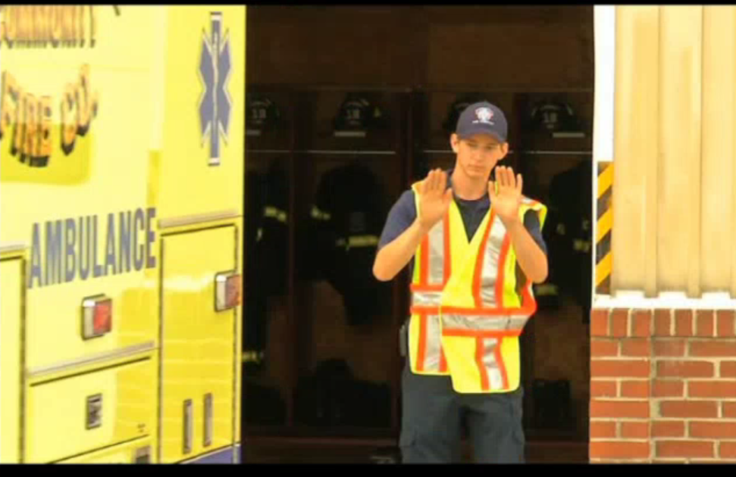
Basic Maneuvers
Backing Up
Park Intelligently
Give Audible Notice
Use a Spotter
Understand Signals
Use Side Mirrors
Check Front Corners
Maintain Speed Control

Slide 58
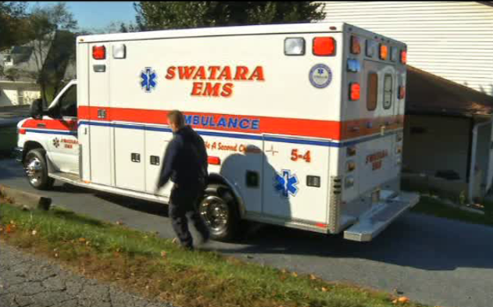
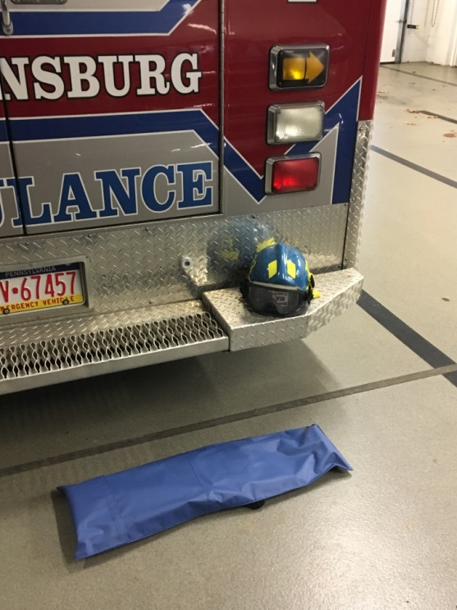
Circle of Safety or Spotter

Slide 59
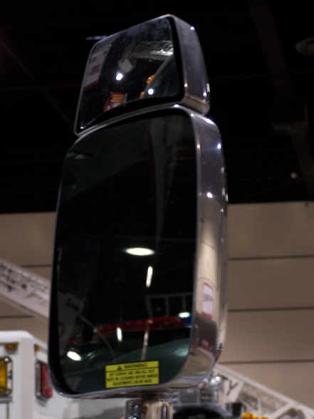
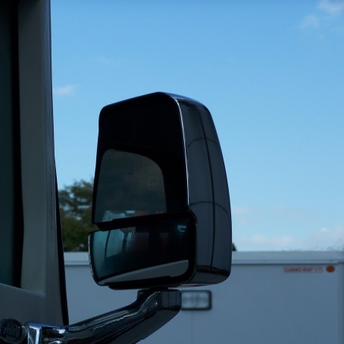
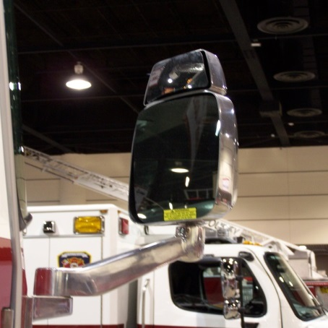
Mirrors

