Slide 1
Basic Maneuvers
Lane Changing
  Plan Ahead
  Signal Intention
  Practice Space Management
  Make the Change of Lanes Smoothly

Slide 2
Basic Maneuvers
Turning
  Always Signal Before Turning
  Whenever Possible Turn from One Proper Lane into Another Proper Lane

Slide 3
Basic Maneuvers
Passing
  Check Traffic Both Ahead and Behind
  Check Sides and Double Check Blind Spots
  Signal Before Initiating Pass
  Accelerate While Changing Lanes
  Signal Before Returning to the Driving Lane
  Check Mirror Before Returning to the Driving Lane
  Cancel Directional Signal
  Resume Speed

Slide 4
Basic Maneuvers
Negotiating Intersections
  Scan for Possible Hazards
  Slow Down
  Change Siren Cadence
  Check Options and Avoid Opposing Lane
  Come to a Complete Stop (controlled intersection)
  Establish Eye Contact
  Proceed One Lane at a Time

Slide 5
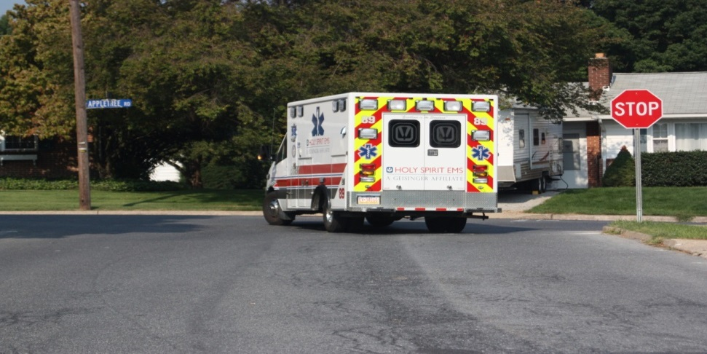
Intersections
Controlled
Uncontrolled
Pre-Emption

Slide 6
Basic Maneuvers
Account for traffic one lane of traffic at a time, treating each lane of traffic as a separate intersection.

Slide 7
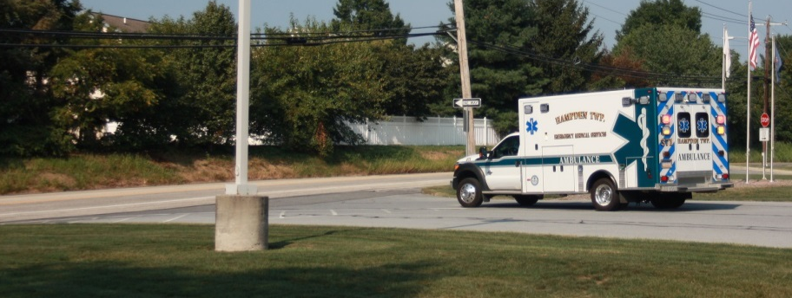
Uncontrolled Intersection
Scan for possible hazards
Begin to slow well before reaching intersection and cover the brake pedal
Change siren cadence not less than 200’ before intersection
Avoid using opposing lane of traffic if at all possible

Slide 8
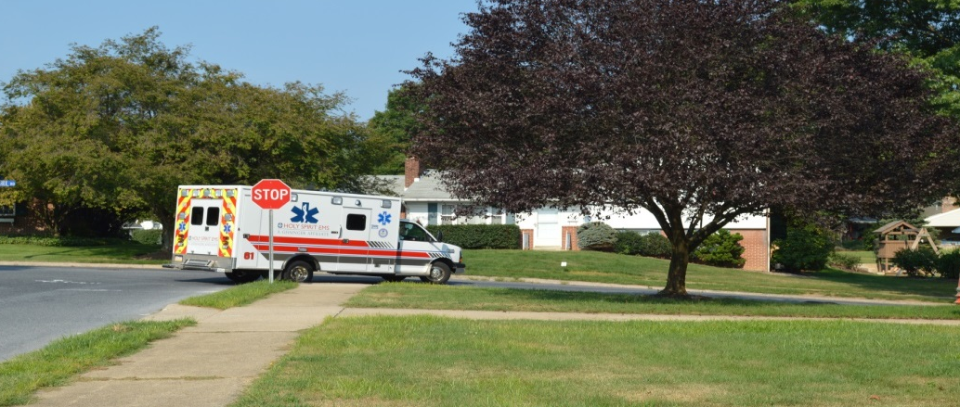
Controlled Intersection
Do not rely on warning devices to clear traffic
Scan for possible hazards
Begin to slow well before reaching intersection and cover the brake pedal
Participant Manual
ACTIVITY

Slide 9
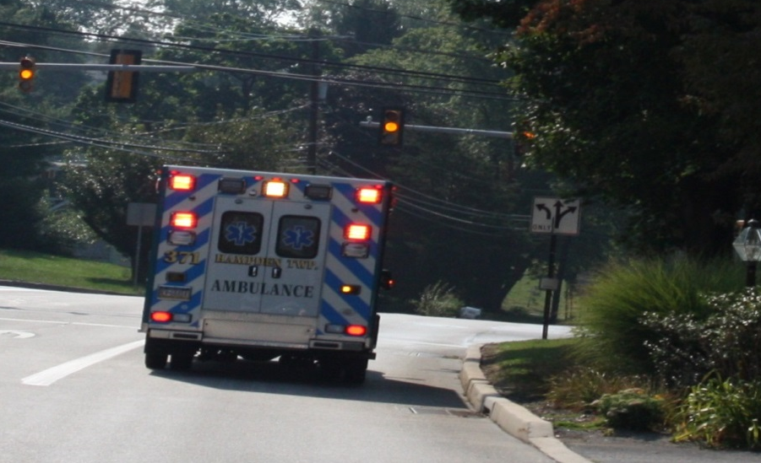
Controlled Intersection
Be aware of “stale” green and prepare to stop
Change siren cadence not less than 200’ before intersection
Scan intersection for possible passing options

Slide 10
Controlled Intersection
NFPA 1500 complete stop guidelines
  When directed by law enforcement
  Red traffic lights
  Stop signs
  Negative right of way intersections
  When driver can not account for all lanes
  When other intersection hazards are present
  Stopped school bus with flashing warning lights
Establish eye contact with other vehicle drivers
PM Fill-In

Slide 11
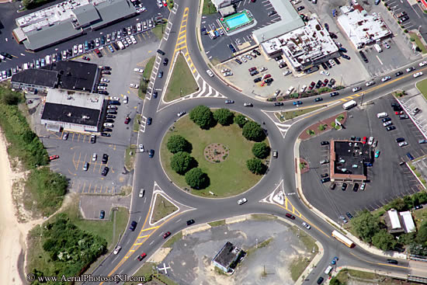
Special Intersections

Slide 12
Road Surface Conditions That Impact Traction
Rain/Standing water
Snow and ice (frost)
Wet leaves
Excessive heat
Loose gravel, sand and stone
Damaged or uneven surface

Slide 13
Identifying Slippery Surfaces
Shaded areas – Shady parts of the road will remain icy long after open areas have melted
Bridges – When the temperature drops, bridges will freeze before the road will. Be especially careful when the temperature is close to 32 degrees Fahrenheit
Melting Ice – Slight melting will make ice wet. Wet ice is much more slippery than ice that is not wet.
Black Ice – Black ice is a thin layer that is clear
enough that you can see the road underneath it. It makes the road look wet.

Slide 14
Identifying Slippery Surfaces (Cont’d)
Just After Rain Begins – Right after it starts to rain, the water mixes with oil left on the road by vehicles. This makes the road slippery. If the rain continues, it will wash the oil away.
Hydroplaning – In some weather, water or slush collects on the road. The tires lose their contact with the road and have little or not traction and your vehicle may hydroplane.

Slide 15
Operating Under Adverse Conditions
Vision Implications
  Night Driving
  Precipitation

Slide 16
Night Driving
Dim Dash and Cab Lights
Reduce Speed
Keep Headlights and Windshield Clean
Watch the Area Beyond the Headlights
Keep your Eyes Moving, Scan Continuously

Slide 17
Operating Under Adverse Conditions
Adverse Handling Implications
  High Winds
  The Driver

Slide 18
Best Practices for High Winds
Reduce speed
Check for oncoming traffic
Adjust lane position
Do not over steer when responding to a gust
Prepare to counter steer
Stay off the brake

Slide 19
The Driver
Prepare Adequately Through Driver Training
Use Low Beams and Wipers
Watch for Slowed and/or Stopped Vehicles
Check Rearview Mirrors Regularly
Practice Both Space and Speed Management While Increasing the Safety Cushion

Slide 20
Railroad Crossing Safety
Passive vs. Active Crossings

Slide 21
Railroad Crossing Safety
Passive Crossing
  No traffic control device
  Decision to top or proceed rests entirely in the hands of the operator
  Requires driver to
    recognize the crossing
    search for a train using the tracks
    decide if there is sufficient clear space to cross safely

Slide 22
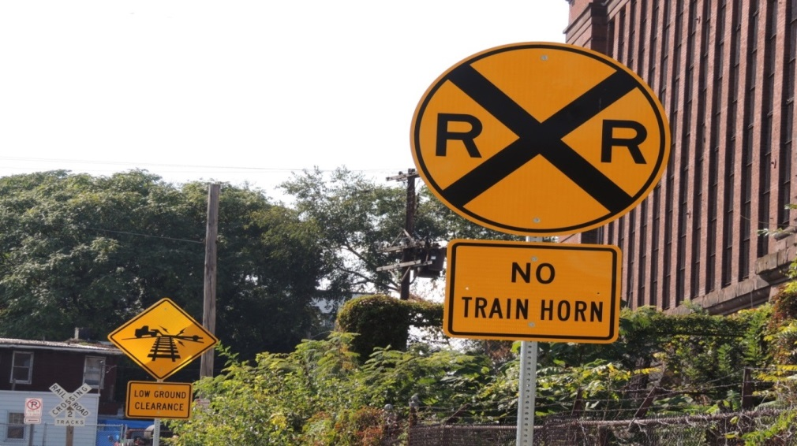
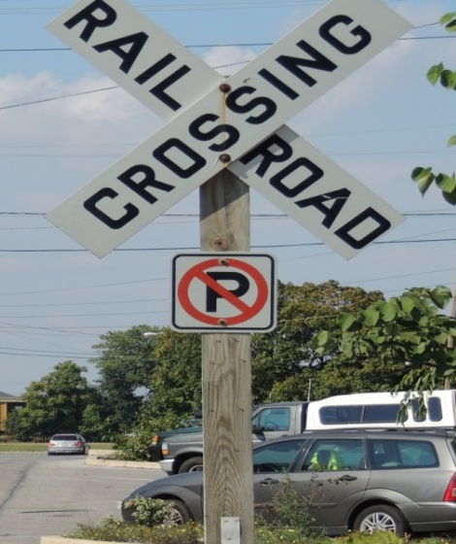
Railroad Crossing Safety
  Passive devices include signs, and pavement markings in advance of the crossing

Slide 23
Railroad Crossing Safety
Active Crossing
  This type of crossing has a traffic control device installed at the crossing to regulate traffic at the crossing.
  These active devices include flashing red lights, with or without a bells and flashing red lights with bells and gates.

Slide 24
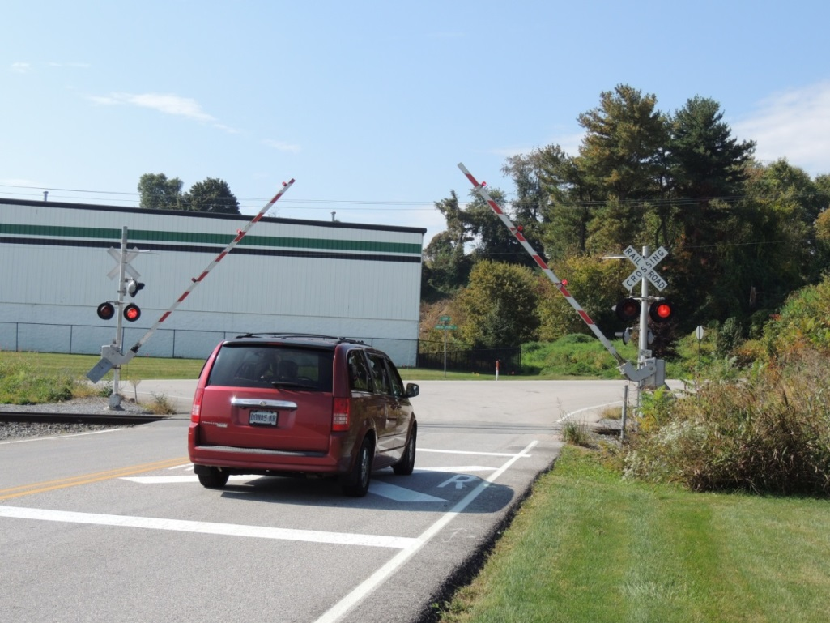
Active Crossing Example

Slide 25
Best Practices for Railroad Crossings
Come to a complete stop at all railroad crossings.
Turn off sound producing devices, open the window and look both ways. At crossings with obstructions or severe curves utilize crew members to check crossing.

Slide 26
Railroad Crossing Life Saving Practices (Cont’d)
Never race a train to cross the track
Never pass another vehicle with 100 feet
of the crossing
Watch out for other vehicles that must stop
at railroad crossings
Never shift gears on the crossing
Don’t place the vehicle on tracks

Slide 27
Railroad Crossing Life Saving Practices (Cont’d)
When responding on or near a track contact the railroad
Only use the crossing if you can be sure your vehicle is high enough to completely clear the crossing without stopping
Don’t be fooled by the optical illusion presented by the train, it is moving faster and is closer than you think

Slide 28
Collision Avoidance
Collision Avoidance
  Identify Escape Route
  Brake Smoothly and Firmly
  Accelerate Smoothly
  Steer to Avoid Head-On Impact

Slide 29
POV Response
Emergency Responders must be educated in their responsibilities and risks associated with response in privately owned vehicles and understand the importance of safe operation when responding
The responder must understand that first and foremost, he or she must arrive safely at the emergency scene or the station in order to be of any help to the public

Slide 30
Placement of Vehicles at Highway Incidents
Placement at Incidents
Positioning So As to Minimize the Blinding Effect of Warning Lights
Identify Potential Hazards at Scenes
Advanced Warning
Traffic Control

Slide 31
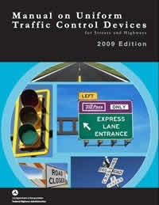
MUTCD
www.mutcd.fhwa.dot.gov

Slide 32
MUTCD 2009
Chapter 1A – General
Section 1A.07 – Responsibility
MUTCD
Each state shall be in substantial compliance
  Highway Safety Act of 1966
State Highway Agencies shall adopt a manual
Meet the requirements of the most recent edition adopted by the Federal Highway Administration
2009 Edition

Slide 33

Section 1A.12
10 of the 13 colors are being used
Fluorescent Pink – Incident Management

Slide 34
Section 6D.03 Worker Safety
Key Elements of Worker Safety and TTC Management
Training
Temporary Traffic Barrier
Speed Reduction
Activity Area
Safety Planning

Slide 35
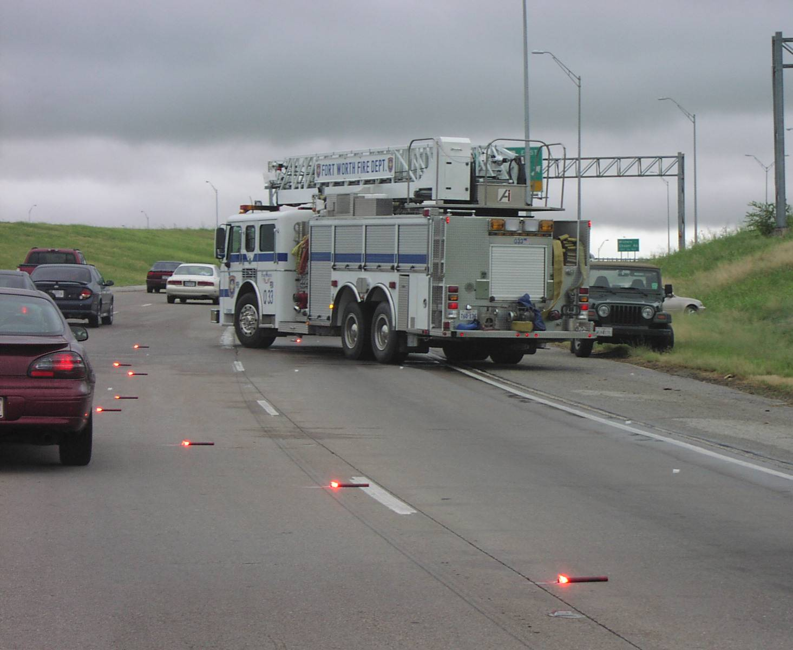
Lateral Buffer Space
If lateral buffer space requires part of a lane, close that lane – avoid partial closures

Slide 36
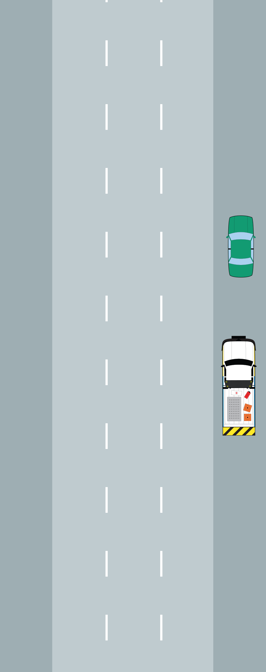
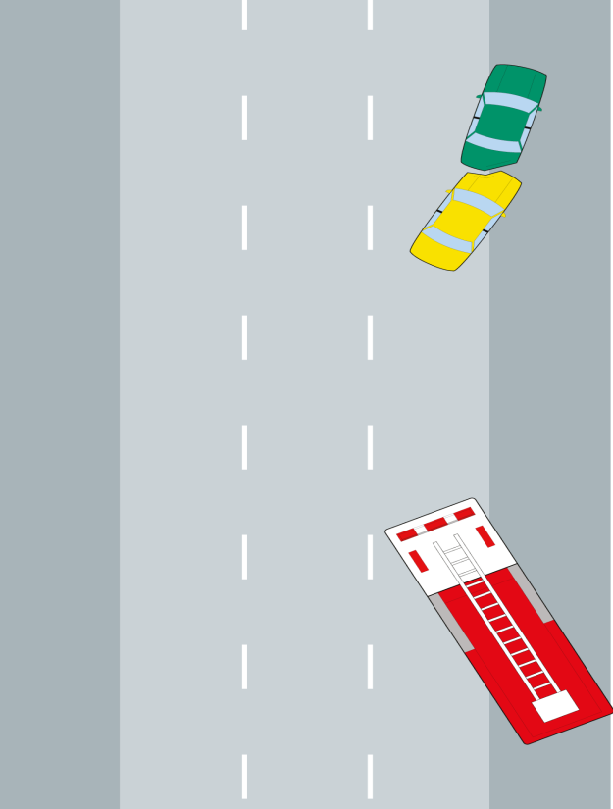
Linear vs. Multi-Lane Blocking
Source: FHA SHRP2

Slide 37
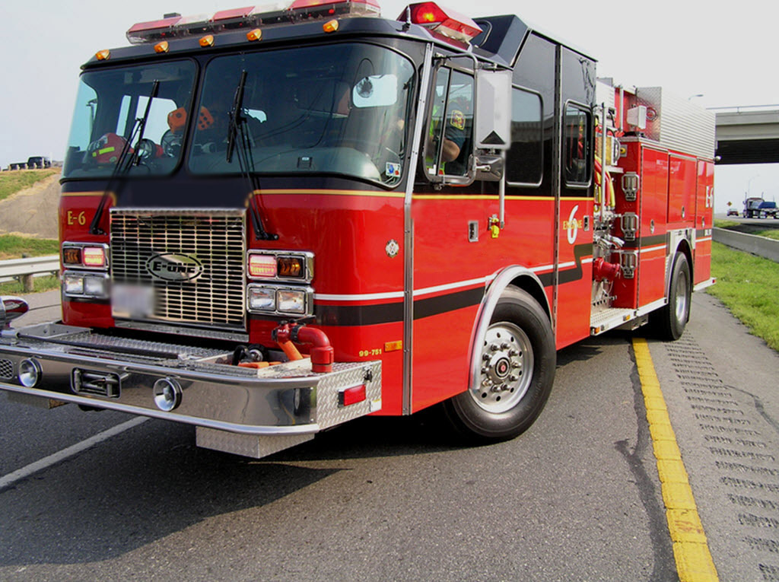
Critical Wheel Angle
Turn front wheels of vehicles away from the incident
Source: FHA SHRP2

Slide 38
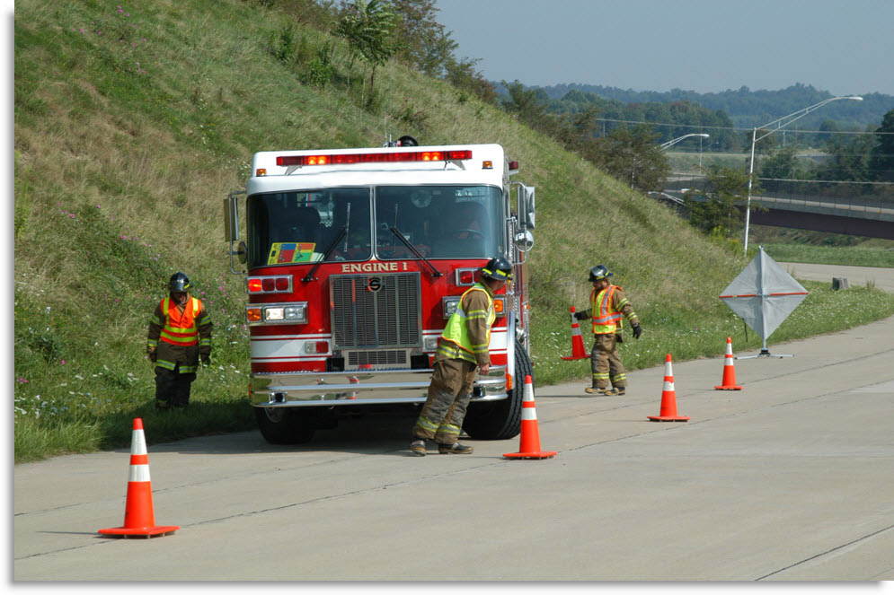

Zero Buffer
Source: FHA SHRP2

Slide 39
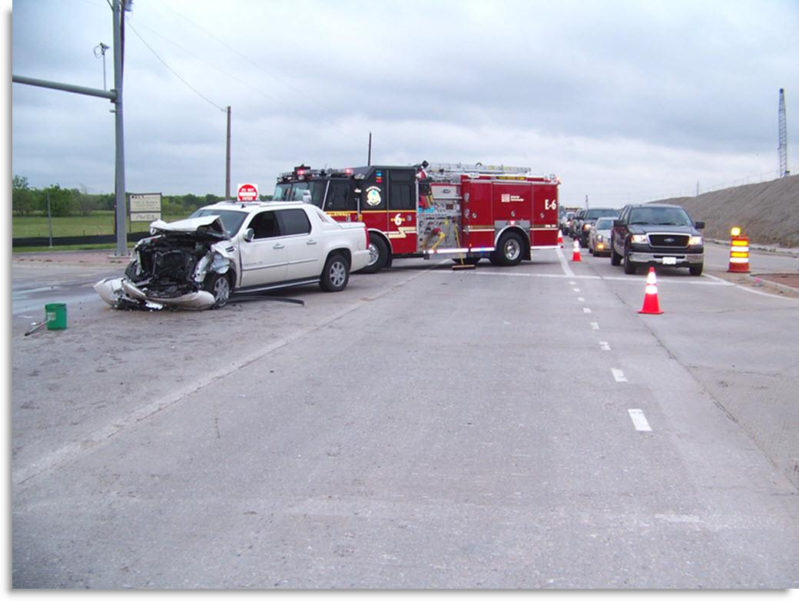
Zero Buffer
Source: FHA SHRP2

Slide 40
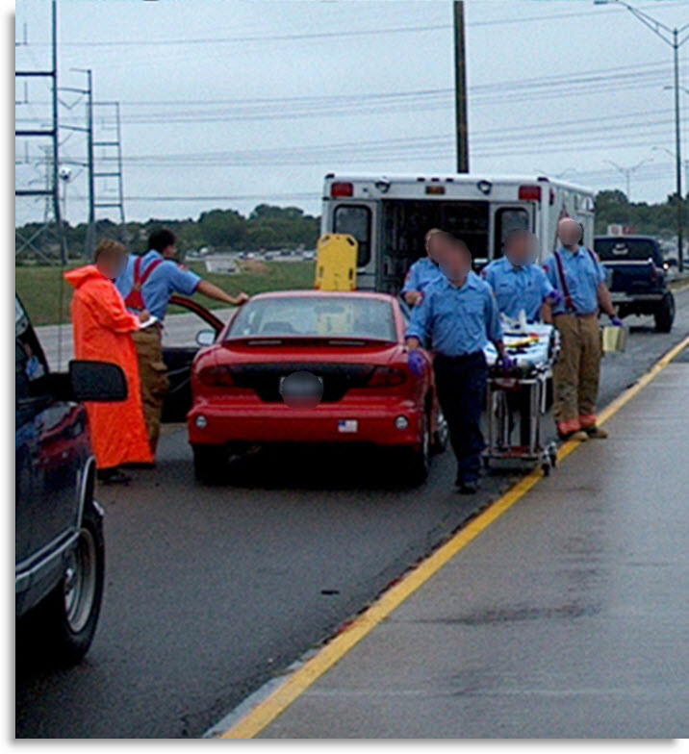
Lane(s) +1 Blocking
By the very natural of fire/rescue and EMS work, additional space to work is typically required
Lane(s) +1 Blocking occurs when responders block the involved lane(s) plus one additional lane to provide a lateral buffer space for safety
Source: FHA SHRP2

Slide 41
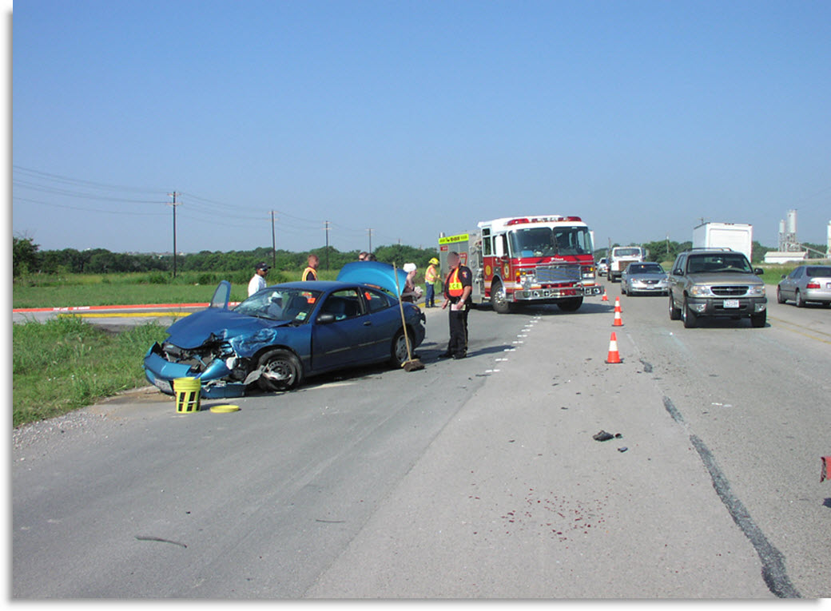
Lane(s) +1 Blocking Protected Work Space
Source: FHA SHRP2

Slide 42
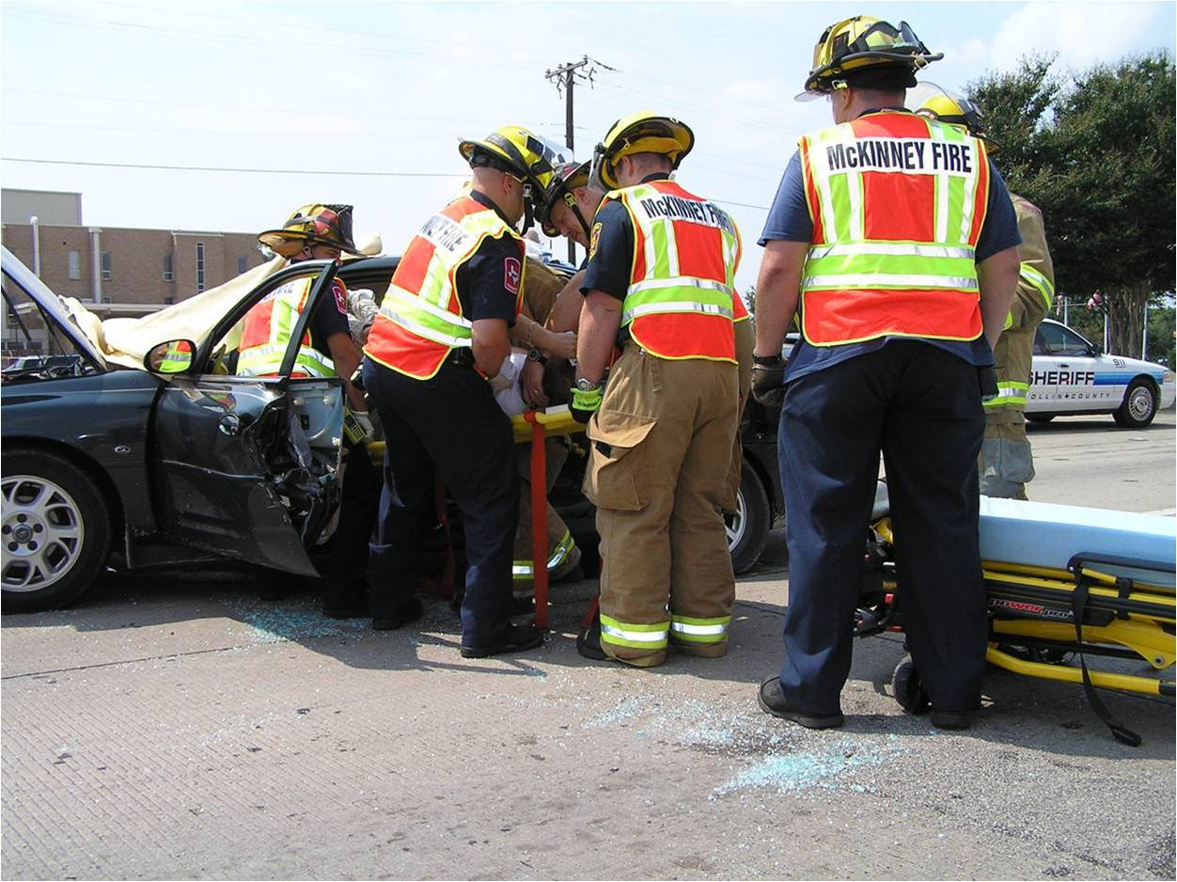
Lane(s) +1 Blocking Patient Loading
Source: FHA SHRP2

Slide 43
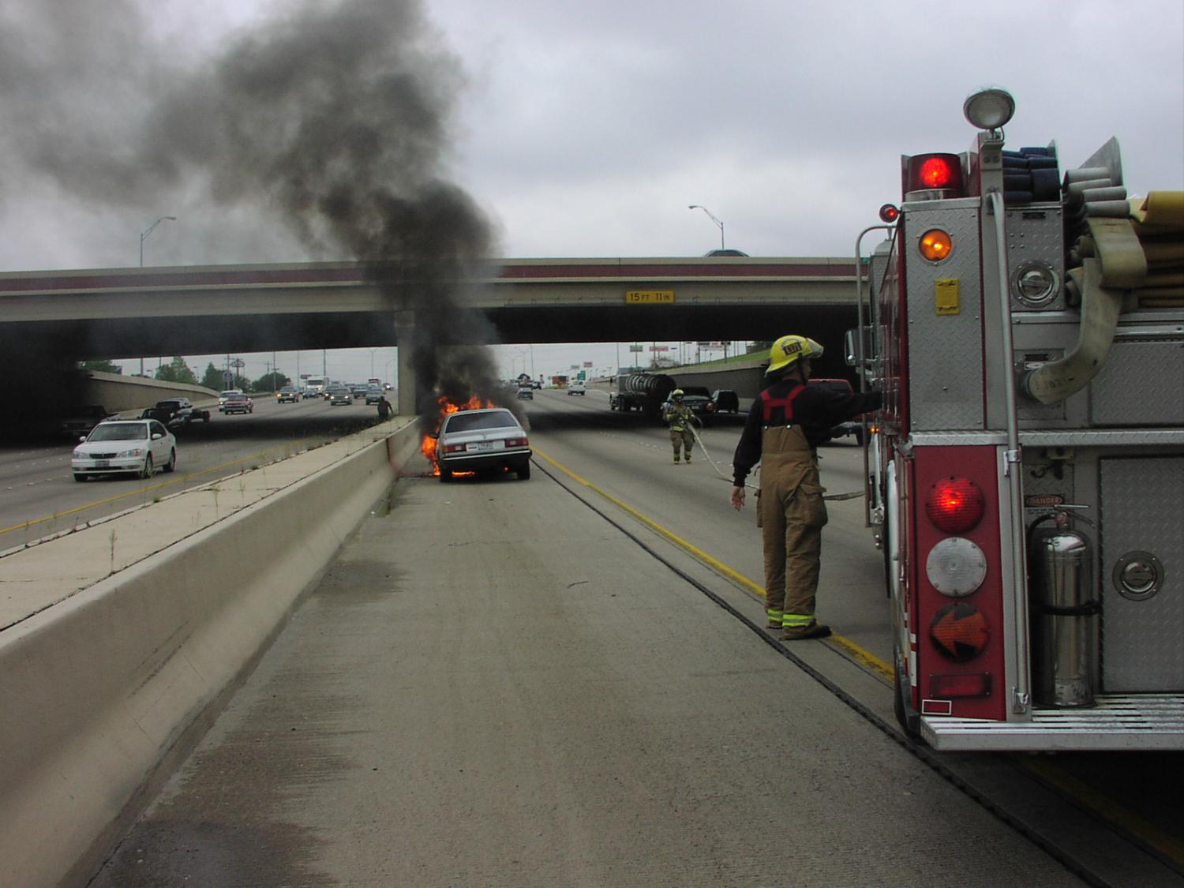
Lane(s) +1 Blocking Vehicle Fires
Source: FHA SHRP2

Slide 44
Federal Regulation
23 CFR 634
Worker Visibility Final Rule
Source: Responder Safety

Slide 45

Source: FHA SHRP2

Slide 46
Exception
Responders, when actively engaged in emergency operation that directly expose workers to flame, fire, heat or hazardous materials may wear retro reflective turnout gear
Police Officers, in potential adversarial rolls to include traffic stops and searches
“At all other times vests shall be worn”
Source: FHA SHRP2

Slide 47





Temporary Traffic Control Zone
Advance
Warning Area
Transition Area
Activity Area
Buffer – Work Space
Termination Area
150’ between Apparatus
Source: FHA SHRP2
Source: FHA SHRP2

Slide 48
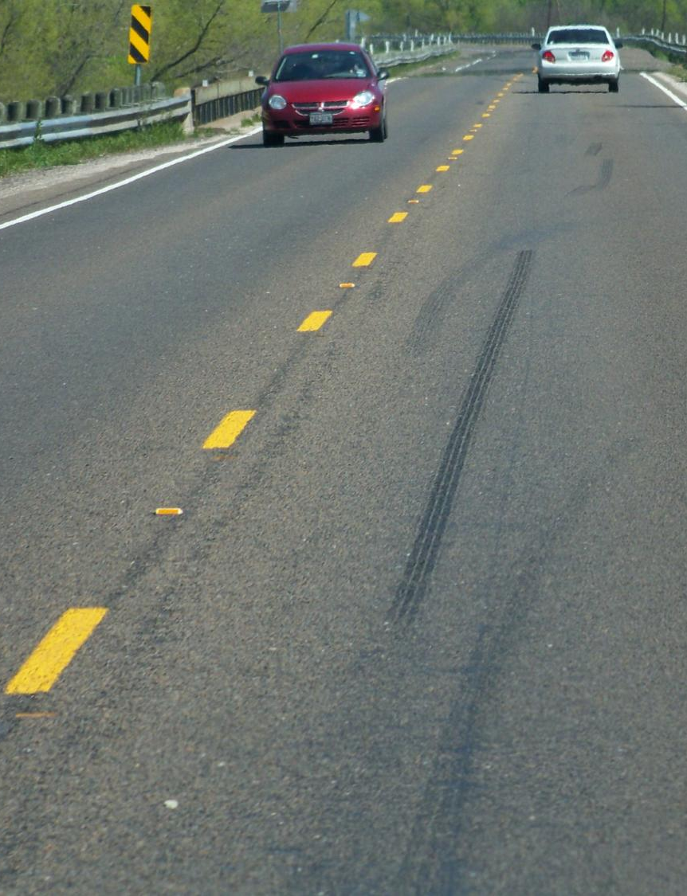
Easy Reference
Skip lines are typically spaced 40 feet apart (start to start)
Speed Limit (MPH) | Taper Length (ft.) | Number of Cones Required
25 | 125 | 4
35 | 245 | 7
45 | 540 | 14
55 | 660 | 17
65 | 780 | 20
40 feet
Source: FHA SHRP2
Source: FHA SHRP2

Slide 49



