Slide 1
Module
IX

Slide 2
Module IX Vehicle Inspections and Maintenance
Goal
To have the participant understand and perform routine maintenance of their emergency vehicles and their role and responsibility in the process.

Slide 3
Module IX Vehicle Inspections and Maintenance
Objectives
Explain the value and importance of regular vehicles inspections.
Identify the major component systems of an emergency vehicle.
Describe how to perform pre- and post-trip inspections.

Slide 4
Module IX Vehicle Inspections and Maintenance
Objectives (Cont’d)
List the three types of preventive maintenance.
Explain the role of the emergency vehicle driver in performing certain vehicle inspections and maintenance functions.
Describe the importance of keeping accurate and complete records.

Slide 5
Emergency Vehicle Components
Chassis
Body
Primary Function Components (task or mission)
Auxiliary Systems

Slide 6
Emergency Vehicle Components
Chassis
  Frame
  Suspension System
  Steering and Braking Systems
  Power Train Components

Slide 7
Emergency Vehicle Components
Body
Primary Function
Auxiliary Systems

Slide 8
Inspections
Post-Trip
  Cleaning of Vehicle
  Replacing Supplies
  Inventory Equipment
  Re-fueling and Checking Fluid Levels, If Justified
  Report Any Unusual Occurrences or Malfunctions
Participant Manual
ACTIVITY

Slide 9
Inspection Checklist
Pre-trip
  Vehicle Overview
  Check the Engine Compartment
  Start Engine and Check Inside Cab
  Check Headlights, Signal Lights, Warning Lights, and Audio Devices
  Conduct Walk Around Inspection
  Check Controls and Indicators
  Check Brake System (air brakes)

Slide 10
PRE-TRIP INSPECTION
CHECKLIST
Practical Application
ACTIVITY

Slide 11
Pre-Trip Inspection Checklist
Vehicle Overview
  Look at general condition
  Check windshield for damage and it is clean
  Look for damage and whether the vehicle is leaning
  Check under the vehicle for fresh oil, coolant, grease or fuel leaks
  Review vehicle log

Slide 12
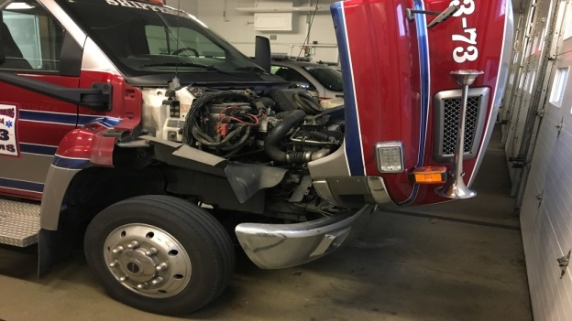
Pre-Trip Inspection Checklist
Check engine compartment
  Verify parking brake is engaged
  Check engine oil level
  Coolant level and condition of hoses
  Power steering fluid

Slide 13
Pre-Trip Inspection Checklist
Check engine compartment (cont’d)
  Windshield washer fluid
  Belts for tightness and wear
  Leaks in engine compartment
  Battery fluid level and connections
  Automatic transmission fluid level

Slide 14
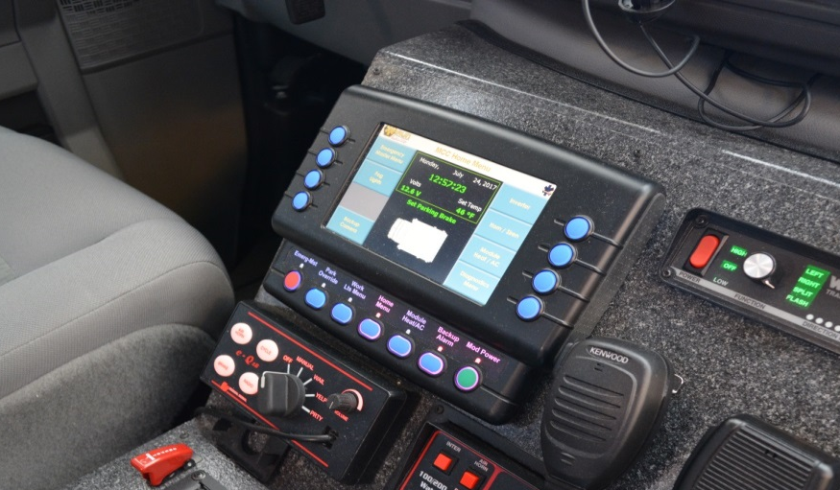
Pre-Trip Inspection Checklist
Check gauges & warning lights
  Coolant temp. gauge
  Voltmeter
  Tachometer
  Speedometer
  Fuel level gauge
  Transmission oil temp
  Compound air pressure

Slide 15
Pre-Trip Inspection Checklist
Start engine
  Listen for noises
  Verify gauges are within normal ranges
    Check any warning lights and/or buzzers

Slide 16
Pre-Trip Inspection Checklist
Check inside cab
  Check operations of vehicle controls
    Steering wheel
    Accelerator
    Brakes (parking, service, secondary braking system)
    Transmission

Slide 17
Pre-Trip Inspection Checklist
Check inside cab (Cont’d)
  Check operations of vehicle controls (Cont’d)
    Horn(s)
    Windshield wiper/washer
    Light switches and indicators
    Mirrors
    Seat adjustments/seatbelts

Slide 18
Pre-Trip Inspection Checklist
Check headlights, signal lights, warning lights and audio devices
  Running, parking and brake lights
  Turn signals and four-way flashers
  Headlights (low and high beams)
  Warning lights
  Work lights (front, rear, intersection, side and others)

Slide 19
Pre-Trip Inspection Checklist
Conduct walk-around inspection
  Left front wheel and tire for condition, tread and inflation and the left front suspension
  Windshield, wipers, washer, front bumper and cleanliness of audio devices, lamps and reflectors
  Right front wheel and tire for condition, tread and inflation and the right front suspension

Slide 20
Pre-Trip Inspection Checklist
Conduct walk-around inspection (Cont’d)
  Cab doors and closure, vehicle body, special body provisions such as patient compartment door, equipment and storage compartments and doors
  Right rear wheels and tires for condition, tread and inflation and the right rear suspension

Slide 21
Pre-Trip Inspection Checklist
Conduct walk-around inspection (Cont’d)
  Rear patient compartment doors and other body features (specific to the vehicle being inspected), lamps and reflectors
  Left rear wheel and tire for condition, tread and inflation and the left rear suspension and fuel fill

Slide 22
Pre-Trip Inspection Checklist
Conduct walk-around inspection (Cont’d)
  All compartments and cab doors, all closures, vehicle body

Slide 23
Pre-Trip Inspection Checklist
Check controls and indicators at operator’s position or any other or any other special function, components, wherever located
  Check engine controls and indicators and other controls specific to the vehicle being checked.

Slide 24
Pre-Trip Inspection Checklist
Check brake system (air brakes)
  Test low pressure warning signal
  Check to ensure that spring brakes come on automatically
  Check the rate of air pressure buildup
  Test the air leakage rate
  Test the parking brake
  Test the service brake

Slide 25
Pre-Trip Inspection Checklist
Fixed equipment
  Onboard suction unit
  Onboard oxygen systems
  Radio equipment
  Other permanently affixed items

Slide 26
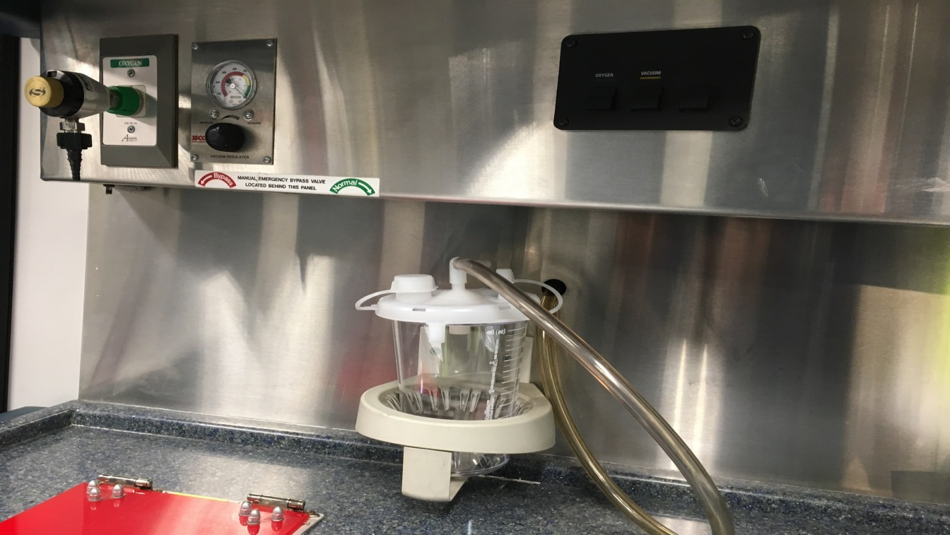
Fixed Equipment

Slide 27

Practical Application
Time to get up and moving…
Provided a copy of vehicle checklist
Demonstrate vehicle check…
Practical Application
ACTIVITY

Slide 28
Preventive Maintenance Benefits
Safety
Costs
Operational Effectiveness
Liability
Basis for Purchasing Decisions

Slide 29
Types of Preventive Maintenance
Routine Maintenance
Scheduled Maintenance
Crisis Maintenance
Participant Manual
ACTIVITY

Slide 30
Types of Preventive Maintenance
Routine
  Fluid Level Checks
  Wheels and Tires
  Electrical Systems and Devices

Slide 31
Types of Preventive Maintenance
Scheduled
  Manufacturer’s Recommended Schedule
  Amount of Use (example: Regeneration Process)
  Organizational Policy
  Professional Standards

Slide 32
Types of Preventive Maintenance
Crisis
  Classification A (immediate)
  Classification B (as soon as possible)
  Classification C (next P.M.)

Slide 33
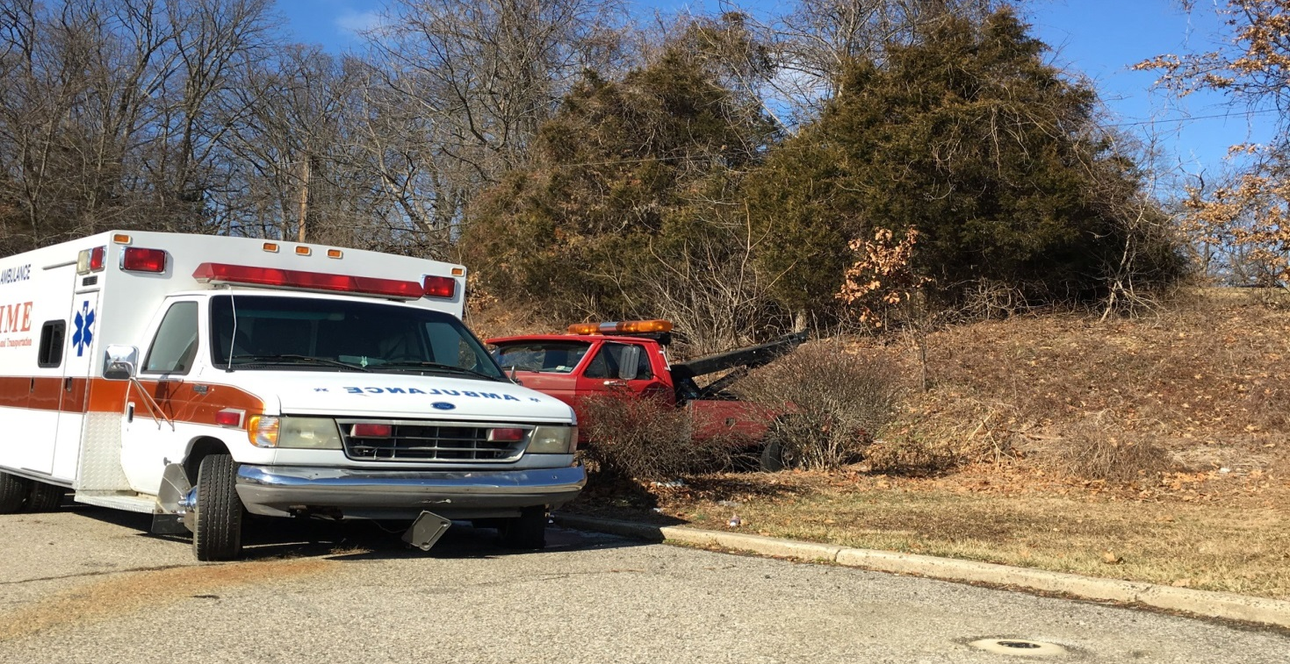
Preventive Maintenance
Avoids Problems

Slide 34
Role of the Emergency Vehicle Driver
Battery or Batteries
Braking System
Coolant System
Electrical System
Fuel
Hydraulic Fluids

Slide 35
Role of the Emergency Vehicle Driver
Lubrication
Oil (engine)
Tires
Steering System
Belts
Tools, Appliances, and Equipment

Slide 36
Role of the Emergency Vehicle Driver
Document the need for maintenance on the assigned vehicle
Verify that the requested and needed maintenance was performed
Follow established departmental guidelines for taking the vehicle out of service

Slide 37
NFPA 1911 Out of Service Criteria
A. Identify apparatus out of service
  Sign on outside of door
  Special bag that covers steering wheel
  Large sign on driver’s window

Slide 38
NFPA 1911 Out of Service Criteria (Cont’d)
B. Identify components out of service
  Distinctive color sign located on the inside of the driver’s door identifying which component
  Highly visible device provided at the components control(s)

Slide 39
NFPA 1911 Out of Service Criteria (Cont’d)
C. Driving and Crew Area
  Cracked or broken windshield
  Missing or broken door latches
  Seats without seatbelts, damaged seatbelts, or missing or broken buckles
  Broken wipers or foot throttle

Slide 40
NFPA 1911 Out of Service Criteria (Cont’d)
D. Chassis, suspension driveline, wheels and axles
  GAWR that exceeds manufacturer’s load rating for any tire
  Weight that exceeds the GAWR for that axle
  Actual overall weight that exceeds GVWR or GCWR

Slide 41
NFPA 1911 Out of Service Criteria (Cont’d)
D. Chassis, suspension driveline, wheels and axles
  Tires with cuts to the cords
  Front tires with less than 4/32 – inch
  tread or rear tires with less than 2/32 – inch tread at two adjacent major tread grooves anywhere on the tire
  Wheels or rims damaged
  Weld cracks

Slide 42
NFPA 1911 Out of Service Criteria (Cont’d)
E. Engine systems
  Engines that won’t crank or start
  Engines that are overheating
  Leaking of fuel
  Excessive leaking of oil
  Oil that contains coolant
  Oil that is diluted with fuel
  Stop-engine light that fails to turn off

Slide 43
NFPA 1911 Out of Service Criteria (Cont’d)
F. Engine cooling system
  Coolant system leak
  Coolant that contains oil
  Cooling system that exceeds max. operating temperature

Slide 44
NFPA 1911 Out of Service Criteria (Cont’d)
G. Transmission and clutch
  Automatic transmission that overheats in any range
  Automatic transmission that has a “do not shift” light on
  Transmission components that are leaking transmission oil

Slide 45
NFPA 1911 Out of Service Criteria (Cont’d)
H. Low voltage and line voltage electrical systems
  Legally required lighting or horn not operational
  Ignition system not operational
  Charging system not operational
  Failure of warning lights that creates any position around the apparatus from which no warning light is visible
  Inoperative siren (OOS for emergency response)
  Damaged receptacles or other observed shock hazards

Slide 46
NFPA 1911 Out of Service Criteria (Cont’d)
I. Braking Systems (Air)
  Service brakes that have a air pressure drop of more than 2 psi in 1 min. or a straight chassis or more than 3 psi in 1 min. for a combination chassis, with the engine stopped and the service brake released.
  Brakes that are out of adjustment
  ABS warning indicator (light) activated

Slide 47
NFPA 1911 Out of Service Criteria (Cont’d)
I. Braking Systems (Air) (Cont’d)
  Braking systems that are not operational
  Air compressor that fails to build up pressure in accordance with manufacturer’s min. specifications
  Air compressor failure to maintain 80 to 90 psi pressure in accordance with manufacturer’s min. specifications
  Brake shoes or disk brake pads that have grease or oil on them

Slide 48
NFPA 1911 Out of Service Criteria (Cont’d)
I. Braking Systems (Air) (Cont’d)
  Rotors and/or drums that are worn beyond manufacturer’s min. specifications
  Brake linings or pads worn beyond manufacturer’s min. specifications
  Air gauge or audio low-air warning device failure

Slide 49
NFPA 1911 Out of Service Criteria (Cont’d)
J. Braking Systems (Hydraulic)
  Leaking brake fluid
  Brake shoes or disc brake pads that have grease or oil on them
  Braking systems not operational
  Braking systems that do not meet tests or standards
  ABS warning indicator (light) activated

Slide 50
NFPA 1911 Out of Service Criteria (Cont’d)
J. Braking Systems (Hydraulic) (Cont’d)
  Parking (service brake) that does not meet tests or standards
  Brake warning light that is activated or brake pedal that falls away or drifts toward floor when brake pressure is applied
  Brake linings, pads, rotors, drums that do not meet manufacturer’s min. specifications
  Rotors and/or drums that are worn beyond manufacturer’s min. specifications

Slide 51
Recordkeeping
Maintenance Records
Operational Records

Slide 52

Practical Application
Review and discuss the departments out of service criteria and the process to document and report the defect.
Practical Application
ACTIVITY

