Slide 1
Module
IV

Slide 2
Module IV - SOPs/SOGs
Goal
Realize the need for guidelines and policies addressing emergency vehicle issues. Review the content of local policies & guidelines.

Slide 3
Module IV - SOPs/SOGs
Objectives
Explain why the development and implementation of Standard Operating Guidelines (SOGs) and Standard Operating Procedures (SOPs) are important to operating an effective emergency vehicle driver training program.
Describe the subject areas necessary for SOPs/SOGs that impact the certification, operation, and recertification of emergency vehicle drivers.

Slide 4
SOPs/SOGs Example
Policy – You will go from Point “A” to Point ”B”.
Procedure – Begin at Point “A” go to Point “B” by following the prescribed directions.
Guideline – Begin at Point “A” go to Point “B” but does not give explicit directions as a procedure.
Rules and Regulations – Do not cross any line, do not backtrack.

Slide 5
Significance of SOPs/SOGs
All Personnel Understand What is Expected or Required
Intended Compliance with All Necessary Requirements is Identified
Pre-planned and Agreed Upon Actions
Resource Documents Upon Which to Base Training
Required Anticipated Actions

Slide 6
SOPs/SOGs Subject Areas
Eligibility Requirements for Drivers
Training and Proficiency Testing Requirements for Drivers
Emergency Response Procedures and Requirements
Customary and Ordinary Operational Procedures
Special Situation Procedures

Slide 7
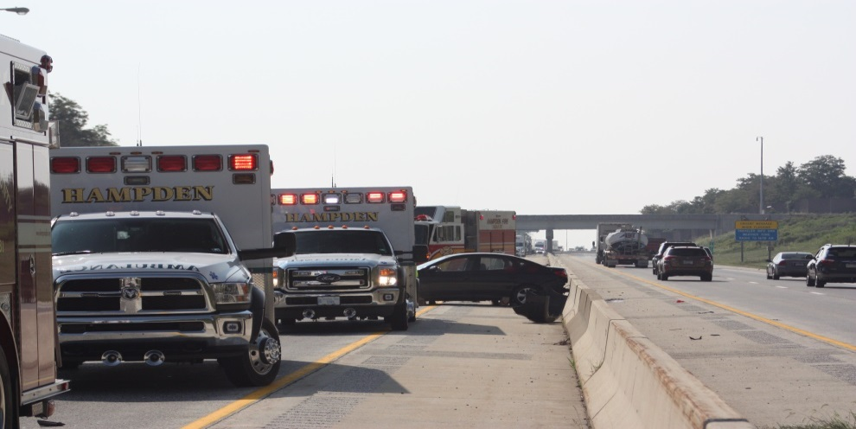
SOPs/SOGs
Emergency Response Procedures
  Must address use of emergency lighting

Slide 8
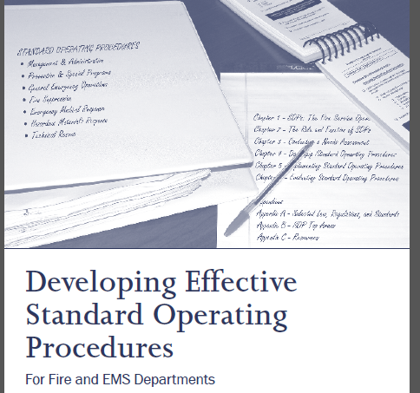
Practical Application
Review and discuss organization’s policies and procedures
Practical Application
ACTIVITY

